Slide 1


Caring for Transgender
Adolescent Patients
Part 1: Initial Evaluation and Primary Care Perspective
Part 2: Ongoing Management, Hormones, Primary Care
Notes:
ARSHEP would like to acknowledge Drs. Michelle Forcier, Joanna Olson, & John Steever for collaborating with Physicians to create and review this module for the 5th Edition of the ARSHEP curriculum.
Revised 1/2/2018.

Slide 2
Objectives
Differentiate assigned sex at birth, gender identity and expression, and sexual orientation
Discuss primary and specialized care that may be needed by transgender adolescents
Explain how bias and stigma create disparities and lead to risks
Provide initial management strategies for appropriate and competent care to gender-nonconforming patients

Slide 3

Content Overview
Gender & social justice
Gender development
  Childhood
  Peri-Pubertal
Initial screening, intervention
Risk resiliency
Puberty blockers
Gender affirming hormones
  Testosterone
  Estradiol
Gender affirming surgery
Resources

Slide 4

Why Talk About Gender?
Professional responsibility
  AMA, AAMC, AAFP, AAP, SAHM, APA
    Recommend training on LGBT health
  Exclusion of coverage for gender care services illegal in some states
Gender care is
  Patient-centered primary care
  Gender is developmental, universal
  Anticipatory guidance
  Prevention
  Future planning
  Models and promotes diversity
Reproductive Justice under the Social Justice Umbrella
Notes:
Several medical organizations, including the AAFP, recommend residents be trained to provide quality, culturally appropriate care to LGBTQ patients of all ages. AAFP and STFM went through a multi-year process to create detailed guidelines on this training, that will be discussed later.
Beyond professional organizations, as family physicians you all have committed yourselves to providing patient-centered primary care. Gender is a part of every patient, and therefore providing care to help affirm and support patients in their gender is part of the spectrum and scope of practice for this specialty.

Slide 5

ARSHEP Commitment to
Reproductive Justice
Reproductive & sexuality health experts
  Comfort talking about “sensitive” health topics
  Effective health education, health promotion
  Advocacy in public & legislative health settings
  Empower other providers to engage & gain knowledge, improve attitudes, develop skills
Reproductive Justice
  Autonomy over self, body, family, destiny
  Focus on underserved populations
  “Make sense” working together together

Slide 6
Early Childhood and Prepubescent
Gender Development

Slide 7

Case 1 Patient “R”
Prepubertal Gender Nonconformity
R is an 8 y/o natal male
During the visit, R’s parent expresses concern that:
  “Most of his friends are female.”
  “He hates sports.”
  “I caught him wearing his older sister’s clothes and make-up last week.”
  “He loves to paint his nails.”
Notes:
Let’s begin with a case that examines common gender exploration in childhood.
While a patient this age is not typically considered an adolescent, the care they receive now will influence their experience entering adolescence. Understanding the issues that this child and their family are going to experience can provide context to future care.

Slide 8
Case 1 Patient “R”
What is your initial reaction?
Are you concerned?
Should his parent be concerned?
Notes:
8
What is your assessment of this case? What is your initial response?

Slide 9
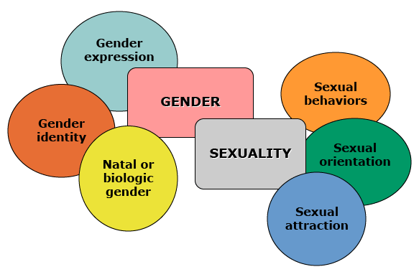
Defining Gender
Assigned gender/sex at birth: Sex assigned at birth; body parts, hormones, biology.
Gender Identity: The understanding of one’s self (Female, male, transgender, gender non-conforming, genderqueer, non-binary, gender fluid, cisgender)
Gender Expression:
Ways in which a person
acts, presents self, and
communicates gender
within a given culture
Gender Expression
Citation: Olson, Forcier
Notes:
Citation: Olson, Forcier
Definitions:
natal gender or biologic gender—this relates to one’s brain, hormones, body parts; their gender assigned at birth.
Gender identity is one’s basic sense of self
Gender expression is the way in which one acts, presents themselves, and communicates (clothes, hair, etc.).

Slide 10
Gender Terminology
Gender diverse/non-conforming
Non-binary/Gender-queer/gender-fluid
Cisgender
A person who views their gender on a spectrum rather than fitting into society’s binary categories of male/female
Transgender
A person whose gender identity aligns with the cultural notions of gender and the sex they were assigned at birth
A person whose gender identity differs from their assigned gender/sex at birth and conventional notions of gender
Terminology & paradigms
Unique to individual
Change, evolve with time & culture
Notes:
Source:
1) “Interviewing Adolescents about Sexual Matters.” Pediatrics Clinics of North America (April 2017 Edition). Pfeffer, B. Ellsworth, TR. Gold, M.
2) Hyderi A, Angel J, Madison M, et al. Transgender patients: Providing sensitive care. The Journal of Family Practice. July 2016: (65)7; 450-461.

Slide 11
Identities and Transition
Identities include but are not limited to
Asserted female
MTF = male to female, transgender woman
Gender Queer
Non-binary
Trans feminine, Trans masculine, Agender
Phenotypic Gender Transition →
Process and time when person goes from living as one gender to living as another gender
Asserted male
FTM = female to male, transgender man
Notes:
Though binary, transgender individuals are often referred to as MTF (male to female) or FTM (female to male). There may be situations, however, where these categories do not hold true.
The term transition refers to the process and time in which a person goes from one gender to another.

Slide 12
Defining Sexuality
Sexual Orientation/Identity:
Sexual concept of one’s self based on feelings, attractions, and desires;
LGBTQ:
Lesbian, Gay, Bisexual, Transgender, Questioning/Queer; Pansexual/Asexual
Sexual Behaviors:
Young Men who have Sex with
Men (YMSM)Young Women
who have sex with Women
(YWSW)
Citation: Olson, Forcier
Notes:
Sexual orientation refers to an individual’s pattern of physical and emotional arousal toward other people.
Complex personal, developmental, cultural, and social variables effect one’s ability to accept, act out, or act against specific aspects of physical and emotional arousal, particularly in developmental stages.
Source: Frankowski B. Sexual Orientation and Adolescents. Pediatrics 2004;113:1827–1832.

Slide 13
Sexual Orientation Identities
Pansexual
Asexual
Sexual attraction to people of any sex or gender
Queer
A person who does not experience sexual attraction
An umbrella term that may include the entire LGBT community and also people who fit outside social norms of sexual identity and gender expression; emphasizes fluid and experience-based identities and attractions
Notes:
Source:
1) “Interviewing Adolescents about Sexual Matters.” Pediatrics Clinics of North America (April 2017 Edition). Pfeffer, B. Ellsworth, TR. Gold, M.
Hyderi A, Angel J, Madison M, et al. Transgender patients: Providing sensitive care. The Journal of Family Practice. July 2016: (65)7; 450-461.
http://www.asexuality.org/home/?q=overview.html

Slide 14
Case 1 Patient “R”
Questions to explore
  How does your child feel about their gender?
  Does your child feel, act, more masculine or feminine?
  What is your child’s preferred name?
  How can parents a child explore gender?
  How does your child feel about you concerns?
Notes:
In building this case, the presenters might be able to model not using any pronouns, and replacing with "your child" or "your kiddo"
Coming back to R. Though R is younger than an adolescent, it still may be appropriate to ask for some time alone with the patient to gain further insight into R’s case. Once alone with R, you ask if there is a preferred name or pronoun. You also assess how R feels about the mother’s concerns. Finally, you probe R’s perceptions of gender identity.

Slide 15



Awareness of Gender Identity
Between ages 1 and 2
Conscious of physical differences between sexes
At 3 years old
Can label themselves as a girl or boy
By age 4
Gender identity stable
Recognize gender constant
Notes:
Awareness of being a boy or a girl begins during the first year of a child’s life, when babies typically discover their genitals. Between the ages of 1 and 2, children become conscious of physical differences between genders. By the age of 3, children are easily able to label themselves as they acquire a strong concept of self. By age 4, a child’s gender identity is stable.
During this same time of life, children learn gender role behavior—that is, doing things "that boys do" or "that girls do.” Before the age of 3, children can differentiate sex-stereotyped toys. By 3 years of age, they have also become more aware of boy and girl activities, interests, and occupations. Many begin to play with youngsters of their own sex in activities identified with that sex. By the time they enter kindergarten, children’s gender identities are well established.
Source: American Academy of Pediatrics. (1995). CARING FOR YOUR SCHOOL-AGE CHILD: AGES 5–12. New York: Bantam Books.
While most individuals will identify in binary “male or female,” “boy or girl,” or “man or woman” paradigms, it is important to note that some individuals’ identities might be in between these categories.

Slide 16
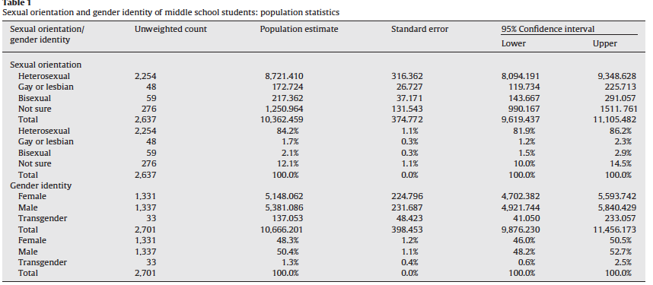
Sexual Orientation and Gender Identity of
Middle School Students
Shields JP, et al. “Estimating population size and demographic characteristic of LGBT youth in middle schools.” J Adol Hlth. 2013:248-50.

Slide 17
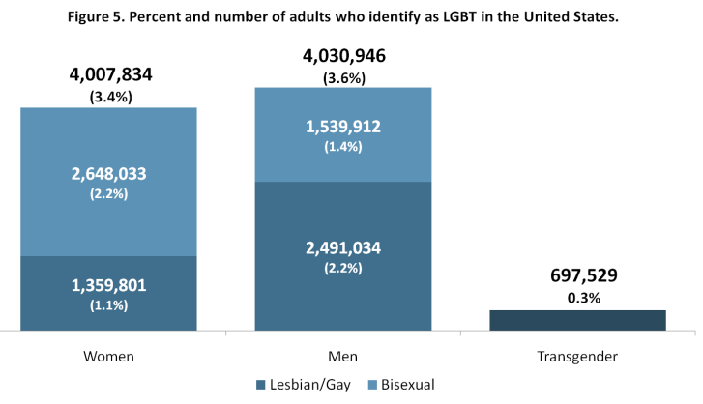
How Many Adults Identify as LGBT in the U.S.?
Conron KJ, et al. “Transgender health in MA: Results from a household probability sample of adults. AJPH. 2012:102(1): 118-122.

Slide 18
Coming Out—Transgender
Patients | Mean, (Age Range) | Assigned Female at Birth | Assigned Male at Birth
Age of Presentation | 14.8 (4-20) | 15.2 (6-20) | 14.3 (4-20)
Tanner Stage | 3.9 (1-5) | 4.1 (1-5) | 3.6 (1-5)
Total n, (%) | 97 (100) | 54 (55.7) | 43 (44.3)
Spack N, GeMS Clinic, Boston Children’s Hospital. Pediatrics, 2012

Slide 19

Gender Play
All prepubertal children play with gender expression & roles
  Passing interest or trying out gender-typical behaviors
  Interests related to other/opposite sex
  Few days, weeks, months, years
Notes:
Pediatric medical, mental health, social service, and school providers have many opportunities to explore with kids and parents what their children are interested in, behaviors that may be concerning, or general activities involved.

Slide 20
Gender Nonconforming
Cross gender expression, role playing
Wanting other gender body/parts
Not liking one’s gender & body (gender dysphoria)
Fluid, nonconforming
Agender
Non binary
Refuses to ascribe to typical masculine or feminine assignments
Persistent, consistent, insistent
Notes:
The overall idea is some people have discordance between gender assigned at birth and lived-gender identity which can include agender.

Slide 21
Common Parental Reports
Before Puberty
Peri Puberty
“She told me in first grade that she was a boy.”
“He wanted to grow his hair long and wear jewelry.”
“She adamantly refused to wear a dress to her aunt’s wedding.”
“He wanted to be in the school play in the role of Cinderella.”
“We did not notice anything different before puberty”
“She had a miserable time with puberty.”
“Before puberty we thought maybe he was gay, but then he told us he was trans.”
Notes:
“S/he was always a little different than peers, even as early as in preschool or kindergarten.”
“He drove his father crazy by never wanting to join his brothers outside but instead playing with his sister and her friends.”

Slide 22


Who to Screen?
All children
  Developmental stages
Nonconforming expression
Concerns/problems with
  Mood
  Behavior
  Social
Notes:
Who should be screened and what are you looking for in terms of gender nonconformity and patients struggling with their gender identities?
First, you should be screening all children to see if they are expressing gender as expected according to developmental stages.
Next, screen kids who present with gender nonconforming behaviors (dress, play choices, identifying as the opposite sex from their natal sex, choosing a gender nonconforming name, etc).
Also, screen kids who are expressing mood or behavior problems or may be struggling with a variety of issues, one of which is gender.

Slide 23
How to Screen
Ask! Parent(s)
Child play, hair, dress preferences
Concerns with these
Concerns with behavior, friends, getting along at school, school failure, bullying, anger, sadness, isolation, other?
Ask! Patient
Do you feel more like a girl, boy, neither, both?
How would you like to play, cut your hair, dress?
What name or pronoun (he for boy, she for girl) fits you?
Notes:
This is where clinicians can come in. What do you ask, and to whom?

Slide 24
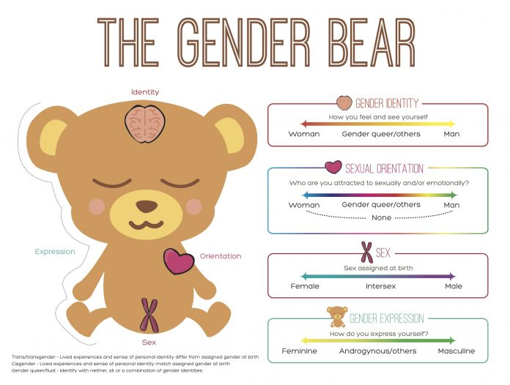
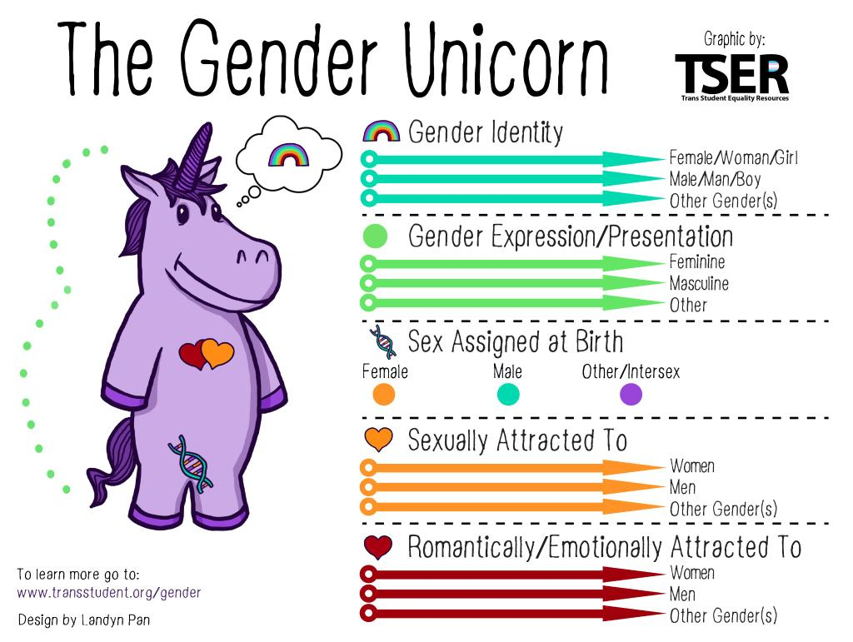
Gender Screening
Notes:
Four areas that we look at:
(1) sex—usually male or female;
(2) identity—how you do identify yourself?;
(3) attractions—whom you are attracted to; and
(4) expression, or sexual behavior.
It is NOT about the label, but we need to use labels for this talk, so we are all speaking the same language!
Source: http://itspronouncedmetrosexual.com

Slide 25
Case 1 Patient “R”
R reports:
  Sometimes wishes he was a girl but prefers the pronoun “he”
  Sadness that his mother is upset
  Unsure what gender he would be if he could choose
  He would like to play with girl things without feeling bad
What do you do next?
Notes:
It does not appear, at this point, that R has gender dysphoria. Gender role and expression exploration in childhood is common.
However, even if R did express gender dysphoria, most children ages 5–12 diagnosed with GID do not persist in having GID as teens, but rather the most likely outcome is homosexuality or bisexuality.[i][ii] However, most teens and adults with GID retrospectively report cross-gender behavior and identity as children and the vast majority of teens diagnosed with GID do have persistence of GID into adulthood.
Sources:
[i] Drummond KD, Bradley SJ, Peterson-Badali M, Zucker KJ. A follow-up study of girls with gender identity disorder. Developmental Psychology. Jan 2008;44(1):34–45.
[ii] Wallien MSC, Cohen-Kettenis PT. Psychosexual outcome of gender-dysphoric children. Journal of the American Academy of Child & Adolescent Psychiatry. Dec 2008;47(12):1413–1423.

Slide 26
Case 1 Patient “R”
Explain to R and his mom that:
  Exploring gender roles and gender expression during childhood is common
  R may or may not have gender identity concerns as he matures
  Support from family is essential
Offer yourself as a resource
Know national, local resources
Notes:
This exploration, though, appears to make R’s mother uncomfortable. Your role is to help her understand that these behaviors are common and they do not predict R’s future gender identity nor sexual orientation.

Slide 27
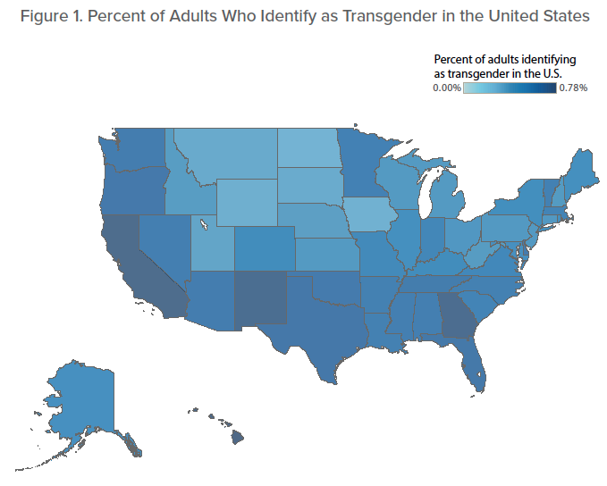
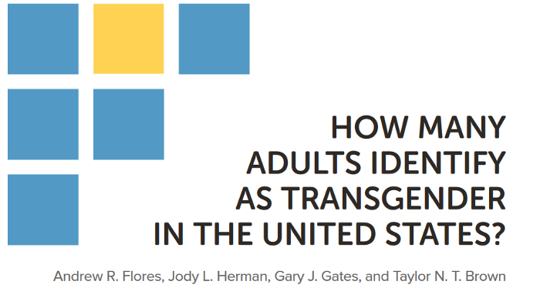
CDC Behavioral Risk Factor Surveillance System (BRFSS)
2016
National estimate transgender persons
0.6% =1.4 million
Range 0.3% ND to 0.8% HI
Highest 18-24 versus older adults

Slide 28
Pathology Based
DIAGNOSIS of GENDER DYSPHORIA
F64 DSM 10 Coding
Marked difference between expressed/experienced gender and gender others would assign
Must continue for at least six months
Causes clinically significant distress or impairment in social, occupational, or other important areas of function
In children, the desire to be of the other gender must be present and verbalized

Slide 29
Developmental Perspective
GENDER DIVERSITY
E34.9 ICD 10
Gender is universal, normal
Variance is expected aspect of biology
& human development
Diversity not = deviance
Improve care
Impact minority stress
Advocate for another form
reproductive justice
Advocate, empower vulnerable populations
Patient-centered developmental care—
Allows flexibility and clinical judgment

Slide 30
Early Intervention: Gender
Seminal Puberty Blocker Work
Early blocking of puberty followed by cross gender hormone replacement At follow-up, all 54 patients were satisfied with their pubertal development
No patients decided to stop GnRH agonist therapy
All patients eligible decided to take cross gender hormones
There were no adverse events from GnRH agonists
No suicides
No street hormones
Delemarre-van de Waal, Cohen Kettenis (2006)
  Reconfirmed over time….
  OlsonKR 2016, deVries AL 2014, Steensma TD 2013, deVries AL 2012, Spack NP 2012, deVries AL 2011, Steensma TD 2011, Steensma TD 2013, Malpas J 2011, Teurk CM 2012, Bussey K 2011, DeVries 2010, Wallien MS 2008, Drummon 2008, Zucker 2005, Green 1987, Davenport 1986
Notes:
30
Psychological and Medical Care of Gender Nonconforming Youth.
Vance SR Jr, Ehrensaft D, Rosenthal SM.
Pediatrics. 2014 Nov 17. pii: peds.2014-0772. [Epub ahead of print] Review.
PMID: 25404716 [PubMed - as supplied by publisher]
Related citations
Select item 252017982.
Young adult psychological outcome after puberty suppression and gender reassignment.
de Vries AL, McGuire JK, Steensma TD, Wagenaar EC, Doreleijers TA, Cohen-Kettenis PT.
Pediatrics. 2014 Oct;134(4):696-704. doi: 10.1542/peds.2013-2958. Epub 2014 Sep 8.
PMID: 25201798 [PubMed - in process]
Related citations
Select item 241774893.
Hormonal therapy is associated with better self-esteem, mood, and quality of life in transsexuals.
Gorin-Lazard A, Baumstarck K, Boyer L, Maquigneau A, Penochet JC, Pringuey D, Albarel F, Morange I, Bonierbale M, Lançon C, Auquier P.
J Nerv Ment Dis. 2013 Nov;201(11):996-1000. doi: 10.1097/NMD.0000000000000046.
PMID: 24177489 [PubMed - indexed for MEDLINE]
Related citations
Select item 239818154.
Sexual quality of life after hormonal and surgical treatment, including phalloplasty, in men with micropenis: a review.
Callens N, De Cuypere G, Van Hoecke E, T'sjoen G, Monstrey S, Cools M, Hoebeke P.
J Sex Med. 2013 Dec;10(12):2890-903. doi: 10.1111/jsm.12298. Epub 2013 Aug 23. Review.
PMID: 23981815 [PubMed - indexed for MEDLINE]
Related citations
Select item 235106375.
Non-medical use of prescription drugs, polysubstance use, and mental health in transgender adults.
Benotsch EG, Zimmerman R, Cathers L, McNulty S, Pierce J, Heck T, Perrin PB, Snipes D.
Drug Alcohol Depend. 2013 Sep 1;132(1-2):391-4. doi: 10.1016/j.drugalcdep.2013.02.027. Epub 2013 Mar 17.
PMID: 23510637 [PubMed - indexed for MEDLINE]
Related citations
Original work compelling--
Talk about how research shows that most kids who show gender variance in early childhood will not turn out to be trans (90%), but those who sense of gender variance persists strongly into early adolescence, nearly 100% trans.
This may be how Zucker gets away with success
Gender variance that is consistent, persistent & insistent into pre & pubertal years will almost always concern gender identity/transgender
Differentiate from gender variance in early childhood that may be common exploration or sexual orientation/homosexuality
30

Slide 31
TransYouth Project
Large-scale (>150 children) longitudinal study of
transgender children in 25 states
(2016) 73 children, age 3-12
NIH Patient Reported Outcome Measurement Information System
Symptoms of depression or anxiety during past week
Rates depression (50.1) and anxiety (54.2) no higher than 2 control groups -- their own siblings & cis age- and gender-matched children
Significantly lower than those of gender-nonconforming children in previous studies
(2017) 116 trans, 122 controls, 72 sibs age 6-14
NIH Patient Reported Outcome Measurement Information System
Symptoms of depression and self worth same
Slightly higher anxiety
Significantly lower than those of gender-nonconforming children in previous studies
Olson KR, Durwood L, DeMeules M, et al. Mental Health of Transgender Children Who Are Supported in Their Identities. Pediatrics. 2016;137(3):e20153223
Dunwood L, McLaughlin KA, Oslon KR. Mental Health and Self-Worth in Socially Transitioned Transgender Youth. J Am Acad Child Adolesc Psych. 2017 Feb;56(2):116-123.
Notes:
Source: https://ceitraining.org/

Slide 32
“
Socially transitioned transgender children who are supported in their gender identity have developmentally normative levels of depression and only minimal elevations in anxiety, suggesting that psychopathology is not inevitable within this group. Especially striking is the comparison with reports of children with GID; socially transitioned transgender children have notably lower rates of internalizing psychopathology than previously reported among children with GID living as their natal sex.

Slide 33
Item 1: “talked about gender identity with you” | 177 (58.8)
Item 2: “expressed affection when you first talked about your gender identity” | 120 (39.9)
Item 3: “supported your gender identity despite feeling uncomfortable” | 187 (62.1)
Item 4: “advocated for you when mistreated because of your gender identity” | 125 (41.5)
Item 5: “required that other family respect you” | 161 (53.5)
Item 6: “ever brought you to LGBTI organization or event” | 56 (18.6)
Item 7: “connected you to LGBTI adult role model” | 45 (15.0)
Item 8: “welcomed LGBTI friends and/or partners to your home” | 190 (63.1)
Item 9: “supported your gender expression” | 196 (65.1)
Item 10: “believe you could have a happy future as trans adult” | 171 (56.8)
Trans youth often underrepresented in LGBT studies
2012-14 SHINE study Trans Female Youth (TFY)
  301 TFY ages 16-24, San Francisco Bay Area
Risk assessment
26.7% history of sex work
Sexual debut most frequently 13-15 (28.6%), 16-17 (28.2%)
In past 6 months
  37.2% any condomless anal intercourse in past 6 months
  Average of 3.23 sexual partners per youth
Parent and Non-parent Support assessment
Compared youth with and without primary parental social support
No associations between HIV risk and types of primary social support
Education is needed for parents to accept and support trans children
LeV, ArayasirikulS, ChenYH, JinH, Wilson EC. JIntlAIDSSoc2016
Notes:
NOTES:
The SHINE study: J Int AIDS Soc. 2016 Jul 17;19(3 Suppl 2):20781. doi: 10.7448/IAS.19.3.20781. eCollection 2016.
Types of social support and parental acceptance among transfemale youth and their impact on mental health, sexual debut, history of sex work and condomless anal intercourse.
Le V¹, Arayasirikul S^{2,3}, Chen YH^{2,4}, Jin H, Wilson EC^{2,4}.
SHINE Study is first longitudinal study on trans female youth
Key findings:
Data confirms that parental acceptance and parents as primary social support are important factors in TFY’s development.
Interventions to increase parental acceptance may positively affect TFY’s access to parental social support which could have protective effects on preventing risks for HIV and other poor health outcomes.
Education for parents to be accepting and supportive of their trans children is urgently needed
Interventions focused on parental acceptance of their children’s gender identity may have the most promise for creating primary parental social support systems for TFY.
Future studies of relationship between primary parental social support and changes in parental acceptance and health over time are needed to understand HIV risk of TFY.
Other sources:
Pediatr Clin North Am. 2016 Dec;63(6):1011-1025. doi: 10.1016/j.pcl.2016.07.005.
Lesbian, Gay, Bisexual, and Transgender Youth and Family Acceptance.
Katz-Wise SL¹, Rosario M², Tsappis M³.

Slide 34
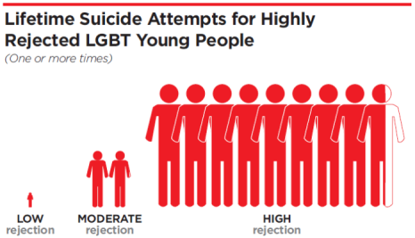

Family Acceptance Project
N=245 LGBT Retrospective assess family accepting behaviors in response to gender & sexual minority status
Self esteem
Social support
General health status
Depression
Substance use
Suicidality
Predicts improved
Protects against
Ryan CJ; 2010, 2009
34

Slide 35


Behaviors and expression may be nonconforming, but children can still feel that they are in the right-gendered body
Family acceptance, love, support is critical.
All children are at risk for crisis when their true sense of identity is discouraged and/or punished.
Addressing Parents’ Questions
Notes:
35
35
If we accept that there is variance in gender expression and identity in early development, what if it persists? What if it’s causing significant distress within the child and/or family? What if there is new or a resurgence of gender non-conforming behavior and expression?
Some common parental questions and concerns:
“How did this happen?”
“Is my child going to be gay?”
“If only my child was gay, not transgender…”
“Who should we tell? How do we tell?”
Worries about safety
Their own process of transition
Grieve the child & dreams they lost…
not yet realize the child they gain.
35

Slide 36
Adolescents and Gender

Slide 37

Case 2 Patient “K”
Initial visit
12 yro assigned female at birth brought in by their mother for mood and behavior concerns
As you explore these concerns, you learn
  K identifies as male and gender expression is very masculine
  K is distressed by onset of puberty and not sure what to do next
Notes:
Here is a case where a young person feels that the gender given at birth does not match their gender identity. K would be referred to as transgender.

Slide 38
Case 2 Patient “K”
Over time
Now 13 yro K is socially transitioned for 4 months
K is interested in not having periods, looking as male as possible & has done some preliminary investigation of transgender
What do you do next?
Notes:
Returning to K. As you recall, K is a 13-year-old natal female brought in by his mother for consultation. K identifies as male but gender expression is still female. K is distressed by the onset of puberty and desires to transition to male. What do you do next?

Slide 39
Setting Up the Initial Assessment
Establish privacy
  Ask mom to step out of room
  Explain what can (and can’t) be kept confidential
Establish trust and rapport
  Ask name and pronoun
  Ask goals of visit
Getting to know the person
  General adolescent health assessment HEADDSSS
  Leading into more detailed & sensitive history
Notes:
First, remember that K is an adolescent. This visit should be conducted in the same way as all other adolescent visits: begin with asking the parent to “please step out;” ensure confidentiality and explain the circumstances in which confidentiality must be broken; and gain trust and establish rapport by actively listening. Before addressing K, it is important to ask which pronoun and name is preferred. Once told, make a cognizant effort to use that pronoun in dialogue. Next, conduct the HEEADDSS assessment.

Slide 40

What Not to Do
Interview only with parent in room
  All teens deserve private time
Assume
  Name or pronoun
  Gender identity and expression correlate
Disclose without patient’s consent
Dismiss
  Parents as a source of support
  As a phase
Refer for reparative therapy
Notes:
After a patient has identified gender concerns, it is essential that the provider establishes confidentiality by asking the parent to please step out. In beginning of the interview, the provider should ask the patient his/her preferred gender pronoun and never assume that gender expression matches gender identity (a patient may present as female but identifies as male and wants to be referred to as “he.”)
As with all adolescents, it is essential not to disclose these issues without first asking permission from the patient (except, of course, if the patient is a danger to him/herself or others). Along these same lines, providers should not assume that parents will not support their children in their decisions to transition. As previously mentioned, parental and familial support is very important to healthy outcomes.
Providers should not assume that the adolescent’s gender identity concerns are a phase. In R’s case, we were presented with a situation where the young person was unsure about gender issues. This could definitely have been normal exploration. In K’s case, however, K is very sure of his gender concerns and wants to transition.
Finally, it is unethical to refer young patients to so-called “reparative therapy” to “treat” homosexuality and gender identity. The American Psychological Association’s official position is that reparative therapists have not produced any rigorous scientific research to substantiate their claims. Furthermore, these therapists often do more harm than good by increasing stigma and fostering self-hatred.

Slide 41
Strength
&
Risk Assessment
Assess personal strengths, resources, goals
Assess social support and resources
Address risk-taking or safety concerns
  Mental health—depression, anxiety, self harm, suicide
  Substance use/abuse
  Sexual activity—STI and pregnancy prevention
Notes:
In the course of taking a comprehensive history, you ask about K’s experience with gender. When does K first recall having concerns about gender? How did this manifest? What are K’s thoughts about transitioning? How do K’s parents feel about this? Does K feel supported at school? In the community?
As with all adolescents facing health concerns, you assess K’s coping abilities and whether there are any behavioral risk factors that need to be addressed.

Slide 42
Gender Experience
Review history of gender experience
  Open-ended encouragement, “Tell me your story in your own words”
  Ask about specific feelings, thoughts, behaviors, preferences
  Parent may offer excellent insight into early childhood
Document prior efforts to adopt desired gender
  Clothing, makeup, play
  Hormone use, if any
Review patient goals
Notes:
In the course of taking a comprehensive history, you ask about K’s experience with gender. When does K first recall having concerns about gender? How did this manifest? What are K’s thoughts about transitioning? How do K’s parents feel about this? Does K feel supported at school? In the community?
As with all adolescents facing health concerns, you assess K’s coping abilities and whether there are any behavioral risk factors that need to be addressed.

Slide 43
Case 2 Patient “K”
Engage parent(s) to support their child
  Explore parent’s concerns and priorities
  Assess parental support and knowledge
  Facilitate discussion and negotiations
Establish expectations for all stakeholders
  Incorporate patient goals, with parental expectations, and management options
Notes:
After you have spoken with K in private, you invite the mother back in the room. The parent may or may not still be adjusting to K’s gender identity concerns so it is important to validate the mother’s concerns. Next, ask the mother about her feelings regarding K’s decision to transition and knowledge of the process. This may be the first time K has been able to discuss these issues with her mother. Your role is to facilitate discussion between the two.
You can explain to K’s mother that families play a key role in the lives of transgender youth—if they are supportive, they protect and buffer youth from negative outcomes and promote positive health and well-being, but if they are rejecting and abusive, the effect is very detrimental and they contribute to their children’s poor health and mental health outcomes. Family members go through their own process of adjusting to a child’s transgender identity and typically experience the following stages: denial/shock, anger/fear, grief, self-discovery, acceptance, and pride/advocacy. If K’s mother is having difficulty adjusting, families can get support from organizations such as Trans Youth Family Allies (TYFA).
If you will not be providing transitioning care, refer K and her mother to a specialist and schedule a follow-up appointment.

Slide 44
Remind Youth and Parents…What Is Healthy?
Gender and sexual development are natural parts of human development
Gender and sexual expression vary
Gender and sexual diversity are different than risk
Open, honest communication is critical to healthy decision-making, behaviors, support, and access to care
Notes:
When talking to patients and parents, you can put forth these very basic ideas about gender and sexuality. Both gender and sexuality are natural, variable, and include diversity.
Remember—Simply identifying as transgender is not, in of itself, a cause of psychological distress. However, many transgender youth experience significant psychosocial and mental health concerns, which are likely due to the challenges often faced by young people with non-conforming gender identity and expression. Psychosocial concerns for transgender youth include familial rejection, peer rejection, harassment, trauma and abuse, inadequate housing, legal problems, lack of financial support, and educational problems.
Given these difficulties, it is not surprising that many transgender youth face significant mental health issues, including depression, suicidality, anxiety, body image issues, substance abuse, and post-traumatic stress disorder. Not only are these issues of concern, but the research suggests that transgender youth experience significantly higher levels of substance abuse, depression, suicidality, and HIV-risk than their gay, lesbian, and bisexual peers.
Being able to engage in open, honest communication is critical to healthy decision-making.

Slide 45
Case 2 Patient “K” Continued
Mental health provider
  Assess/treat other mental health concerns
Medical provider
  Assess and consent for hormonal management
Consider appropriate referrals to providers with experience in transgender care
Focus on individual needs of young person & family
Notes:
Goal: Focus on the individual needs of the young person and family; present all possibilities (readiness assessment in the gatekeeper model is problematic)
Because many primary health care providers will not have the expertise to adequately treat K, most will refer the patient to a mental health provider and transgender specialist.

Slide 46

Referrals and Seeking Specialized Care
Many mental health and medical providers may not have expertise in transgender health
Transgender health “specialists”
  Variety of providers with experience and/or training in caring for transgender patients
  Wide variety of disciplines, degrees, specialties
YET!
We have lots of work to do ☺
Notes:
Because many primary health care providers will not have the expertise to adequately treat K or other transgender patients, most will refer the patient to a mental health provider and transgender specialist.
No fellowships available in transgender health.

Slide 47
Case 2 Patient “K” Continued
Medical and mental providers assist with identifying
  Gender identity and gender needs
  Gender dysphoria, other psychosocial stressors
  Options, planning for safe social transition
  Benefit from delaying puberty
  Benefit of gender affirming hormones
  Benefit of surgical referrals
  Documentation and support for name, gender marker, and other options for transition
K’s mother is supportive
What options for care might you offer this family?
Notes:
Are the suggestions made by the expert in-line with nationally recognized guidelines? Do guidelines for the treatment of gender dysphoria even exist?
47

Slide 48
Treatment Goals
Improve quality of life by:
Facilitating transition to physical state that more closely represents the individual’s sense of self
Experiencing puberty congruent with gender
Preventing unwanted secondary gender/sex characteristics
  Reduce need for future medical, surgical interventions
Avoiding depression, risk-taking
Establishing early, strong social support
Notes:
What is the goal of treatment in these adolescents? Ultimately, treatment improves quality of life by facilitating the transition to a physical state that more closely represents the individual’s sense of themselves.
Why did the specialist consider puberty suppression and cross-gender hormones?
The beginning signs of puberty in transgender children often bring increased body dysphoria, and the potential development of a whole host of comorbidities for these youth including, but certainly not limited to depression, anxiety, illicit substance use, high risk sexual behaviors, and increased suicidality. There are complicated factors surrounding the initiation of gonadotropin-releasing hormone agonists and cross-gender hormones. Ideally, young people should be treated early in order to facilitate psychotherapy by easing distress, “buy time” to avoid reactive depression, and prevent unwanted secondary sex characteristics, thereby reducing the need for future medical interventions.
Slide taken from: Olson J. Hormonal Therapy for Transgender Youth. Society for Adolescent Health and Medicine presentation, April 7, 2010. Toronto, ON.

Slide 49
Range of Treatment Approaches
NO!
Gender identity stable
Initiate puberty with hormones
congruent with gender identity
No treatment until 18
(after full pubertal experience)
GCS
Living in Asserted Gender
NO!
Allow some experience puberty, to age 15-16 or Tanner 4, then start GnRH analogues or hormones
Gender identity stable
Start GnRH analogues at Tanner 2
Initiate hormones several years later
https://ceitraining.org/
Notes:
Source: https://ceitraining.org/

Slide 50
Phases of Transitioning
Reversible
clothes, hair, shoes, toys, GnRH analogues
Partially reversible
masculizing and feminizing hormone therapy
Irreversible
Surgical interventions
Notes:
Phenotypic transitioning occurs in phases: reversible, partially reversible, irreversible, and surgical. The reversible portion of transition includes the adoption of preferred gender hairstyles, clothing, play, perhaps a new name and suppression of biologic gender puberty. The portions of the reversible phase that do not involve suppression of puberty will sometimes occur before the age of ten. Parents of younger children with gender dysphoria may work with families, friends, teachers, and administrators to create a safe environment for children to present in their preferred gender. Allowing transition prior to puberty is controversial and should be determined by a close evaluation of the potential risks and benefits in a decision-making process between health care providers, parents, and the child.
Slide adapted from: Olson J. Hormonal Therapy for Transgender Youth. Society for Adolescent Health and Medicine presentation, April 7, 2010. Toronto, ON.

Slide 51
Benefits of Early Treatment
Children with gender diversity or questions
  See when concerns identified, ideally BEFORE puberty
  Gives providers time to engage with family and patient, build rapport and trust
  Offer relief to patient worried about upcoming puberty
Consider “blocking” puberty
  Effects fully reversible
  “Buys time” and avoid reactive depression
  Psychotherapy facilitated when distress eased
  Prevent unwanted secondary sex characteristics
  Reduces needs for future medical interventions
Notes:
Slide adapted from: Olson J. Hormonal Therapy for Transgender Youth. Society for Adolescent Health and Medicine presentation, April 7, 2010. Toronto, ON.

Slide 52
Beginning Hormonal Treatment
Assess needs of young person around phenotypic transition
  Physical (Tanner stage)
  Psychological
  Social
Review risks and benefits of hormone therapy
  Differentiate between reversible and irreversible physical changes
  Determine that youth has a realistic sense of what can and can’t be impacted by hormones
Notes:
Before a specialist would begin K’s transitioning, she would assess K’s stage of development as this will determine whether pubertal suppression is an option. Working with a mental health professional, the provider will determine whether K is psychologically ready to transition. Additionally, the provider and patient must discuss how the transition will affect K’s social interactions including school, family, and community life.
The provider will review all the benefits and risks associated with pubertal suppression and cross-hormone therapy.

Slide 53
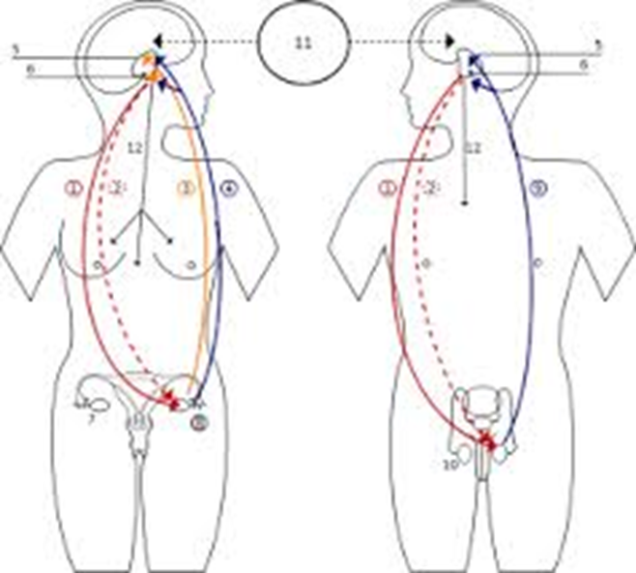
Timing Puberty Blocking
Ideal before or early Tanner 2
  Maintain prepubertal status
  Follow exam, LH, estradiol/testosterone
Can use Tanner 3-5
  Halt continued puberty changes
  Prevent continued 2nd gender characteristics
  Mental health & perimenopausal symptoms
Puberty Blocking
53

Slide 54
Planning for Hormonal Treatment
Prescribing provider will establish
  Informed consent
  Reasonable goals, expectations
  Baseline screening labs
  Set up referrals and/or follow up
Provider and patient should establish
  Disclosure when patient is ready
  Sources of social support
  Impact on school or work

Slide 55

Case 3 Patient “B”
B is 16 yro MTF kicked out by her mother’s boyfriend for being “gay”
B presents as female
B is new to you and presents with chief complaint of “genital rash”
What next?
Notes:
Let’s move onto another case. B is 16 years old and comes to you with a complaint of a genital rash. B is already living as a female but has not legally changed her gender. Given her age, gender expression, and familial situation, what barriers might B encounter when seeking care?
55

Slide 56
Sexual Health History
What name or pronouns should I use?
What are gender(s) of your partner(s)?
Have you ever had anal, genital, or oral sex?
  Do you give, receive, or both?
  Other sexual activities?
How many partners have you had in past six months?
Do you use condoms…never, some, most, all of the time?
Any symptoms of STIs?
Any sex for shelter, food, drugs, other?
Any forced sex or rape?
Notes:
Asking about sexual behaviors is very important in this case. Primarily, B has presented with a symptom that is indicative of a sexually transmitted infection (STI). The history must include specific questions about sexual behaviors while being sensitive to the terms the patient uses to describe her genitalia.

Slide 57
Case 3 Patient “B”
Establish safety, trust, rapport
Evaluate problem patient wants help with
If there’s time, begin HEEADDSSS assessment knowing health risks for transgender population
HEADDSSS screen reveals
  Victimization at home and school
  Sex work with consistent unprotected receptive anal and oral sex
  Depression, considered suicide in past
  Substance use—meth and alcohol
  Street hormones and silicone injection
Last HIV test—one year ago
Notes:
Given B’s history, it is evident that she is in a vulnerable position. The first thing to do is to verbalize that you will not judge her and are here to help her.
Next, address B’s chief complaint. When did she first notice the rash? Does it itch? Are there any accompanying symptoms?
Your usual sexual script may be modified in this case because your patient has identified as transgender but it is important to take a comprehensive health history.

Slide 58
Trans Student Health…Risks
Health Risk Behavior | Trans/Non-Conforming Youth | Cis Youth
Alcohol use | 23% | 17%
No condom at last sex | 51% | 38%
No birth control at last sex | 41% | 25%
Depressive symptoms | 58% | 21%
Self-harm past year | 54% | 14%
Suicidal Ideation | 61% | 20%
Physical bullying Relational bullying Prejudice-based reason: gender Prejudice-based reason: gender expression | 25% 52% 35% 47% | 12% 32% 5% 15%
Student Survey 9th and 11th graders, n=81,885
Trans/genderfluid/non-conforming n=2,168 (2.7%)
Risk behaviors significantly higher among trans than cis
Emotional distress, bullying significantly more common among birth-assigned females than males
Protective factors
  Family connectedness
  Student-teacher relationships
  Feel safe in community
Eisenberg, Gower, McMorris, Rider, Shea and Coleman. J Adolesc Health 2017.
Notes:
Protective factors significantly lower among trans/non-conforming youth
Needs updated if using case: A lot of transgender patients, like B, who’ve experienced home/school victimization and homelessness exhibit other risk behaviors.
NOTES from updated study (Minnesota Student Survey, n=81,885, trans/genderfluid/unsure/non-conforming = 2.7%, n=2,168
Involvement in all types of risk behaviors and experiences was significantly higher among trans than cis
Protective factors were significantly lower among TGNC (trans or gender non-conforming) than cis
Almost two-thirds (61%) of TGNC youth reported suicidal ideation, which is over three times higher than cisgender youth (20%)
Key finding: Among trans youth there were significant differences between birth-assigned male and female
Emotional distress and peer harassment were significantly more common among birth-assigned females than males.
Lower internal and external protection among assigned female that male.
This finding may suggest a biological component across gender identities (in the absence of gender-affirming hormone treatment).
Source:
Eisenberg ME, Gower AL, McMorris BJ, Rider GN, Shea G, Coleman E. Risk and Protective Factors in the Lives of Transgender/Gender Nonconforming Adolescents. J Adolesc Health 2017 Jul 20.
58

Slide 59
Case 3 Patient “B”
Given B’s sexual & drug history
  HIV serology
  Syphilis serology
  NAAT urine GC/CT
  Rectal GC /CT
  Hepatitis C
What immunizations?
  Hepatitis A & B
  HPV
Notes:
Because B engages in unprotected anal sex, she should be screened for HIV, syphilis, GC, CT, rectal GC and CT, and pharyngeal GC. Additionally, because of B’s use of street hormones and silicone, she is at risk for Hepatitis C.
She is also a good candidate for the Hepatitis A and B vaccine and HPV.
Source: CDC 2010 STD Testing and Treatment Guidelines. Available at: http://www.cdc.gov/std/treatment/2010/toc.htm

Slide 60
Harm Reduction Counseling
Sexual
Psychosocial
Safer sex options
Facilitate condom use
Plan for future STI testing
Family planning as appropriate
  Egg-sperm sex
PreP or PeP education
Close follow-up
Support and survival
Housing/shelter/food referral
Vocational assistance
Substance abuse screen/counseling
Mental health screen/counseling
Notes:
B is in reach of several immediate resources. Specifically, a referral for housing and food. To help B extricate herself from the sex industry, a social worker may be able to find vocational assistance. As B disclosed substance use, a referral for harm reduction counseling in this area and mental health care is also warranted.
If B is not ready or willing to stop working in the sex industry, providers can work with her to strategize about how to increase condom use at each act of sex.

Slide 61
Minority Stress Theory
Gender or Sexual Minority
Stigma
Prejudice, Discrimination, Abuse, Lack of Acceptance, Isolation, Esteem, Resources
Minority Stress
Anxiety, Depression
Suicide, Substance Use, SES Disadvantage, Victimization
Adapted from O’Hanlan, et al (1997). A review of the medical consequences of homophobia with suggestions for resolution. JGLMA;1:25‐39.)
Notes:
61
Adapted from O’Hanlan, et al (1997). A review of the medical consequences of homophobia with suggestions for resolution. JGLMA;1:25‐39.)
Identifying as transgender is not in and of itself a mental health disorder
Social stigma is a problem
Familial rejection
Social isolation (friends, dating)
Fear of physical attacks
Mental health concerns for transgender
Depression
Suicidality
Body image issues
Substance abuse
Unfortunately, there is stigma attached to gender nonconformity in many societies around the world. Such stigma can lead to prejudice and discrimination, resulting in “minority stress” (I. H. Meyer, 2003). Minority stress is unique (additive to general stressors experienced by all people), socially based, and chronic, and may make transsexual, transgender, and gender nonconforming individuals more vulnerable to developing mental health concerns such as anxiety and depression (Institute of Medicine, 2011). In addition to prejudice and discrimination in society at large, stigma can contribute to abuse and neglect in one’s relationships with peers and family members, which in turn can lead to psychological distress. However, these symptoms are socially induced and are not inherent to being transsexual, transgender, or gender nonconforming.

Slide 62

Bias Negative Effects YRBS 2015
Exposure to violence health disparities
LGB students 12% v 5% more likely to not go to school at least one day during 30 days prior because of safety concerns
  Absenteeism linked to low graduation rates, SES impact
29% LGB youth attempted suicide at least once prior year compared to 6% of heterosexual youth
2014, YMSM 80% HIV diagnoses among youth
62
Notes:
Kann L, Olsen EO, McManus T, et al. Sexual Identity, Sex of Sexual Contacts, and Health-Related Behaviors Among Students in Grades 9-12 – United States and Selected Sites, 2015. MMWR Surveill Summ 2016; 65(9): 1-202.
Bouris A, Everett BG, Heath RD, Elsaesser CE, Neilands TB. Effects of Victimization and Violence on Suicidal Ideation and Behaviors Among Sexual Minority and Heterosexual Adolescents. LGBT Health 2016; 3(2): 153-61.
Huebner DM, Thoma BC, Neilands TB. School victimization and substance use among lesbian, gay, bisexual, and transgender adolescents. Prev Sci 2015; 16(5): 734-43.
Russell ST, Ryan C, Toomey RB, Diaz RM, Sanchez J. Lesbian, gay, bisexual, and transgender adolescent school victimization: implications for young adult health and adjustment. Journal of School Health. 2011;81(5):223-30.
Centers for Disease Control and Prevention. HIV Surveillance Report, 2014; vol. 26. Published November 2015. Accessed October 2016.

Slide 63
Countering Minority Stress
Social stigma
Familial rejection
Social isolation Fear of physical attacks
Early identification
Resources, connection, support
Change cultural appreciation for diversity
Minority stress
Pro-diversity
Resiliency
Improved Health Outcomes
Mental health
Social
Medical
Financial
Educational
Identity congruent with anatomy/physiology
Puberty in gender identified. living safely in identified gender
Notes:
Simply identifying as transgender is not, in itself, a cause of psychological distress. However, many transgender youth experience significant psychosocial and mental health concerns, which are likely due to the challenges often faced by young people with non-conforming gender identity and expression. Psychosocial concerns for transgender youth include family rejection, peer rejection, harassment, trauma and abuse, inadequate housing, legal problems, lack of financial support, and educational problems. Being an identifiable transwoman can be life threatening, especially a transwoman of color
Given these difficulties, it is not surprising that many transgender youth face significant mental health issues, including depression, suicidality, anxiety, body image issues, substance abuse, and post-traumatic stress disorder. Not only are these issues of concern, but the research suggests that transgender youth experience significantly higher levels of substance abuse, depression, suicidality, and HIV-risk than their gay, lesbian and bisexual peers ^{1, 13}.
Unfortunately, there is stigma attached to gender nonconformity in many societies around the
world. Such stigma can lead to prejudice and discrimination, resulting in “minority stress” (I. H.
Meyer, 2003). Minority stress is unique (additive to general stressors experienced by all people),
socially based, and chronic, and may make transsexual, transgender, and gender nonconforming
individuals more vulnerable to developing mental health concerns such as anxiety and depression
(Institute of Medicine, 2011). In addition to prejudice and discrimination in society at large, stigma
can contribute to abuse and neglect in one’s relationships with peers and family members, which
in turn can lead to psychological distress. However, these symptoms are socially induced and are
not inherent to being transsexual, transgender, or gender nonconforming.
63

Slide 64
Internalizing effects of homophobia/ transphobia
Impact of homophobia/ transphobia
Trauma/violence
Discrimination
Rejection
Lack of civil rights
Stigma Shame Isolation Stress Depression | Anxiety Low self-esteem (Resiliency) (Better coping strategies)
*
*
Decreased access to competent health services
*
*
Poor health outcomes
  No screening
  Low compliance
  Present late in disease
  Unsafe sex
Poor psychological outcomes
* Where culturally competent medical and mental health care can be a mitigating factor
Suicide Unsafe sex | Substance use Eating disorders
5. O’Hanlan, et al (1997)
Notes:
Adapted from: O’Hanlan, et al (1997). A review of the medical consequences of homophobia with suggestions for resolution. JGLMA;1:25‐39.)
As we can see, homophobia and transphobia effect LGBTQ youth at many levels. This gets internalized in various forms of shame and resiliency. In turn, LGBTQ youth are at higher risk for certain medical and mental health outcomes. We’ll talk about how access to competent health services improves these outcomes. Outside of health care, are there other mitigating factors?

Slide 65
Trans Survival-
Barriers to Care
Loss of parental and familial support
  Loss of housing, emotional, and financial care
  Loss of education, activities, opportunities
Lack of health care
  Loss of insurance/ability to pay
  Access, availability of health providers
  Concerns regarding confidentiality, rights to care
Social stigma
  Hostile or violent social environments
  Mental health sequelae
Notes:
A patient like B will often run into many barriers in trying to access quality healthcare. Because B is estranged from her family, she probably is not covered on their insurance. Therefore, ability to pay for services will be an issue. Additionally, even if B has insurance, it is often difficult to get insurance plans to cover the cost of medications because the care for GID is frequently carved out of the plans.
B will also face social stigma when presented for care and (often very real) fear that she will be judged by providers and other staff members.
Additionally, very few providers are trained to competence in the provision of care to transgender individuals.

Slide 66
Trans Survival-
Barriers to Care
Transgender and gender diverse patients experience decreased access to care/worse health outcomes compared to LGB counterparts
Racially diverse LGBTQ emerging adults’ health care access study
  206 participants, ages18-27; 86% racial/ethnic minority, 10% transgender
Findings:
  68% reported relatively easy access to care
  White and bisexual participants higher rates of insurance than racial/ethnic minority and gay or lesbian participants.
  Trans patients more likely than cis to report delay in care and negative effects of disclosure to provider
  Discrimination based on LGBTQ in healthcare, more limited access to/use of health services
Macapagal K, Bhatia R, Greene GJ. Differences in Healthcare Access, Use, and Experiences Within a Community Sample of Racially Diverse LGBTQ Emerging Adults. LGBTHealth Vol 3, Number 6, 2016. DOI: 10.1089/lgbt.2015.0124
Notes:
Notes about patient in the case: A patient like B will often run into many barriers in trying to access quality healthcare. Because B is estranged from her family, she probably is not covered on their insurance. Therefore, ability to pay for services will be an issue. Additionally, even if B has insurance, it is often difficult to get insurance plans to cover the cost of medications because the care for GID is frequently carved out of the plans. B will also face social stigma when presented for care and (often very real) fear that she will be judged by providers and other staff members.
Additionally, very few providers are trained to competence in the provision of care to transgender individuals.
LGBTHealth Vol 3, Number 6, 2016. DOI: 10.1089/lgbt.2015.0124
Differences in Healthcare Access, Use, and Experiences Within a Community Sample of Racially Diverse LGBTQ Emerging Adults
Macapagal K, Bhatia R, Greene GJ.
Findings:
Questionnaire assessing healthcare access, use, and experiences
Queer or questioning reported negative healthcare experiences more frequently than LGB-identified
Different subgroups of the LGBTQ community experience greater barriers to care related to their sexual orientation or gender identities.
Similar rates of healthcare use to non LGBT youth, yet LGBTQ youth more frequently uninsured with lower rates of private insurance.
One explanation may be that LGBTQ young adults may have lost access to insurance coverage due to parental rejection of their sexual orientation or gender identities.
These factors may further compound the health disparities experienced by LGBTQ emerging adults and need to be addressed to optimize health outcomes for this vulnerable population.
Might also be interesting to mention secondary findings from SHINE study:
J Adolesc Health. 2017 Aug;61(2):259-261. doi: 10.1016/j.jadohealth.2017.02.013. Epub 2017 Apr 21.
Sociodemographic Factors Associated With Trans*female Youth's Access to Health Care in the San Francisco Bay Area.
Johns EA¹, Jin H², Auerswald CL³, Wilson EC².
Key findings:
Youth who identified as genderqueer/genderfluid less likely than female-identified to report problems accessing medical care
Previous research with LGBTQ youth has shown that flexibility with gender identity offers control over how they present
In health care situations gender-nonconforming identity may not feel safe to disclose
Flexibility in presenting one’s gender identity to clinicians and clinic staff to avert stigma could result in increased access to medical care for genderqueer/genderfluid youth.
Ann Emerg Med. 2017 Jul 13. pii: S0196-0644(17)30583-8. doi: 10.1016/j.annemergmed.2017.05.002. [Epub ahead of print]
"Sometimes You Feel Like the Freak Show": A Qualitative Assessment of Emergency Care Experiences Among Transgender and Gender-Nonconforming Patients.
Samuels EA¹, Tape C², Garber N³, Bowman S⁴, Choo EK⁵.
Hum Reprod. 2015 Jun;30(6):1365-74. doi: 10.1093/humrep/dev087. Epub 2015 Apr 22.
Trans people's experiences with assisted reproduction services: a qualitative study.
James-Abra S¹, Tarasoff LA², Green D³, Epstein R⁴, Anderson S⁵, Marvel S⁶, Steele LS⁷, Ross LE⁸.
Hum Reprod. 2017 Feb;32(2):383-390. doi: 10.1093/humrep/dew323. Epub 2016 Dec 19.
Transgender men's experiences of fertility preservation: a qualitative study.
Armuand G¹, Dhejne C^{2,3}, Olofsson JI^{4,5}, Rodriguez-Wallberg KA^{6,7}.

Slide 67

Create a Trans-Friendly Environment
Visible nondiscrimination policy
Staff training, openness
Use pronoun and name that patient requests
  This improves care for both trans and cis persons as it indicates carefully listening & respect
Transgender-inclusive materials
Unisex/individual bathrooms
Respect confidentiality, don’t “out”
Notes:
There are ways that you can help alleviate barriers to care that young trans youth face. Primarily, establish a zero tolerance policy and conduct staff trainings about the special needs of transgender adolescents.
Patient charts should alert staff that a patient is transgender and has a preferred pronoun. This pronoun should be used throughout the visit—from the front desk task to the triage nurse and nurse practitioner or physician.
It is also beneficial to all patients, to visibly display a non-discrimination policy or sign designating the office as a “safe space.”
Offices/clinics should make an attempt to display health literature that is inclusive of the transgender experience.

Slide 68

Welcoming Office
Inclusive intake forms
Welcoming signage
Staff training and education

Slide 69
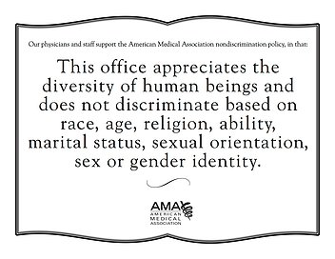
Welcoming Office
Notes:
Develop non-discrimination policies that include gender identity and expression, and post them in highly visible areas
Have education and marketing materials with affirmative imagery and content
Have educational brochures on transgender health topics

Slide 70

Welcoming Office
Create accountability for homophobic/transphobic remarks
  Staff
  Caregivers
Model acceptance, support for diversity
Knowledge about local resources
  Therapist, psychiatrists, voice therapists, hair removal specialists, surgeons
  Insurance coverage issues
Notes:
The guidance states that "Denial, exclusion or other limitations of coverage by a health insurer for medically necessary treatment otherwise covered by a health insurance policy or contract based solely on an individual's gender identity, expression or gender dysphoria is sex discrimination and prohibited under Rhode Island Law".‬

Slide 71
Forms
If done correctly, can signal welcoming office
Some patients may be more comfortable answering questions by self-report
  Can use as screening questions to flag areas for f/u in face to face
Consider using blanks for write-ins
Instead of marital status – relationship status
A sign to youth, that your office will know
how to care for him/her/they/ze.

Slide 72
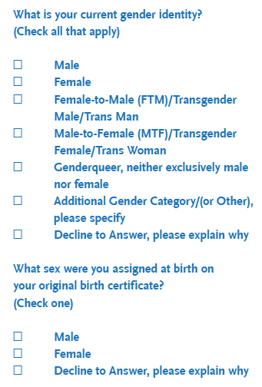

SO/GI collection
Important personal health history as well
Data that does not allow gender/sex minorities to remain “invisible”
Notes:
Instead of boxes for gender, blank line where patients can identify as they choose
Citation: Cahill S, Singal R, Grasso C, King D, Mayer K, Baker K, et al. (2014) Do Ask, Do Tell: High Levels of Acceptability by Patients of Routine Collection of Sexual Orientation and Gender Identity Data in Four Diverse American Community Health Centers. PLoS ONE 9(9): e107104. doi:10.1371/journal.pone.0107104

Slide 73
Transgender Youth
Take Home Points
Children and youth explore gender as well as sexual identity
Provider role
  Assessing individual goals, needs, risks
  Facilitating communication, support of family
  Referrals for support and resources
  Creating safe space for all youth

Slide 74
Caring for Transgender
Adolescents
Part 2: Understanding Medical Management &
Providing Ongoing Primary Care
Notes:
This section of the presentation delves deeper into the care of transgender youth. Part 2 is intended for those providers who want to know more about transitioning care, providing care in collaboration with other specialists, or those who want to begin providing such care.
74

Slide 75
Case 2 Patient “K” Continued
K 13 yro natal female identifying as male with some male gender expression
  K already socially transitioned and is in your office wanting to talk about hormone options for care
K, his parents
  State they want their child to be happy and healthy
  K and parent feels like they need some time to figure things out before they consider anything “irreversible”
Notes:
K is a 13-year-old natal female who identifies as male. K feels that the gender given at birth does not match the gender identity. K would be referred to as transgender. K’s primary care physician is participating in his care along with a team that includes a mental health provider and a specialist for transgender health care.
75

Slide 76
Beginning Hormonal Treatment
Establish commitment to next steps
  Gender questioning, incongruency, dysphoria
  Readiness for medications, exploring gender, and/or planning transition
  Expectations, goals
  Management plan
Obtain informed consent
Order baseline labs
Establish follow-up
Letters from mental health professionals may help inform providers and allow for coordinated care.
However, not all children or families have immediate mental health needs that “require” mental health evaluation.

Slide 77
Phases of Transitioning
Reversible
Clothes, hair, shoes, toys
Partially Reversible
Masculizing and feminizing hormone therapy
Irreversible
Surgical interventions
GnRH analogues
Notes:
Phenotypic transitioning occurs in phases: reversible, partially reversible, irreversible and surgical. The reversible portion of transition includes the adoption of preferred gender hairstyles, clothing, play, perhaps a new name and suppression of biologic gender puberty. The portions of the reversible phase that do not involve suppression of puberty will sometimes occur before the age of ten. Parents of younger children with gender dysphoria may work with families, friends, teachers, and administrators to create a safe environment for children to present in their preferred gender. Allowing transition prior to puberty is controversial and should be determined by a close evaluation of the potential risks and benefits in a decision-making process between health care providers, parents, and the child.
Slide adapted from: Olson J. Hormonal Therapy for Transgender Youth. Society for Adolescent Health and Medicine presentation, April 7, 2010. Toronto, ON.

Slide 78
Benefits of “Blockers”
Gonadotropin-Releasing Hormone (GnRH) analogues block puberty
  Leuprolide
  Histrelin
Delay irreversible secondary sex characteristics
  Allow time for teen to mature and make decision
  Allow time for parent and social support to develop
  Allow provider reluctance for irreversible effects in minor
Notes:
Slide adapted from: Olson J. Hormonal Therapy for Transgender Youth. Society for Adolescent Health and Medicine presentation, April 7, 2010. Toronto, ON.

Slide 79
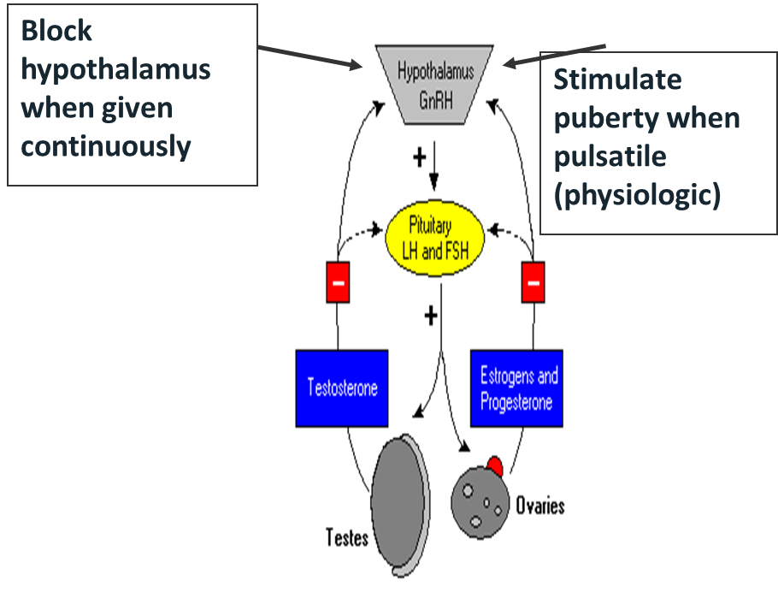
GnRH Agonists
Continuous GnRH secretion
  Suppress FSH, LH
  Initial ↑ LH, FSH followed by desensitized pituitary
  LH, FSH secretion suppressed
Leuprorelin
Triptorelin
Goserelin
  Monthly $500-1000
  3-monthly depot $1500-2000
Histrelin implant
  24 + months
  $3500 (Vantas)
  15,379.16 -$12,560.00 (Supprelin)
15
79
Notes:
Short-acting preparations that need to be delivered one- to three-times daily by nasal spray are also available but are not as efficient as sustained release preparations in suppressing gonadotropin secretion with prolonged non pulsatile GnRH-like hormone.

Slide 80
Dosing GnRH Analogues
Select dosing schedule
  Monthly or every 3 month depot SQ or IM
    Range 3.75, 7.5, 11.5 mg, 22.5 mg, 30 mg
  Starting dose long-acting 11.25 – 22.5 mg IM Q 3 months
Counseling and consent
  Few side effects aside from injection pain, need for labs & follow up
  Withdrawal bleed if peri-menarchal
  Hot flashes, mood changes…. “menopausal symptoms”
  Expect to see some “effects” in 2-4 week range
  Effect = no changes, halting new gender characteristics, no menses, erectile dysfunction
Notes:
Dosing can change from practice to practice. While some sites use as little as 3.25 mg Lupron, others use up to 11.5 mg. Other practices that differ by provider/site include the administration of Cyproterone acetate and use of stimulation tests.
There is a 22.5 three month long-acting dose.
Lupron has gluten.
anti-androgen Cyproterone acetate (Androcur®) 50 mg to 100 mg qd not FDA/available US but obtained from overseas
Androcur® 50 mg tablets, Diane-35 contraceptive 2 mg of cyproterone /0.035 mg EE

Slide 81
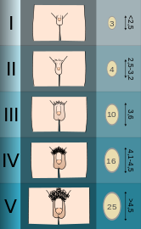
Assigned Male Puberty
Tanner stage | Testicles (volume cc) | Penis (length cm) | Pubic Hair
1 prepubertal | <1.5 | <=3
2 | 1.6-6 Scrotal skin thins, reddens | No change | Downy sparse
3 | 6-12 | <6 | More coarse, spread laterally
4 | 12-20 Scrotum darkens | <10 | Adult quality
5 adult | >20 | Average 15 | Spreads to thighs
81

Slide 82
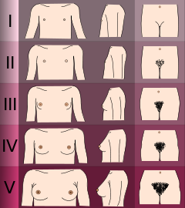
Assigned Females
Puberty
Tanner stage | Breast | Aerola | Pubic Hair
1 Prepub-ertal | No glandular tissue |  | None
2 | Breast bud, small firm tender glandular tissue | Areaola widens but in contour of breast | Sparse, fine
3 | Elevates extends beyond aerola | Areaola widens but in contour of breast | Increasing coarsenesslateral spread
4 | Increases | Secondary mound, project from contour | Adult quality
5 Adult |  | Returns to contour of breast, projecting papilla | Spreads to thighs
82

Slide 83
Blocker Considerations for…
GNC Boys
GNC Girls
Breast development early in puberty
Broaden hips
Early epiphyseal closure, shorter height
Early identification before menses
Low dose T for promoting height
Tanner 4-5 testes but minimal external gender characteristics
Bigger heavier skeleton
Adam’s apple
Male pattern face, body hair
Estradiol earlier for earlier puberty & height reduction
83

Slide 84
Blocking
CONS
PROS
Few long term, lifetime outcome data
Possible temporary adverse effect on bone density
  Reversible once hormones initiated
  BMD normal in teens with precocious puberty treatment
Height reduction (MTF) if started early
  Not necessarily a bad thing
  Negligible impact on height for FTMs
Lack of 2ndary sex characteristics compared to peers
Expensive! Insurance sometimes covers
Delays decision to undergo cross hormone therapy until child is older
Prevents undesired irreversible pubertal changes
Decreases distress, with mental health/self esteem benefits
Prevents need for costly and invasive surgery as adult
Cosmetic congruency as adult leading to passing & greater social & financial opportunities
Completely Reversible!
Delemarre-van de Waal, EuropJEndo 2006
84

Slide 85
Risks of “Blockers”
Required medical visits, injections, labs, exam
Height consideration
Expense
  Time & effort with prior authorizations
Wait and anxiety for patients/parents
Bone mineral density reduced
  Reversible once hormones initiated
Lack of secondary sex characteristics compared to peers
Relief >>> Risk or Harms
Notes:
Source: H Delemarre-van de Waal. European J of Endo. 2006
The most common concern with the administration of GnRHa’s is the effect on height and bone density. A study of the Dutch protocol that calls for the administration of GnRHa’s starting at age 12 and moving to concomitant administration of cross gender hormones at age 16, shows height is increased for female to male patients by delaying biologic female puberty, and decreased in male to female patients with the administration of estrogen promoting closure of the growth plates. This effect is generally desirable to both respective populations. Bone density may be diminished at the time of GnRHa administration, but is found to catch up when appropriate cross-gender hormones are started.
Slide adapted from: Olson J. Hormonal Therapy for Transgender Youth. Society for Adolescent Health and Medicine presentation, April 7, 2010. Toronto, ON.
85

Slide 86
Phases of Transitioning
Reversible
clothes, hair, shoes, toys
Partially Reversible
masculizing and feminizing hormone therapy
Irreversible
Surgical interventions
GnRH analogues
Notes:
Phenotypic transitioning occurs in phases: reversible, partially reversible, irreversible, and surgical. The reversible portion of transition includes the adoption of preferred gender hairstyles, clothing, play, perhaps a new name and suppression of biologic gender puberty. The portions of the reversible phase that do not involve suppression of puberty will sometimes occur before the age of ten. Parents of younger children with gender dysphoria may work with families, friends, teachers, and administrators to create a safe environment for children to present in their preferred gender. Allowing transition prior to puberty is controversial and should be determined by a close evaluation of the potential risks and benefits in a decision-making process between health care providers, parents, and the child.
Slide adapted from: Olson J. Hormonal Therapy for Transgender Youth. Society for Adolescent Health and Medicine presentation, April 7, 2010. Toronto, ON.

Slide 87
Case 3 Patient “B”
Homeless 16 y/o MTF returns
Presents as female
Trades sex for drugs and shelter
Diagnosed genital HPV last visit
Follow visit plan
  To learn more about how you can medically support her transition
Notes:
Let’s move onto another case. B is 16 years old and comes to you with a complaint of a genital rash.
87

Slide 88
Early Access to Gender Affirming Hormones
Increased opportunities for preventive health care
Improved family functions, school performance
Prevents risk taking, suffering
Leads to social change
Goals…improve quality of life
Child development in asserted gender
Notes:
88
What are the benefits of initiating hormones in adolescents?
Slide adapted from: Olson J. Hormonal Therapy for Transgender Youth. Society for Adolescent Health and Medicine presentation, April 7, 2010. Toronto, ON.

Slide 89
Estrogen
Estradiol
  Sublingual 2- ?? mg/day total dose
    Decreased risk VTE preferred over oral daily
  Patch 0.1-0.4 mg twice weekly
  Estradiol cypionate or valerate injection
    5–20 mg IM q 2 wks, 5-10 mg IM weekly
  Tailor hormone support according to
    Desired effects- acknowledges each patient may want & identify in different ways
    Average female levels 100-350 mimicking “known” healthy cis phyisiology, until we have more data
    Avoiding side effects, adverse effects- harm reduction explicit
Notes:
89
Potential sources and doses for different types of estrogen. Again, standards of care regarding doses have not been established.
Premarin®—1.25–10 mg PO daily or BID—is a less desirable option due to increased risk of DVT.
Slide adapted from: Olson J. Hormonal Therapy for Transgender Youth. Society for Adolescent Health and Medicine presentation, April 7, 2010. Toronto, ON.

Slide 90
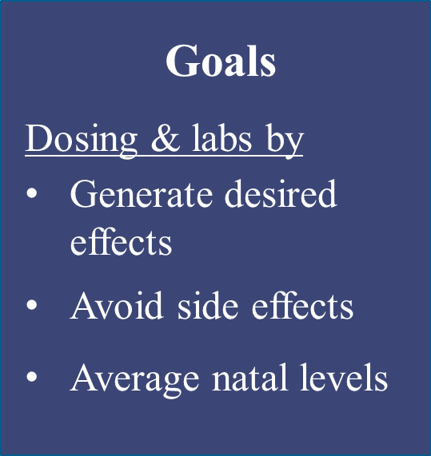
Estradiol Feminization
 | Sublingual | Intramuscular | Transdermal
Agent | 17 b estradiol | Estradiol Cypionate Valerate | Patch | Gel
Pre-orchiectomy | 2-12 mg daily Sublingual 30 minutes, swish spit | 5-20 mg IM q 1-2 weeks ?New data Subcutaneous? | 0.1-0.4 mg twice weekly | 1gm applied to skin 2-3 times daily
Maintenance after 2 years | Reduce to level needed to keep serum free testosterone suppressed, estradiol within average female range
https://ceitraining.org/
Notes:
Source: https://ceitraining.org/

Slide 91
Predicting Effects of Feminizing Hormones
Action | Onset | Max
Breast growth | 3-6 months | 2-3 yrs
Body fat, muscle changes Softening skin Softer, less male pattern terminal hair Emotional changes | 3–6 months 3-6 months 6-12 months 1-3 months | 2-3 yrs > 3 years
Change in libido, erectile dysfunction Decrease testicular volume Decrease sperm production | 1-3 months 25% see change in 1 yr ? | 3-6 months 50% see change by 2–3 yrs ?
Notes:
91
Expected effects of testosterone therapy include cessation of menses, usually within the first month of therapy, deepening of voice, increased facial and body hair growth, increased clitoral size, increased libido, and enhanced ability to maintain and increase muscle mass. Testosterone will not decrease breast size.
After masculinization has occurred, the testosterone dose can often be decreased for maintenance. If a patient has undergone hysterectomy with oophorectomy, the testosterone dose can often be decreased to 100–150 mg IM every 2 weeks. Serum estradiol levels and luteinizing hormone (LH) levels can document suppression of the hypothalamic–pituitary axis, but these are expensive and not routinely used by primary care physicians caring for FTM patients.
Source: Oriel K., Journal of the Gay and Lesbian Medical Association 2000;4:185–194.

Slide 92
Other Feminizing Options
Anti-androgens
  Spironolactone 50-100 mg PO BID
  Finasteride 1-5 mg PO QD
Progesterone
  Prometrium 100-200 mg nightly
  Other options
    Medroxyprogesterone (Provera) 5-10 mg PO QD
    DMPA 150 IM Q3 months
  Unclear if benefit or harm
Cosmetics
  Hydroquinone, Vaniqua®, laser, electrolysis
Notes:
92
Spironolactone is an anti-androgen binding to the androgen receptor. The side effects include gynecomastia, menstrual irregularities and testicular atrophy, ataxia, erectile dysfunction, drowsiness, and rashes.
Finasteride blocks the conversion of testosterone to more powerful androgen dihydrotestosterone by inhibiting 5-alpha reductase in tissues such as the scalp, skin, and prostate. Side effects include impotence, abnormal ejaculation and sexual function, gynecomastia, and testicular pain.
Cyproterone acetate blocks androgen receptors suppressing test and dihydrotestosterone, suppresses LH.
Has weak progesterone and glucocorticoid activity also decreases LH.
Blockade of adrenal 21-hydroxylase results in the accumulation of androgen precursors which may be converted to testosterone, reducing the efficacy of the antiandrogen treatment. Due to the possibility of increased adrenal androgens, cyproterone acetate is sometimes combined with finasteride. Studies of hirsutism treatment show increased efficacy of this combination over cyproterone alone.
Side effects and risks include liver toxicity at doses in 200 mg+ range, ↑K, ↑ VTE with estrogen

Slide 93
Risks of Feminizing Hormones
Studies over time indicate that hormones have minimal clinically
significant physiologic affects & suggest we can do less labs in future
Increased BP
Glucose intolerance
Gall bladder disease
Pituitary adenoma
Breast cancer (3 cases)
Anti-androgens
↑ K ↓ BP
VTE
Increased Weight
Decreased Libido
Erectile dysfunction
Liver dysfunction
TG ↑ (pancreatitis)
HDL ↑ LDL ↓
Notes:
Effects continue at decreasing rate for ≤ 2 years often with a “spurt” of breast growth and other changes after orchiectomy. Undesirable side effects could include deep venous thrombophlebitis, prolactinomas, hypertension, liver disease, decreased libido, and potential biological female risk of breast cancer. Anti-androgens can cause hyperkalemia and decreased blood pressure. Most male-to-female patients receiving cross-gender hormones will experience a decrease in testicular mass, penis size, and fertility.
There is also an increased risk of VTE on oral estradiol.
There have been three cases of breast cancer, three cases of prostate cancer, and three benign prolactinomas in the literature.
References:
Price TM, Blauer KL, Hansen M, et al. Single-dose pharmacokinetics of sublingual versus oral administration of micronized 17 beta-estradiol. Obstet Gynecol 1997; 89:340.
Hannema SE, Schagen SEE, Cohen-Kettenis PT, Delemarre-van de Waal HA. The efficacy and safety of pubertal induction using 17beta-estradiol in transgirls. J Clin Endocrinol Metab 2017.
Moore E, Wisniewski A, Dobs A. Endocrine treatment of transsexual people: a review of treatment regimens, outcomes, and adverse effects. J Clin Endocrinol Metab 2003; 88:3467.
Meyer WJ 3rd, Webb A, Stuart CA, et al. Physical and hormonal evaluation of transsexual patients: a longitudinal study. Arch Sex Behav 1986; 15:121.
Tangpricha V, Ducharme SH, Barber TW, Chipkin SR. Endocrinologic treatment of gender identity disorders. Endocr Pract 2003; 9:12.
Jarin J, Pine-Twaddell E, Trotman G, et al. Cross-sex hormones and metabolic parameters in adolescents with gender dysphoria. Pediatrics 2017; 139:e20163173.

Slide 94
Baseline Labs
Feminizing Hormone Therapy
No single protocol when administering hormone therapy to transgender patients
Labs common prior to starting estradiol hormone therapy
  AST
Labs for spironolactone use
  Cr, Na, K
Labs for patients already using hormones
  Estradiol vs Testosterone
  LC-MS/MS (liquid chromatography–tandem mass spectrometry) most accurate for comparing measures over time
Notes:
A liquid chromatography–tandem mass spectrometry (LC-MS/MS) method

Slide 95
Lab Follow-Up for
Feminizing Hormone Therapy
? How often
  Used to be Q 3 months
  Yearly
  Test according to need
Testosterone < 70 ng/dL
Estradiol 100-350 ng/dl
  If concerns re overuse
  Goal “average female levels”
  Reassure patient
  How useful vs expensive
BP, Na, K (Cr)
  If spironolactone
Prolactin only if symptoms
Goals
Dosing & labs by
Generate desired effects
Avoid side effects
Average natal levels
Notes:
There is not a common protocol that all providers use when administering hormone therapy to transgender patients.
Laboratory follow-up should include a liver function testing, and potassium levels at three and six months and yearly thereafter. Prolactin levels may be drawn after six months of therapy, then yearly for three years. Lipid profiles should be followed regularly, especially for those with elevated or borderline values. Serum testosterone levels within the normal female range help document adequate hypothalamic–pituitary suppression, but are expensive. They can be especially helpful when making decisions about whether to increase estrogen doses. Some check estrogen as well if expected results are not seen, or if there is potential for the patient to be over- or under-dosing. The goal level for is 200 pg/mL.
95

Slide 96
Health Care Maintenance for MTFs
Emotional well-being
STI testing, prevention
Fertility considerations
  Sperm/embryo banking
  Contraception
Breast cancer screening
  Self breast exam
  Mammography 10+ years estradiol, age 50
  According to cis guidelines at present
Additional screenings, limited evidence
  ?Prostate screening for older patients
  ?Pap if neo cervix created
Notes:
During subsequent visits, providers should enquire about body changes, breast development, and mood. One should discuss the social impact of transitioning and understand the patient’s perspective on body changes. It is quite common for patient to be frustrated about the length of time required to transition, be disappointed in breast size, and feel shame in their ability to “pass” as female. Although most breast development occurs in the first 1–2 years of hormonal therapy, 4–6 years may be required for full maturation. Specific techniques for measuring and quantifying breast development are described elsewhere for those interested.
Usual health-care maintenance is also a critical part of subsequent visits. This includes: minimizing coronary artery disease risk factors, reinforcing safer sexual practices, and performing sexually transmitted disease screening when appropriate.
Mammography is generally recommended after 10 years of hormonal therapy for women older than 40, although there is no data to support or refute this practice. Given the controversial nature of prostate specific antigen (PSA) screening for men with normal testosterone levels (35), PSA screening is probably not indicated for MTF women whose testosterone levels are suppressed.

Slide 97
Cancer Risks for MTFs
?
No evidence of increased cancer in trans pop
Breast
  Gooring 2013, Turo 2013, Van Hurst, Doff
Uterine
  Urban 2011 – 1 case report
  Goynbert 2004, Perrone 1994 – endometrial atrophy
Ovarian
  Barry 2014, Erickson BK 2013, Dizon 2006,
Cervical
  Peltzmeier 2014
Prostate
  6 cases, older women E > 50
Notes:
During subsequent visits, providers should enquire about body changes, breast development, and mood. One should discuss the social impact of transitioning and understand the patient’s perspective on body changes. It is quite common for patient to be frustrated about the length of time required to transition, be disappointed in breast size, and feel shame in their ability to “pass” as female. Although most breast development occurs in the first 1–2 years of hormonal therapy, 4–6 years may be required for full maturation. Specific techniques for measuring and quantifying breast development are described elsewhere for those interested.
Usual health-care maintenance is also a critical part of subsequent visits. This includes: minimizing coronary artery disease risk factors, reinforcing safer sexual practices, and performing sexually transmitted disease screening when appropriate.
Mammography is generally recommended after 10 years of hormonal therapy for women older than 40, although there is no data to support or refute this practice. Given the controversial nature of prostate specific antigen (PSA) screening for men with normal testosterone levels (35), PSA screening is probably not indicated for MTF women whose testosterone levels are suppressed.

Slide 98
Fertility
Ever changing technologies
Post GnRA, no change in fertility or birth defects (Lazar 2014)
Live births after cryopreservation prepubertal ovary (Demeestre 2015)
Uterine transplant, successful live birth (Brannstrom 2015)
Trans men experiencing pregnancy (Light AD, Obedin-Maliver J, Sevelius JM, Kerns JL. Transgender men who experienced pregnancy after female-to-male gender transitioning. Obstet Gynecol. 2014;124(6):1120–7.)
Sperm preservation
  1 month
  Masturbate, freeze
Oocyte preservation
  1-3 months
  Consult, labs, TVUS
  Daily US x 2 weeks cycle
  1-3 cycles
Notes:
J Hum Reprod Sci. 2010 Jan;3(1):2-7. doi: 10.4103/0974-1208.63113.
Fertility preservation in young cancer patients.
Revel A¹, Revel-Vilk S.
Author information
Abstract
As a result of advances in treatment, almost 80% of children and adolescents who receive a diagnosis of cancer become long-term survivors. The increased survival rate of children and adolescents with cancer has resulted in a major interest in the long-term effects of cancer treatment on the possibility for future fertility. Currently established methods for the preservation of fertility are available only for pubertal males and females. Pubertal male cancer patients should be encouraged to freeze numerous sperm samples even when sperm count and motility are poor. In these cases, intracytoplasmic sperm injection is a powerful technique compared with intrauterine insemination since thawed sperm samples with poor parameters can produce relatively high fertilization rates resulting in normal pregnancies and deliveries. Married pubertal women should be proposed ovulation induction, follicular aspiration, and fertilization with husband sperm. Single women could benefit from vitrification of oocytes. This requires a delay of about 3 weeks in the commencement of chemotherapy to enable follicular growth. Fertility preservation for prepubertal patients is more of a problem. Young girls could be offered cryopreservation of gametes in the gonadal tissue. Cryopreservation of testicular tissue was suggested for fertility preservation for young boys, but this method is totally experimental and not currently offered. Discussing future fertility is part of the consultation of young female and male patients facing potentially gonadotoxic cancer therapy. It is the role of reproductive specialists to create various options in their laboratory to preserve fertility potential of cancer patients.
Hum Reprod. 2015 Nov;30(11):2463-75. doi: 10.1093/humrep/dev190. Epub 2015 Sep 10.
A European perspective on testicular tissue cryopreservation for fertility preservation in prepubertal and adolescent boys.
Picton HM¹, Wyns C², Anderson RA³, Goossens E⁴, Jahnukainen K⁵, Kliesch S⁶, Mitchell RT³, Pennings G⁷, Rives N⁸, Tournaye H⁹, van Pelt AM¹⁰, Eichenlaub-Ritter U¹¹, Schlatt S⁶; ESHRE Task Force On Fertility Preservation In Severe Diseases.
Author information
Abstract
STUDY QUESTION:
What clinical practices, patient management strategies and experimental methods are currently being used to preserve and restore the fertility of prepubertal boys and adolescent males?
SUMMARY ANSWER:
Based on a review of the clinical literature and research evidence for sperm freezing and testicular tissue cryopreservation, and after consideration of the relevant ethical and legal challenges, an algorithm for the cryopreservation of sperm and testicular tissue is proposed for prepubertal boys and adolescent males at high risk of fertility loss.
WHAT IS KNOWN ALREADY:
A known late effect of the chemotherapy agents and radiation exposure regimes used to treat childhood cancers and other non-malignant conditions in males is the damage and/or loss of the proliferating spermatogonial stem cells in the testis. Cryopreservation of spermatozoa is the first line treatment for fertility preservation in adolescent males. Where sperm retrieval is impossible, such as in prepubertal boys, or it is unfeasible in adolescents prior to the onset of ablative therapies, alternative experimental treatments such as testicular tissue cryopreservation and the harvesting and banking of isolated spermatogonial stem cells can now be proposed as viable means of preserving fertility.
STUDY DESIGN, SIZE, DURATION:
Advances in clinical treatments, patient management strategies and the research methods used to preserve sperm and testicular tissue for prepubertal boys and adolescents were reviewed. A snapshot of the up-take of testis cryopreservation as a means to preserve the fertility of young males prior to December 2012 was provided using a questionnaire.
PARTICIPANTS/MATERIALS, SETTING, METHODS:
A comprehensive literature review was conducted. In addition, survey results of testis freezing practices in young patients were collated from 24 European centres and Israeli University Hospitals.
MAIN RESULTS AND THE ROLE OF CHANCE:
There is increasing evidence of the use of testicular tissue cryopreservation as a means to preserve the fertility of pre- and peri-pubertal boys of up to 16 year-old. The survey results indicate that of the 14 respondents, half of the centres were actively offering testis tissue cryobanking as a means of safeguarding the future fertility of boys and adolescents as more than 260 young patients (age range less than 1 year old to 16 years of age), had already undergone testicular tissue retrieval and storage for fertility preservation. The remaining centres were considering the implementation of a tissue-based fertility preservation programme for boys undergoing oncological treatments.
LIMITATIONS, REASONS FOR CAUTION:
The data collected were limited by the scope of the questionnaire, the geographical range of the survey area, and the small number of respondents.
WIDER IMPLICATIONS OF THE FINDINGS:
The clinical and research questions identified and the ethical and legal issues raised are highly relevant to the multi-disciplinary teams developing treatment strategies to preserve the fertility of prepubertal and adolescent boys who have a high risk of fertility loss due to ablative interventions, trauma or genetic pre-disposition.
Hum Reprod. 2015 Sep;30(9):2107-9. doi: 10.1093/humrep/dev128. Epub 2015 Jun 9.
Live birth after autograft of ovarian tissue cryopreserved during childhood.
Demeestere I¹, Simon P², Dedeken L³, Moffa F⁴, Tsépélidis S⁵, Brachet C⁶, Delbaere A⁷, Devreker F⁸, Ferster A³.
Author information
Abstract
Ovarian insufficiency is a major long-term adverse event, following the administration of a myeloablative conditioning regimen, and occurring in >80% of children and adolescents receiving such treatment for malignant or non-malignant disease. Cryopreservation of ovarian tissue is currently offered to preserve the fertility of these young patients. At least 35 live births have been reported after transplantation of cryopreserved ovarian tissue in adult patients, but the procedure remains unproven for ovarian tissue harvested at a prepubertal or pubertal age. We report here the first live birth after autograft of cryopreserved ovarian tissue in a woman with primary ovarian failure after a myeloablative conditioning regimen as part of a hematopoietic stem cell transplantation performed for homozygous sickle-cell anemia at age 14 years. This first report of successful fertility restoration after the graft of ovarian tissue cryopreserved before menarche offers reassuring evidence for the feasibility of the procedure when performed during childhood.
Lancet. 2015 Feb 14;385(9968):607-16. doi: 10.1016/S0140-6736(14)61728-1. Epub 2014 Oct 6.
Livebirth after uterus transplantation.
Brännström M¹, Johannesson L², Bokström H³, Kvarnström N⁴, Mölne J⁵, Dahm-Kähler P², Enskog A⁶, Milenkovic M², Ekberg J⁴, Diaz-Garcia C⁷, Gäbel M⁴, Hanafy A⁸, Hagberg H⁹, Olausson M⁴, Nilsson L².
Author information
Abstract
BACKGROUND:
Uterus transplantation is the first available treatment for absolute uterine infertility, which is caused by absence of the uterus or the presence of a non-functional uterus. Eleven human uterus transplantation attempts have been done worldwide but no livebirth has yet been reported.
METHODS:
In 2013, a 35-year-old woman with congenital absence of the uterus (Rokitansky syndrome) underwent transplantation of the uterus in Sahlgrenska University Hospital, Gothenburg, Sweden. The uterus was donated from a living, 61-year-old, two-parous woman. In-vitro fertilisation treatment of the recipient and her partner had been done before transplantation, from which 11 embryos were cryopreserved.
FINDINGS:
The recipient and the donor had essentially uneventful postoperative recoveries. The recipient's first menstruation occurred 43 days after transplantation and she continued to menstruate at regular intervals of between 26 and 36 days (median 32 days). 1 year after transplantation, the recipient underwent her first single embryo transfer, which resulted in pregnancy. She was then given triple immunosuppression (tacrolimus, azathioprine, and corticosteroids), which was continued throughout pregnancy. She had three episodes of mild rejection, one of which occurred during pregnancy. These episodes were all reversed by corticosteroid treatment. Fetal growth parameters and blood flows of the uterine arteries and umbilical cord were normal throughout pregnancy. The patient was admitted with pre-eclampsia at 31 full weeks and 5 days, and 16 h later a caesarean section was done because of abnormal cardiotocography. A male baby with a normal birthweight for gestational age (1775 g) and with APGAR scores 9, 9, 10 was born.
INTERPRETATION:
We describe the first livebirth after uterus transplantation. This report is a proof-of-concept for uterus transplantation as a treatment for uterine factor infertility. Furthermore, the results show the feasibility of live uterus donation, even from a postmenopausal donor.

Slide 99
Fertility
Sperm
Success rates
  IUI 15%
  Intracervical 5%
Costs
  $500/vial sperm
  $ 200-1000 + annual fee
Oocyte
Success rates
  5% chance live birth per egg frozen
  Goal 20 eggs= 50% success
Costs
  $500 consult
  $500 US/blood
  $150,000/cycle
  $500 annual fee
  $7,000 oocyte thaw, frozen embryo transfer
Notes:
Goldberg et al, Fertil Steril. 1999 Nov; 72(5):792-52. Carroll et al, Fertil Steril. 2001 Apr:75(4):656-603. Subak et al, Am J Obstet Gynecol. 1992 Jun; 166:1597-6044. Bordson et al, Fertil Steril. 1986 Sept;46(3):466-95. Khattab et al, Hum Reprod. 2005 Sep;20(9):2542-56. Byrd et al, Fertil Steril. 1994 Oct;62(4):850-67. Wolf et al, Fertil Steril. 2001 July;76(1):181-58. Centola et al, Fertil Steril. 1990 Dec;54(6):1089-929. Lincoln et al, J Assist Reprod Genet. 1995 Feb;12(2):67-910. Khalifa et al, Hum Reprod. 1995 Jan;10(1):153-411. Matilsky et al, J Androl. 1998 Sept-Oct;19(5):603-7

Slide 100
Case 3 Patient “B”
Since the last visit, B reports:
  More consistent use of condoms with new partners after your last visit
  Taking estrogen, purchased over the Internet
  She would like a stronger dose from you as she wants more feminizing effects and breast changes

Slide 101
Issues with Self-Prescribed
Hormonal Therapy
Excessive amounts
  Increased risks and medication side effects
    Estradiol VTE risks
    Testosterone conversion to estrogens
  Does not increase feminization nor override heredity
Quality
  Purity not guaranteed
  Medication and dose not guaranteed
Safety
  Self-injection poses HIV & hepatitis risks
Notes:
When obtaining hormones from a non-medical source, the patient often decides the correct dosing. Sometimes patients think that an increase in the amount of hormone will quicken the feminization process or make their features more feminine than when using the normal dose. However, increasing hormone doses does not have these effects. In fact, too much estrogen can have the opposite effect because it can be turned into testosterone. Additionally, though not documented in the literature, genetics suggests that patients’ heredity determines the outcomes of their feminization processes. If a patient’s mother had small breasts (and small breasts are in the patient’s DNA), no amount of hormone will increase the size. Increasing hormone does not have the intended effect. It does, however, increase risk for estrogen related complications such as VTE.
There is also a question of the quality of the hormone when obtained through the Internet or on the street. There is no telling how much hormone is being provided nor the purity of the product. There may be other (possibly harmful) chemicals mixed in.
Finally, if a patient is self-injecting with dirty needles, there is a very real risk of HIV and or hepatitis infection.

Slide 102
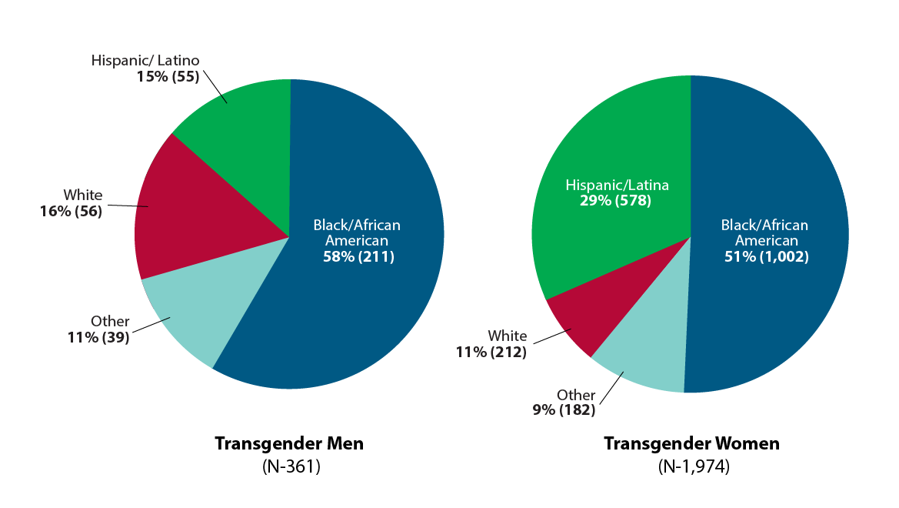
HIV in
Gender Minority Populations
Estimated 1 million transgender adults
(2009- 2014) 2,351 transgender people diagnosed with HIV
84% (1,974) transgender women
15% (361) transgender men
<1% (16) another gender identity
Around half lived in the South
Transgender women over represented in HIV diagnoses
22% transgender women in US live with HIV
3 x > national average
Clark H, Babu AS, Wiewel EW, Opoku J, Crepaz N. Diagnosesd HIV infection in transgender adults and adolescents: Results from the National HIV Surveillance System, 2009-2014. December 2016.
Notes:
Estimated 1 million transgender adult
(2009- 2014) 2,351 transgender people diagnosed with HIV
84% (1,974) transgender women
15% (361) transgender men
<1% (16) another gender identity
• Around half of transgender people (43% [844] of transgender women; 54% [193] of transgender men) who received an HIV diagnosis from 2009 to 2014 lived in the South.^{c}
• A 2013 report found that the estimated percentage of transgender women living with HIV in the United States was 22% among 2,705 transgender women sampled.
• Among the 3.3 million HIV testing events^{d} reported to CDC in 2013, the percentage of transgender people who received a new HIV diagnosis was more than 3 times the national average.
prevention issues.
ª According to Williams Institute scholars, this estimate likely does not represent the entire transgender population. National surveys in the future may observe higher numbers of transgender people.
^{b}These data may underreport HIV diagnoses among transgender people because of challenges in accurately identifying and reporting gender identity in HIV surveillance.
^{c} Includes Alabama, Arkansas, Delaware, District of Columbia, Florida, Georgia, Kentucky, Louisiana, Maryland, Mississippi, North Carolina, Oklahoma, South Carolina, Tennessee, Texas, Virginia, and West Virginia.
^{d} An HIV testing event is one or more HIV tests performed with a person to determine that person’s HIV status. During one testing event, a person may be tested once or multiple times.
For more information, visit CDC’s Lesbian, Gay, Bisexual, and Transgender Health website.

Slide 103
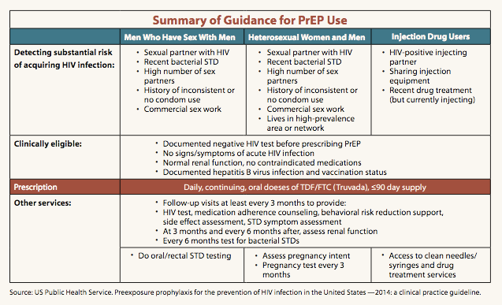

Health Care Maintenance for MTFs
HIV
Prevention
Notes:
During subsequent visits, providers should enquire about body changes, breast development, and mood. One should discuss the social impact of transitioning and understand the patient’s perspective on body changes. It is quite common for patient to be frustrated about the length of time required to transition, be disappointed in breast size, and feel shame in their ability to “pass” as female. Although most breast development occurs in the first 1–2 years of hormonal therapy, 4–6 years may be required for full maturation. Specific techniques for measuring and quantifying breast development are described elsewhere for those interested.
Usual health-care maintenance is also a critical part of subsequent visits. This includes: minimizing coronary artery disease risk factors, reinforcing safer sexual practices, and performing sexually transmitted disease screening when appropriate.
Mammography is generally recommended after 10 years of hormonal therapy for women older than 40, although there is no data to support or refute this practice. Given the controversial nature of prostate specific antigen (PSA) screening for men with normal testosterone levels (35), PSA screening is probably not indicated for MTF women whose testosterone levels are suppressed.

Slide 104

Case 4 Patient “C”
C is a 21 yro asserted male new to your practice
  Self-injects testosterone from the Internet for two years
  Has just relocated to start a new job
  Wants to establish his identity as male at work
Notes:
Let’s move onto a slightly older patient well into his transition.
For female-to-male patients, testosterone administration is indicated. In female-to-male patients, ideal treatment would start early enough to bypass the development of female secondary sexual characteristics, however the guidelines recommend starting GnRHa’s at Tanner stage 2 or 3. Some natal females may have started menses, and most will have started breast tissue development. The use of GnRHa’s may lead to the regression of the early stages of puberty, but large scale studies are still needed to make definitive statements about this aspect of treatment.

Slide 105
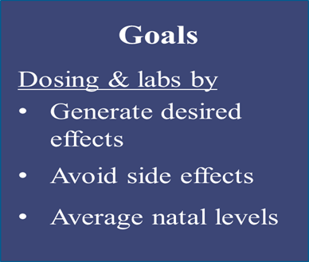
Testosterone Masculinization
 | Injection |  | Transdermal gel | Transdermal patch
Agent | Testosterone cypionate | Testosterone enanthate | Testosterone crystals dissolved in gel
Brand name | Depo-Testosterone® | Delatestryl® | AndroGel® | Androderm®
Pre-oophorec tomy | 40-100 mg SQ every week previously 100-200 mg IM every 2 weeks |  | 5-10 g daily Start 2.5 grams if comorbid conditions could be worsened by testosterone
Maintenace after 2 years | Reduce to level needed to keep serum free testosterone within lower-middle end male reference interval; Monitor risk of osteoporosis
https://ceitraining.org/
Notes:
Source: https://ceitraining.org/

Slide 106
Masculinizing Hormones
Other forms
Transdermals
  Compounded formulations 50-150 mg/ml
  Androderm 2.5–10 mg daily
  Androgel 2.5–5 mg packets with dosing 50–200 mg daily
Testopel
  75mg/pellet with 6-12 pellets subcutaneous buttock insertion every 3-4 months
  150 mg or 2 pellets for every 25mg T SQ weekly)
Topical testosterone to clitoris will not increase size
Progestins may be used short term to stop menses
Notes:
106
Most androgen action is transmitted via androgen receptors, so effect is limited by number of receptors.
Some patients experience skin reactions to the adhesive in Androderm® (transdermal patch). Compounding pharmacies may be able to provide testosterone cypionate in sesame oil.
Androderm® , AndroGel® 1%/Testim® if slower progress is desired, ongoing maintenance after desired virilization has been accomplished via IM.
Patients who develop polycythemia may respond well to transdermal gel preparations.
Slide adapted from: Olson J. Hormonal Therapy for Transgender Youth. Society for Adolescent Health and Medicine presentation, April 7, 2010. Toronto, ON.

Slide 107
Predicting Effects of Masculinizing Hormones
Action | Onset | Max
Male pattern facial/body hair Acne Voice deepening | 6–12 mo 1–6 mo 1–3 mo | 4–5 yrs 1–2 yrs 1–2 yrs
Clitoromegaly Vaginal atrophy Amenorrhea Emotional changes/ ↑ libido | 3–6 mo 2–6 mo 2–6 mo | 1–2 yrs 1–2 yrs
Increased muscle mass Fat distribution Tendon weakening | 6–12 mo 1–6 mo | 2–5 yrs 2–5 yrs
Notes:
107
Expected effects of testosterone therapy include cessation of menses, usually within the first month of therapy, deepening of voice, increased facial and body hair growth, increased clitoral size, increased libido, and enhanced ability to maintain and increase muscle mass. Testosterone will not decrease breast size.
After masculinization has occurred, the testosterone dose can often be decreased for maintenance. If a patient has undergone hysterectomy with oophorectomy, the testosterone dose can often be decreased to 100–150 mg IM every 2 weeks. Serum estradiol levels and luteinizing hormone (LH) levels can document suppression of the hypothalamic–pituitary axis, but these are expensive and not routinely used by primary care physicians caring for FTM patients.
Source: Oriel K., Journal of the Gay and Lesbian Medical Association 2000;4:185–194.

Slide 108
Risks of Masculinizing Hormones
Studies over time indicate that hormones have minimal clinically
significant physiologic affects & suggest we can do less labs
Common, mild
Initial mood changes, resolve by 3-4 months
Initial weight gain, restabilize after 3-4 months
Acne
Increase in Hgb, Hct
Over time
Male pattern baldness
Pelvic pain
Not clinically significant
  TG ↑ HDL ↓ LDL ↑
  Insulin resistance
  Increased homocysteine
  Polycythemia
Notes:
108
Health risks to testosterone therapy include hepatotoxicity, insulin resistance, weight gain, and a deleterious effects on lipid profiles by decreasing high-density lipoproteins (HDL), increasing triglycerides, and increasing homocysteine levels. The erythropoietic effects of testosterone may cause polycythemia in those already at risk with serious respiratory illness. There is a theoretical risk of breast cancer and endometrial cancer (testosterone is aromatized to estrogen), so patients who have not undergone mastectomy should be taught self breast exams, and abnormal uterine bleeding should be pursued to rule out hyperplasia or carcinoma. Some sources report that exogenous androgens may cause polycystic ovarian syndrome, whereas others argue that polycystic ovarian syndrome is present prior to androgen therapy in a disproportionate number of FTM transsexual patients.
Source: Oriel K., Journal of the Gay and Lesbian Medical Association 2000;4:185–194.

Slide 109
Management of Side
Effects of
Masculinizing Hormones
Finasteride to treat pattern baldness
Estrogen vaginal cream for atrophy
  “Always time for lube!”
  Premarin vs estradiol, cost & coverage issue
Retinoids, benzoyl peroxide, doxycycline for acne
Creating amenorrhea
  Usually occurs over time & appropriate dosing of testosterone
  LNG IUD, Etonorgestrel implant
  DMPA
  Continous COCs
  If menses continue OR if needs additional contraception
Notes:
109

Slide 110
Initial Lab Testing for
Masculinizing Hormone Therapy
No single protocol when administering hormone therapy to transgender patients
Labs common prior to starting testosterone hormone therapy
  AST
  Hb/Hct
  Cholesterol panel
Labs for patients already using hormones
  Testosterone
  LC-MS/MS (liquid chromatography–tandem mass spectrometry) most accurate for comparing measures over time

Slide 111
Lab Follow-Up for
Masculinizing Hormone Therapy
? How often
  Used to be Q 3 months
  Yearly
  Test according to need
Testosterone 400-1000 ng/dL
  Goal “average male levels”
  Reassure patient
  Allows titration to goals, side effects
  How useful vs expensive
  ? Need for Estradiol < 100 ng/dl
Hb/Hct
Ast
Cholesterol
Goals
Dosing & labs by
Generate desired effects
Avoid side effects
Average natal levels
Notes:
There is not a common protocol that all providers use when administering hormone therapy to transgender patients.
Laboratory follow-up should include a liver function testing, and potassium levels at three and six months and yearly thereafter. Prolactin levels may be drawn after six months of therapy, then yearly for three years. Lipid profiles should be followed regularly, especially for those with elevated or borderline values. Serum testosterone levels within the normal female range help document adequate hypothalamic–pituitary suppression, but are expensive. They can be especially helpful when making decisions about whether to increase estrogen doses. Some check estrogen as well if expected results are not seen, or if there is potential for the patient to be over- or under-dosing. The goal level for is 200 pg/mL.
111

Slide 112
Case 4 Patient “C”
Reports currently sexually active
Reports had chest reconstruction surgery two years ago
  He is considering a hysterectomy & oophorectomy in the next year or two
  How might you support your patient in obtaining these surgical procedures?
Notes:
(removal of breast tissue with nipple grafting)

Slide 113
STI Screening
All trans patients
Assess STI- and HIV-related risks based on current anatomy and sexual behaviors
  Diversity of transgender persons regarding surgical affirming procedures, hormone use, and their patterns of sexual behavior
  Providers must remain aware of common STI sx and screen for STIs on basis of behavior and sexual practices
Notes:
New this year is the section addressing STD screening in transgender men and women.
CDC recommends that Clinicians assess STD- and HIV-related risks for their transgender patients based on current anatomy and sexual behaviors. Because of the diversity of transgender persons regarding surgical affirming procedures, hormone use, and their patterns of sexual behavior, providers should routinely ask about common STD symptoms and routinely screen for asymptomatic STDs on the basis of behavioral history and sexual practices. Clinicians should also be aware that HIV prevalence among transgender women, especially black transgender women, is very high.

Slide 114
Case 4 Patient “C”
During your sexual history-taking, C reports
  He is in relationship with a cisgender male & identifies as a gay man having receptive sex in both genital openings (anal/vaginal)
  Last STI screening—three years ago when C had parents’ insurance
  C has never had cervical screening and expresses anxiety over having “a Pap”
How can you help? Does he need a pelvic exam?
What about cervical screening? STI testing?

Slide 115
Asserted Males &
Cervical Cancer Screening
According to cis guidelines at present
  ASCCP > age 21
  Exposure to HPV necessary for cervical cancer
  What if NEVER EVER sexually active?
New technologies
  Fenway self swab study
  Urine HPV DNA testing
  Other?
Post hysterectomy
  No history of abnormal pap, no future paps

Slide 116
Contraception
Transmasculine patients may have some pregnancy risk
  Testosterone not fail-safe contraceptive
  May continue to ovulate while on testosterone
  Testosterone may adversely affect development of fetus
  Consider Nexplanon, progesterone IUD, DMPA, other
  Avoid assumption—do Family Planning
  Do you want to be pregnant or have genetic children?

Slide 117
Reproductive Counseling
3 things that sound at odds, but are all true!
With sperm egg sex, need contraception!
Testosterone may impair future fertility
  Does not mean cannot parent, as many ways to be a dad
  Offer fertility preservation
Some trans men get pregnant after testosterone
  50% unplanned pregnancy on testosterone
  50% planned pregnancy coming off testosterone < 1 year
Light AD, Obedin-Maliver J, Sevelius JM, Kerns JL. Transgender men who experienced pregnancy after female-to-male gender transitioning. Obstet Gynecol. 2014;124(6):1120–7.

Slide 118
Gender Confirmation Surgeries for Transmasculine Individuals
Male chest construction
  Different technique than mastectomy or implants
Hysteroopherectomy w salpingectomy
Phalloplasty/metoidioplasty
  No function without pump
  Rarely covered by health insurance
  Performed by specialized surgeons
Notes:
Gender reassignment surgery includes a host of surgeries that can create a more masculine or feminine appearance and include vaginoplasty, labioplasty, tracheal shave, liposuction, breast implants, jaw shaping and orchiectomy for male-to-female patients. For female-to-male patients it includes mastectomy, construction of neoscrotum, metoidioplasty, or phalloplasty. Female-to-male patients also may choose hysterectomy and oophorectomy as well, especially with a family history of cancer.

Slide 119
Health Care Maintenance for FTMs
Breast cancer screening
  Instructions in self breast exam
  Mammography if breasts accord to cis guidelines
Pap cancer screening
  Note FTM on testosterone
  Atrophy looks like dysplasia
? Dexa scans
  Testosterone > 5 yrs
  Age > 50
Emotional well-being
STI testing
  Consider, don’t assume
  ? HIV
Family planning
  Contraception, fertility
Notes:
119

Slide 120
What Health Care Providers Can Do…
Infrastructure | Make office, clinic, wait areas gender neutral
Training | Work with clinic staff to create trans-friendly environment Zero tolerance policies
Screen | All patients, at various points of development and age All children with mood, behavior, and school problems
Identify | Become comfortable; take a more detailed gender history
Offer primary care | Promote open disclosure and acceptance
Offer referrals & resources | Offer gender care and/or referral to gender experts
Advocacy | Promote diversity in your professional and personal communities
Notes:
What can health care providers do to support patients across the gender spectrum?

Slide 121



Trans Supportive Culture

Slide 122
Transgender Youth Take-Home Points
Screening for gender issues, like sexual health concerns, important throughout life span
Medical management of treatment, including hormones, safer than self-prescribing
Mental health and support is important
STI and other health care maintenance continue
Recognize vocational, financial, and social discrimination

Slide 123
Resources on Transgender Health Care
World Professional Association for Transgender Health www.wpath.org
Vancouver Coastal Health Guidelines for Transgender Care transhealth.vch.ca
The Fenway Guide to LGBT Health, American College of Physicians www.amazon.com/Fenway-Lesbian-Bisexual-Transgender-Health/dp/193051395X
Center of Excellence for Transgender Health http://transhealth.ucsf.edu/
Transgender Law Center Health Care Issues www.transgenderlawcenter.org/issues/health

Slide 124
Provider Resources—Transgender Health
National Center for Transgender Equality www.transequality.org
cdc.gov/lgbthealth/transgender.htm
transbodies.com
Freeing Ourselves A Guide to Health & Self Love for Brown Bois: www.brownboiproject.org

Slide 125
Trainings on Transgender Health
Physicians for Reproductive Health Adolescent Reproductive and Sexual Health Education Program: prh.org/teen-reproductive-health/arshep-explained/
Massachusetts Transgender Political Coalition: www.masstpc.org/projects/trainings.shtml
The National LGBT Health Education Center: www.lgbthealtheducation.org
Center of Excellence for Transgender Health: www.transhealth.ucsf.edu
Callen-Lorde Community Health Center: www.callen-lorde.org/transgender-health-training

Slide 126
Resources: Changing Name and Gender
Massachusetts Transgender Political Coalition: www.masstpc.org/publications
The Name Change Project from the Transgender Legal Defense and Education Fund: www.transgenderlegal.org/work_show.php?id=7
Transgender Law Center: www.transgenderlawcenter.org
Health Care Rights and Transgender People: www.transequality.org/Resources/HealthCareRight_UpdatedAug2012_FINAL.pdf

Slide 127
Insurance and Billing Information
Medicare Benefits and Transgender People: www.transequality.org/Resources/MedicareBenefitsAndTransPeople_Aug2011_FINAL.pdf
Human Rights Campaign: Finding Insurance for Transgender-Related Healthcare (list of links to the carriers’ websites where major guidelines for transgender-related treatments are openly available): www.hrc.org/resources/entry/finding-insurance-for-transgender-related-healthcare
Department of Veteran’s Affairs Directive: Providing Health Care for Transgender and Intersex Veterans: transequality.org/PDFs/VHA_Trans_Health.pdf

Slide 128
Questions?
128

Slide 129


Slide 130
Thank You!
130

