Slide 1
Caring for Pregnant and Parenting Adolescents

Slide 2
Objectives
Provide patients with accurate and nonjudgmental information about teen parenting
Counsel adolescent patients who desire pregnancy
Describe models for providing primary care to parenting teens and their children
Notes:
By the end of this presentation, participants will be able to:

Slide 3
Case: Kim
Kim, a 16-year-old female, saw a colleague in your office last week.
After disclosing unprotected sex in the past month, she was given a pregnancy test, which was positive.
How common is teen pregnancy?
®

Slide 4
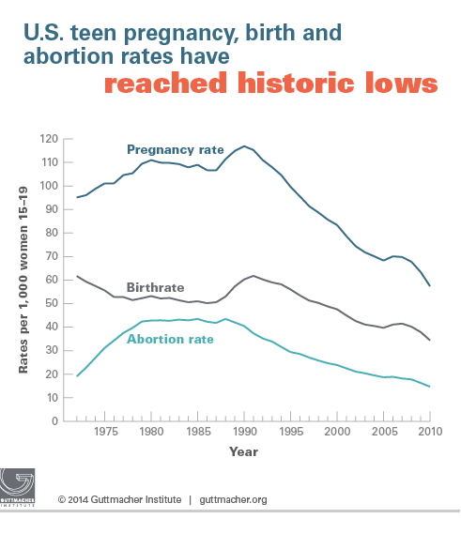
Teen Pregnancy, Birth, and Abortion Rates Are Declining (15-19 year olds)
Kost K and Henshaw S, U.S. Teenage Pregnancies, Births and Abortions, 2010: National and State Trends by Age, Race and Ethnicity. Guttmacher Institute 2014.
Notes:
https://guttmacher.org/media/nr/2014/05/05/index.html
http://www.guttmacher.org/pubs/USTPtrends10.pdf
Overall pregnancy, birth and abortion rates for 15–19 year olds are declining
In 2010, some 614,000 pregnancies occurred among teenage women aged 15–19, for a rate of 57.4 pregnancies per 1,000 women that age. This marks a 51% decline from the 1990 peak, and a 15% decline in just two years, from 67.8 in 2008
While there was a substantial drop in the pregnancy rate for 15–17-year-olds and 18–19-year-olds between 2008 and 2010, pregnancies among 18–19-year-olds constituted the majority (69%) of teen pregnancies. During this same time period, increasing proportions of 18–19-year-olds reported having ever had sex, yet fewer of them became pregnant. The likely reason is improved contraceptive use and use of more effective methods.
The study also found dramatic declines in teen pregnancy rates among all racial and ethnic groups.
However, wide disparities persist, and rates among both black and Hispanic teens remain twice as high as the rate for non-Hispanic white teens.
Teen pregnancy rates declined in all 50 states between 2008 and 2010. Yet even with ongoing declines, substantial disparities remain between states. In 2010, New Mexico had the highest teenage pregnancy rate (80 per 1,000), followed by Mississippi (76), Texas (73), Arkansas (73), Louisiana (69) and Oklahoma (69). The lowest rates were in New Hampshire (28 per 1,000), Vermont (32), Minnesota (36), Massachusetts (37) and Maine (37). The authors suggest that the demographic characteristics of states’ populations, the availability of comprehensive sex education, knowledge about and availability of contraceptive services and cultural attitudes toward sexual behavior and early childbearing likely play a role in these variations.

Slide 5
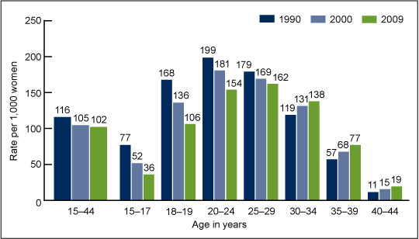
Pregnancy Rates Highest for Women in 20s
CDC/NCHS, NSFG, Guttmacher
Notes:
Sources:
CDC/NCHS, National Vital Statistics System and National Survey of Family Growth; CDC, Abortion Surveillance System; and Guttmacher Institute.
http://www.cdc.gov/nchs/data/databriefs/db136.htm
Pregnancy rates were highest for women in their 20s.
The overall number and rate of pregnancy were highest for women aged 25–29 in 2009, followed by women aged 20–24 (Figure 1 and Table). This is a change from 1990 and 2000, when rates for women aged 20–24 were the highest of all groups (2).
Pregnancy rates in 2009 for older teenagers aged 18–19 (106 per 1,000) were nearly three times the rates for younger teenagers aged 15–17 (36 per 1,000).
Pregnancy rates for women under age 30 declined consistently across all three time points, whereas rates for women aged 30 and over increased consistently.
The largest declines in the pregnancy rates from 1990 to 2009 among women aged 15–44 were for teenagers aged 15–17 (down 53%) and 18–19 (down 37%).

Slide 6
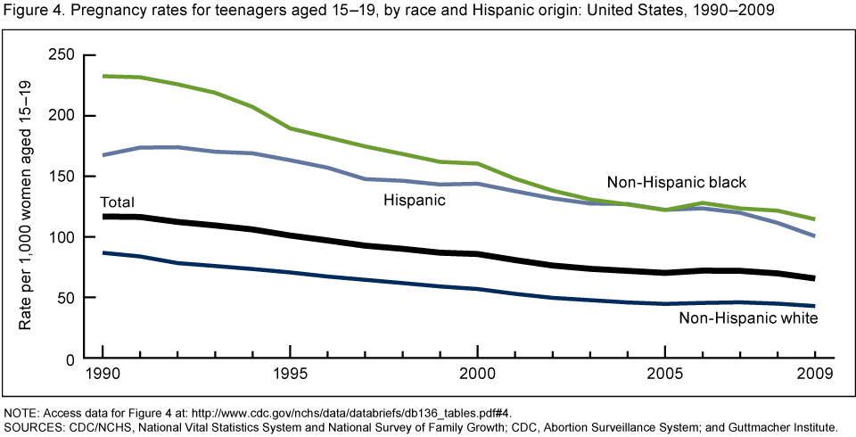
Disparities in Teen Pregnancy Rates Persist
Notes:
Sources:
CDC/NCHS, National Vital Statistics System and National Survey of Family Growth; CDC, Abortion Surveillance System; and Guttmacher Institute. Number 136, December 2013
Rates for teenagers reached historic lows in 2009, including rates for the three major race and Hispanic origin groups.
Teen pregnancy rates continued to fall and reached record lows in 2009 for the three major race and Hispanic origin groups.
From 1990 to 2009, rates fell 51% for non-Hispanic white and non-Hispanic black teenagers and 40% for Hispanic teenagers (Figure 4).
Non-Hispanic black and Hispanic teen pregnancy rates were at least twice those of non-Hispanic white teenagers during the entire period.
The non-Hispanic black teen pregnancy rate was 39% higher than the Hispanic teen rate in 1990 (232.7 compared with 167.4). The difference disappeared by the mid-2000s, and then reappeared in 2006.

Slide 7
Prevention Messages
Use of shame and stigma to discourage sexual activity and teen parenthood
No evidence to support efficacy of this approach
Diminishes young parents’ perception of their ability to thrive
Weakens advocacy efforts to support young parents and their children
Notes:
Image taken from http://www.reproductivejusticeblog.org/2014/04/noteenshame-schools-candies-foundation.html
Teen pregnancy happens—that much is clear. How effective are our public health messages and campaigns, and how do they affect how others see teen parents and how they see themselves?
Unfortunately, shame and fear are often used in pregnancy prevention campaigns and programs, despite the lack of evidence that such tools work. Analysts of these strategies in abstinence-only-until-marriage programs concluded such programs did not delay sexual initiation, or decrease unintended pregnancy or sexually transmitted infections among youth. Yet many teen pregnancy prevention programs continue to stigmatize young parents in an attempt to discourage adolescent sexual behavior.
Additionally, stigmatizing teen parents ignores a complex picture of why some adolescents may not postpone childbearing or at least not make delayed childbearing a priority. Research shows young people’s perceptions of opportunities and their own ability to achieve can play a role in their actions regarding early parenthood. Teens who believe that a lack of opportunity at the individual, family, or community level prevents them from investing in future goals like education have less incentive to delay early childbearing, and by extension to avoid behaviors that put them at risk for parenthood.
Finally, enabling the stigma around teen parenting does nothing to create support for programs or campaigns that might help young parents and their children.
Sources:
Impacts of Four Title V, Section 510 Abstinence Education Programs. Princeton, NJ: Mathematica Policy Research; 2007. 59–61.
Driscoll AK, Sugland BW, Manlove J, Papillo AR. Community opportunity, perceptions of opportunity, and the odds of an adolescent birth. Youth & Society. 2005;37(1):33–61.

Slide 8
NYC Teen Pregnancy Prevention Campaign: Effective or Stigmatizing?
NYC DOH Campaign Posters
Notes:
Talking Point: Under the Bloomberg administration, the NYC HRA campaign launched a teen pregnancy prevention campaign in March 2013, which consisted of 6 print advertisements (4 shown above). The original campaign website is now gone.
What’s harmful or shaming about this language and rhetoric? Does this campaign empower teen parents?
What would a successful campaign about pregnancy prevention look like? Perhaps increased access to information on family planning services and confidentiality for adolescents?

Slide 9
Addressing Root Causes
What kinds of prevention strategies do not marginalize teen parents?
Increased access to reproductive health care and health information
Increased access to higher education and employment
Notes:
Polices that increase access to reproductive health care and health information:
Comprehensive sexuality education
Public funding for reproductive health care
Title X
Medicaid
Increased access to contraceptives
Policies that increase access to higher education and employment:
Loan forgiveness
Affirmative action
Fair wages
Child care for students
Source:
Fuentes L, Bayetti Flores V, Gonzles-Rojas J; National Latina Institute for Reproductive Health. Removing Stigma: Towards a Complete Understanding of Young Latinas’ Sexual Health. New York: National Latina Institute for Reproductive Health; 2010.

Slide 10
Case: Kim
You ask Kim how she feels about the pregnancy. Does she have an idea of what she wants to do next?
You reaffirm confidentiality
You provide options counseling
You explore support and safety

Slide 11
Case: Kim
Kim has decided to continue the pregnancy and wants to discuss her options.
How many teens choose to continue their pregnancies?
®
Notes:
In 2006, there were 742,990 pregnancies among women 15–19 in the U.S. 435,436 of these pregnancies ended in births; 200,420 ended in abortion; 107,130 is the estimated number of miscarriages.
Source:
Kost K, Henshaw S, Carlin L; Guttmacher Institute. U.S. Teenage Pregnancies, Births, and Abortions: National and State Trends and Trends by Race and Ethnicity, 2010. http://www.guttmacher.org/pubs/USTPtrends.pdf. Accessed September 21, 2010.

Slide 12
What Do Teens Decide?
6% of teens aged 15-19 become pregnant. Of this group, outcomes are:
Births (59.8%)
Abortion (25.6%)
Miscarriage (14.5%)
Kost K, et al; Guttmacher Institute. 2010
Notes:
Talking point: The majority of teen pregnancies end in birth.
When we say “teen” we are referring to 15–19 year olds unless otherwise specified.
6% of teenagers aged 15–19 become pregnant. Of this group, the above percentages have been computed.
When faced with a pregnancy, an adolescent has three options:
(1) Carrying her pregnancy to delivery and raising the baby.
(2) Carrying her pregnancy to delivery and planning an adoption.
(3) Terminating her pregnancy.
In 2010, the pregnancy rate among 15–19 year olds was 57.4, abortion rate 14.7, 34.4 birth rate.
Source:
Kost K, Henshaw S, Carlin L; Guttmacher Institute. U.S. Teenage Pregnancies, Births, and Abortions: National and State Trends and Trends by Race and Ethnicity, 2010. http://www.guttmacher.org/pubs/USTPtrends.pdf. Accessed September 21, 2010.

Slide 13
Birth Rates, Females Aged 15-19, U.S. 1991-2013
National Vital Statistics System. July 2014.
Notes:
http://www.cdc.gov/mmwr/preview/mmwrhtml/mm6328a6.htm Weekly July 18, 2014 / 63(28);609
Talking point: The 2013 preliminary birth rate for teenagers was 26.6 births per 1,000 women aged 15–19, down 10% from 2012 (29.4) and another historic low for the nation (Source: http://www.cdc.gov/nchs/data/nvsr/nvsr63/nvsr63_02.pdf). Although data for the same time period are not yet available for abortions (and therefore pregnancies), these numbers suggest that teen pregnancy rates may very well have continued their long-term declines as well. Teen birth rate for teens in the US dropped from 41.5 to 34.3 in 2010, down to 29.4 in 2012 and 26.6 in 2013. Why? Improved use of more effective methods of contraception.
This graph shows the teen birth rates according to race and Hispanic ethnicity for females, aged 15–19-years-old from 1991 through 2013.
The highest rates are for Hispanic and non-Hispanic blacks.
Rates for all races are also at historic lows.
Lowest rates of teen births are among Asian/Pacific Islanders. What could explain that? Cultural factors?
* Persons categorized as American Indian/Alaska Native or Asian/Pacific Islander also might be Hispanic. Data for 1991 and 1992 for the categories non-Hispanic black, non-Hispanic white, and Hispanic exclude data from New Hampshire, which did not report Hispanic ethnicity.
The overall birth rate for females aged 15–19 years in the United States declined from 61.8 births per 1,000 in 1991 to 26.6 in 2013, a historic low. By racial/ethnic population, rates also declined to historic lows in 2013. Among non-Hispanic black females, the rate declined from 118.2 per 1,000 to 39.2; among Hispanic females, the rate declined from 104.6 to 41.9. Other declines were as follows: American Indians/Alaska Natives, from 84.1 to 31.2; non-Hispanic whites, from 43.4 to 18.7; and Asians/Pacific Islanders, from 27.3 to 8.8.

Slide 14
Pregnancy Options Counseling
Professional and ethical responsibility
Offer unbiased counseling regarding any of the possible options for her pregnancy
If you cannot provide comprehensive, medically accurate counseling, you must refer her to someone who can
Notes:
Some adolescents will desire to continue an unintended pregnancy, and some adolescent pregnancy is intended and planned. While this may not always seem in the best interest of the patient, it is essential for providers to put personal feelings aside, provide unbiased counseling, and ultimately support the patient whatever decision she makes.

Slide 15
Provider Values Clarification
What are your feelings about teen parenthood?
What is the data on teen parenthood?
Can you respect a teenager’s autonomy in deciding whether to parent?
Can you identify biases in yourself that may affect your ability to counsel Kim?
Notes:
Take a moment to consider your own values, beliefs, understanding of teen parenthood, and how your experiences might shape your ability to counsel patients about this option.

Slide 16
Case: Kim
Kim tells you she wants to become a parent.
She is unsure of what to do next.
What do you advise for her?
®

Slide 17
Challenging Biases Against Teen Parenting
Are adolescents responsible enough to be good parents?
Can teen parents fulfill their life goals?
Why might teens plan or desire pregnancy?
Notes:
These are provider questions to think about before counseling pregnant adolescents. In order to provide unbiased counseling, it is essential to identify personal beliefs that may influence counseling and put them aside.

Slide 18
Reevaluating Risks of Teen Pregnancy and Parenting
Teen Pregnancy: Cause for Concern?
Unintended pregnancies can prove challenging regardless of age
Research indicates poor outcomes for teen parents and their children
Health of teen mothers and infants
Educational outcomes
Highlights complexity with multiple factors contributing to outcomes
Notes:
Teen pregnancy remains a concern for several reasons. Unintended pregnancy is a cause for concern, regardless of age. Unintended pregnancies create crises for women and their families. The challenges created by an unintended pregnancy are exacerbated for teens who have the least financial and social support to overcome them. When looking at the outcomes for teens and their children, it is essential to examine the context of these adolescents’ lives. How do poverty, barriers to education, and barriers to health care exacerbate the effects of unintended pregnancy for teens and their children?
Looking closely at the data, some poor outcomes seem to remain linked with early childbearing. Others seem to be more strongly influenced by socioeconomic status or access to health care or education.

Slide 19
Pregnancy Complications
Most prevalent in youngest adolescents
Roles of lack of education, limited access to prenatal care, absence of familial support?
Anemia, hypertension, poor weight gain
Increased postpartum depression
Increased intimate partner violence
Notes:
Data supports the view that compared to women in their twenties, younger mothers are at increased risk for medical complications of pregnancy, including postpartum depression and intimate partner violence. One study found that 50% of adolescent mothers experience moderate-to-severe depression during the first year postpartum. While these outcomes exist for all young mothers, they are greatest in women whose first birth was at or before age 15.
Factors like poverty, lack of access to education and prenatal care, can contribute to these poor outcomes.
Sources:
American Academy of Pediatrics Trends
Klein JD; American Academy of Pediatrics Committee on Adolescence. Adolescent pregnancy: current trends and issues. Pediatrics. 2005;116:281–286.

Slide 20
Outcomes for Teen Mothers
Less likely to
Receive adequate prenatal care
Graduate from high school
More likely to
Die in childbirth
Be poor as adults
Have symptoms of depression
Lack resources to foster their children’s development
®
Notes:
Many poor educational, financial, and health outcomes have been identified among teen mothers.
Source:
Felice ME, Feinstein RA, Fisher MM, et al. Adolescent pregnancy—current trends and issues: 1998 American Academy of Pediatrics Committee on Adolescence, 1998-1999. Pediatrics. 1999 February;103(2); 516–20.

Slide 21
Challenges for Teen Fathers
Poor academic performance
Higher school dropout rates
Limited financial resources
Decreased income capacity
Difficulties staying involved in children’s lives
®
Notes:
At the same time, a range of challenges have been identified for young fathers as well.
Sources:
Marsiglio W. Adolescent fathers in the United States: their initial living arrangements, marital experience, and educational outcomes. Fam Plann Perspect. 1987;19:240-251.
Hardy JB, Duggan AK. Teenage fathers and the fathers of infants of urban, teenage mothers. Am J Public Health. 1988;78:919–922.

Slide 22
Educational Achievement and Poverty
Unintended pregnancy can disrupt education
Poverty may be a stronger factor in educational disparities than early pregnancy
Low-income women have poor educational outcomes
Low-income teen mothers no different than counterparts who delay parenting until >20
Notes:
Emerging research highlights the role of poverty in young mothers’ educational achievement. While childbearing can disrupt education for any young women, it is women in the lowest income groups who are least likely to graduate high school. Additionally, barriers to higher education exist for all low income women, and some research indicates that when controlling for socioeconomic status and comparing teen mothers with those delaying parenthood until 20 or later, educational outcomes are similar.
A 2005 analysis of the National Educational Longitudinal Study examined the likelihood of early childbearing among young women of varying socioeconomic status. In their findings, authors point out that all women in the lowest socioeconomic quartiles have poor educational outcomes, regardless of the age of childbearing. While childbearing certainly creates challenges to completing education, it seems that poverty may play a stronger role.
Additionally, young people’s perceptions of opportunities and their own ability to achieve can play a role in their actions regarding early parenthood. Doing well in school and believing that one will be able to continue on to college are protective factors against early childbearing. In contrast, teens who believe that a lack of opportunity at the individual, family, or community level prevents them from investing in education have less incentive to delay early childbearing, and by extension to avoid behaviors that put them at risk for parenthood.
Sources:
Driscoll AK, Sugland BW, Manlove J, Papillo AR. Community opportunity, perceptions of opportunity, and the odds of an adolescent birth. Youth & Society. 2005;37(1):33–61.
Klein JD; American Academy of Pediatrics Committee on Adolescence. Adolescent pregnancy: current trends and issues. Pediatrics 2005;116:281–286.
Fuentes L, Bayetti Flores V, Gonzalez-Rojas J; National Latina Institute for Reproductive Health. Removing Stigma: Towards a Complete Understanding of Young Latinas’ Sexual Health. New York: National Latina Institute for Reproductive Health; 2010.

Slide 23
Infants Born to Young Teens
More than two times more likely
Low birth weight
Premature
Three times more likely to die in the first month of life
Notes:
In the birth outcomes for infants born to teens, a disparity exists between infants born to the youngest teens and those born to older teens. The outcomes above were present in infants born to young women 15 and younger. These young women may also be the least likely to receive prenatal care, which can lead to poor infant outcomes.
Source:
Felice ME, Feinstein RA, Fisher MM, et al. Adolescent pregnancy—current trends and issues: 1998 American Academy of Pediatrics Committee on Adolescence, 1998-1999. Pediatrics. 1999 February;103(2); 516–20.

Slide 24
Birth Outcomes for Infants Born to Youngest Teens
Women <15 years old have infants at greater risk for poor health
Age group accounts for ~1% of teen births
Receives less prenatal care than older teens or adults
Infants born to 16- to 19-year-olds have outcomes similar to births in women >20
Notes:
Much attention has been brought to the risk for poor health outcomes among infants born to teen mothers: low birth weight, risk for infant death, very preterm (less than 32 weeks’ gestation) birth. However, when we look at teen mothers by age, the picture becomes more complex. Of nearly 450,000 teen births in the U.S. in 2006, just 6,400 were to women under 15. Most (296,000) were to older teens—18 or 19 years old. These women have outcomes similar to their older counterparts. It is only the smallest group of young women, those 15 and under, whose infants consistently have poor health outcomes. This youngest group is also much less likely to receive adequate prenatal care, which if improved, could contribute to better infant outcomes.
Sources:
Fuentes L, Bayetti Flores V, Gonzalez-Rojas J; National Latina Institute for Reproductive Health. Removing Stigma: Towards a Complete Understanding of Young Latinas’ Sexual Health. New York: National Latina Institute for Reproductive Health; 2010.
Fraser AM, Brocker JE, Ward RH. Association of young maternal age with adverse reproductive outcomes. N Eng J Med. 1995;332:1113–1117.
Kost K, Henshaw S, Carlin L; Guttmacher Institute. U.S. Teenage Pregnancies, Births, and Abortions: National and State Trends and Trends by Race and Ethnicity, 2010. http://www.guttmacher.org/pubs/USTPtrends.pdf. Accessed September 21, 2010.
Phipps MG, Sowers M. Defining early adolescent childbearing. Am J Public Health. 2002;92:125–128.

Slide 25
Violence Affects Teen Mothers
Birth control sabotage/inability to negotiate contraceptive use with dating partner
Difficulty refusing sexual activity
Increased chance of repeat pregnancy within 2 years when physically abused within 3 months of delivery
Prenatal violence = risk factor, preterm birth
Futures Without Violence, February 2010
Notes:
Futures Without Violence, February 2010
Source:
http://www.futureswithoutviolence.org/userfiles/file/HealthCare/Adolescent%20Pregnancy%20Reproductive%20Risk%20FINAL%202-10.pdf
A 2005 study of 474 teen mothers on public assistance found that of the teens (55 percent of the total sample) experiencing intimate partner violence in the past year, two in three teen mothers also experience birth control sabotage at the hands of their dating partner.
• In a qualitative study of 53 sexually active young women age 15 to 20 with a history of intimate partner violence, one in four (26 percent) young women reported that their abusive male partners were actively trying to get them pregnant.
• Adolescent mothers who are in violent relationships may find it difficult to refuse sexual activity or to negotiate contraceptive use with an agitated partner. A study of more than 500 adolescent mothers from Texas found that those who experienced physical abuse within three months after delivery were nearly twice as likely to have a repeat pregnancy within 24 months.
• Pregnant teens who experience abuse are more likely to miscarry than their non abused peers.
• A 2000 study on the consequences of prenatal violence among adolescent and adult participants in a North Carolina county health department prenatal care coordination program of Medicaid-eligible program participants found that prenatal violence is a significant risk factor for preterm birth, especially among teens.
Sources:
Raphael J. 2005. Teens Having Babies: The Unexplored Role of Domestic Violence. The Prevention Researcher,
12(1):15–17.
Miller E, Decker MR, Reed E, Raj A, Hathaway JE, Silverman JG. 2007. Male Partner Pregnancy-Promoting
Behaviors and Adolescent Partner Violence: Findings from a Qualitative Study with Adolescent Females.
Ambulatory Pediatrics, 7(5):360–366.
Raneri LG, Wiemann CM. 2007. Social Ecological Predictors of Repeat Adolescent Pregnancy. Perspectives on
Sexual and Reproductive Health, 39(1):39–47.
Jacoby M, Gorenflo D, Black E, Wunderlich C, Eyler AE. 1999. Rapid Repeat Pregnancy and Experiences of
Interpersonal Violence Among Low-Income Adolescents. American Journal of Preventive Medicine, 16(4):318–
321.
Covington DL, Justason BJ, Wright LN. 2001. Severity, Manifestations, and Consequences of Violence Among
Pregnant Adolescents. Journal of Adolescent Health, 28:55–61.

Slide 26
Evaluating Outcomes
Identify challenges faced by a parenting adolescent
Identify opportunities and support available to young parents
Avoid assumptions about young parents’ abilities to reach personal goals
Evaluate each young parent’s individual circumstances

Slide 27
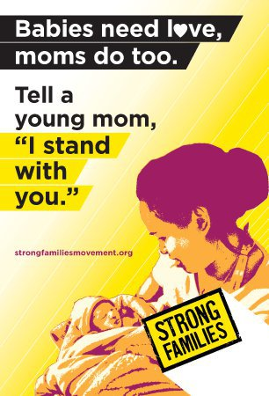
Teen Parents: Resilient and Vulnerable
Unplanned pregnancy, young motherhood, and young fatherhood are not universally negative experiences
Notes:
Slide adapted from presentation by teen mom and doctor, Rebecca Trotzky-Sirr, M.D. Family Medicine

Slide 28
Case: Kim
Kim tells you she is excited but also scared about what comes next.
How can you facilitate her referral to prenatal care?
What are the characteristics of successful teen parenting programs?
®

Slide 29
Clinician’s Role During and After Pregnancy
Respect adolescents’ decisions to parent
Provide or refer for
Prenatal care
Postpartum care
Peer support for young parents
Educational support
Employment assistance
Housing assistance

Slide 30
Research on Supporting Young Mothers
Research is limited on most effective ways to support pregnant/parenting teens
Existing studies are not randomized
Sample sizes are small
Data support multidisciplinary approach
Notes:
While the research is limited, the data that does exist on effective programs to improve the outcomes for teen parents support multidisciplinary approaches where primary care, reproductive health care, nutrition, mental health care, educational support, housing support, and assistance accessing public benefits are provided by a team in one location or institution.
Such programs have shown improved outcomes in
Reducing rapid repeat pregnancy
Improved prenatal care
Improved delivery weights
Improved substance use
Decreased stress/depression
Decreased child abuse/neglect
Increased contraceptive compliance
Continued parental education
Improved teen and infant health over the course of 6–18 months
Sources:
Akinbami LJ, Cheng T, Kornfeld D. A review of teen-tot programs: comprehensive clinical care for young parents and their children. Adolescence. 2001 Summer;36(142):381–393.
Cox JE, Buman M, Valenzuela J, Natalie JP, Mitchell A, Woods ER. Depression, parenting attributes, and social support among adolescent mothers attending a teen tot program. J Pediatr Adolesc Gynecol. 2008;21:275–281.
Klerman LV. Another Chance: Preventing Additional Births to Teen Mothers. Washington, DC: National Campaign to Prevent Teen Pregnancy and National Organization on Adolescent Pregnancy, Parenting, and Prevention; 2004.
Omar H, Fowler A, D’Angelo S. Improved continuation rate of depo-provera in teen mothers. J Adolesc Health. 2001;14(3):147.

Slide 31
Factors That May Improve Outcomes
Twenty-year study of teen mothers showed improved outcomes when
Participating in program for pregnant teens
Remaining in school
No subsequent pregnancies 26 months postpartum
Not isolated
Have sense of control
Have only 1 or 2 subsequent children
Notes:
Outcomes measured were
Finishing high school
Employment or support by spouse at time of follow up
Source:
Horowitz SM, Klerman LV, Kuo HS, Jekel JF. School-age mothers: predictors of long-term educational and economic outcomes. Pediatrics. 1991;87:862–868.

Slide 32
How Do Adolescent Fathers Fare?
Research is limited
Understudied and underserved population
Fewer teen fathers than teen mothers
Past attempts to involve teen fathers centered on child support
Few programs for young fathers
Notes:
50%–70% of teen pregnancies involve fathers >20 years old.
In the past, programs trying to involve teen fathers often started with a focus on collection of child support. Not only did this discourage young men from participating in programs, it also had the effect of limiting the pool of young fathers willing to participate in research.
Source:
Healthy Teen Network. Fast facts: Unique needs of teen fathers. http://www.healthyteennetwork.org/vertical/Sites/%7BB4D0CC76-CF78-4784-BA7C-5D0436F6040C%7D/uploads/%7B831934FA-3A1B-42BB-8ED4-425528E23D5E%7D.PDF. Accessed May 20, 2010.

Slide 33
Supporting Male Involvement
Recognize boys and young men as critical and valued members of society
Teen fathers are/want to be involved in child’s life, more than just financially
Young father’s parental role helps form healthy, enduring parent-child bond
Notes:
Healthy Teen Network
References:
Gavin, L., et al. (2002). Young, disadvantaged fathers’ involvement with their infants: An ecological perspective. Journal of Adolescent Health, 31, 266–276.
6 Allen, W. & Doherty, W. (1996). The responsibilities of fatherhood as perceived by African American Teenage Fathers. Families in Society

Slide 34
Risks for Children who Grow Up without Fathers
Poverty
Experiencing violence and/or abuse
Exhibiting aggressive behaviors
Involvement in juvenile/criminal justice systems
Behavior/achievement problems in school
Interpersonal relationship problems
Substance abuse
Teen pregnancy
Notes:
Source: Healthy Teen Network
Reference:
Ruiz, S. New Mexico young fathers project: involving young fathers in their children’s lives. NOAPPP Network, 23, 3 (2003)

Slide 35
Effectively Involving Males
Ensure medically accurate information
Assist young men in effectively communicating about their reproductive health, sexual limits, and desires
Help young men examine and break down negative stereotypes surrounding their reproductive health, sexual behaviors, and values
Notes:
Healthy Teen Network
Reference: Sanchez-Flores, H. Young male involvement in pregnancy prevention and parenting. NOAPPP Network, 23, 3 (2003)

Slide 36
Train Staff to Work with Young Fathers
Respect differences in communication styles
Recognize/respect different parenting styles
Realize the importance of young father involvement in the early years
Address barriers to young father involvement
Develop recruitment and retention strategies for working with young fathers
Notes:
Healthy Teen Network
Reference: Tift, N. Inviting young dads in. NOAPPP Network, 23, 3 (2003).

Slide 37
“The teenager who elects to continue to term deserves comprehensive, age-appropriate, multidisciplinary prenatal care.”
“Education programs optimally include [other] family members as well as fathers...”
“…one health care provider should provide continuity of care…as a member of a multidisciplinary team…”
“…teens who receive good prenatal care and support can have good obstetric outcomes and postpartum contraceptive compliance.”
Society for Adolescent Health and Medicine. Position Paper: Reproductive Health Care for Adolescents. 1991.
Notes:
Society for Adolescent Health and Medicine (SAHM) Position Paper on Reproductive Health Care for Adolescents (1991) includes a statement on Care of the Pregnant Teen
“The teenager who elects to continue to term deserves comprehensive, age-appropriate, multidisciplinary prenatal care.”
In general, teens who receive good prenatal care and support can have good obstetric outcomes and postpartum contraceptive compliance.
“Ideally, one health care provider should provide continuity of care throughout the pregnancy as a member of a multidisciplinary team which can include nutrition, education, job training, nursing, social work, medicine and obstetrics.”
“Education programs optimally include [other] family members as well as fathers of the babies and interventions are targeted with consideration of ethnic diversity.”
Source:
Society for Adolescent Health and Medicine. Position Paper: Reproductive Health Care for Adolescents. 1991.

Slide 38
Case: Kim
You refer Kim for full prenatal care
In the meantime, you offer some basic prenatal counseling
®

Slide 39
Clinician’s Role
When teens are pregnant and considering parenting, assess
Diet, pre-pregnancy BMI, lifestyle (smoking, substance use)
Sexually transmitted infections
Family and partner support
Intimate partner violence
Financial support, eligibility for public benefits
Notes:
While family support can be essential to young mothers, in most states adolescents do not need parental consent to receive prenatal care. All minors can receive confidential services at sites funded by federal title X.
http://www.guttmacher.org/statecenter/spibs/spib_MAPC.pdf

Slide 40
Nutrition for Pregnant Teens
Dieting, eating fast/convenience foods
Likely deficiencies in teens
Calcium
Iron
Zinc
Vitamins A, D, B6
Riboflavin
Folic acid
Notes:
Also note that poverty may complicate nutritional issues for pregnant teens. This is another reason to refer pregnant teens to programs like the Special Supplemental Nutrition Program for Women, Infants, and Children, better known as the WIC Program. WIC provides food assistance for mothers and children. It safeguards the health of low-income women, infants, and children up to age 5 who are at nutritional risk by providing nutritious foods to supplement diets, information on healthy eating, and referrals to health care.
Sources:
American Dietetic Association. Position of the American Dietetic Association: nutrition care for pregnant adolescents. J Am Diet Assn. 1994;94(4):449.
U.S. Department of Agriculture, Food and Nutrition Service. About WIC. http://www.commodityfood.usda.gov/wic/aboutwic/. Accessed July 30, 2010.

Slide 41
Nutritional Recommendations
Supplementation of iron, calcium, B6, C, folate
Weight gain
Recommend the same gain as older women
Higher end of the range is appropriate for teens
Gain early in pregnancy
Specific weight limits not established
Source: American Dietetic Association
Notes:
Source:
American Dietetic Association. Position of the American Dietetic Association: nutrition care for pregnant adolescents. J Am Diet Assn. 1994;94(4):449.

Slide 42
Family Support Is Key
Family support critical to positive long-term outcomes for young mothers
Providing child care
Supporting efforts to finish education
Family support of partner/relationship should be assessed
Notes:
Source:
Cooley ML, Unger DG. The role of family support in determining developmental outcomes in children of teen mothers. Child Psychiatry Hum Dev. 1991;21:217–234.

Slide 43
STI Screening Important in Pregnancy
Chlamydia
Gonorrhea
Pap Test
Bacterial Vaginosis
Screen
Routinely at prenatal visits
Repeat during third trimester for women <25 or at high risk
Screen
Women at increased risk
Women in high-prevalence areas
Perform
On women >20
When patient has not had a Pap in past year
Evaluate
Patients at high risk of preterm labor
Routine testing not recommended
Notes:
New ACOG Guidelines recommend beginning Pap testing at age 21. For most adolescents, a Pap will not be necessary. For older pregnant patients, Pap tests should be performed if the patient has not had a Pap in the previous year.
Sources:
Centers for Disease Control and Prevention. Sexually transmitted diseases treatment guidelines 2006. Special populations. Pregnant women.
http://www.cdc.gov/std/treatment/2006/specialpops.htm#specialpops1. Accessed on September 27, 2010.
ACOG practice bulletin 109: cervical cytology screening. Obstet Gynecol. 2009;114(6):1409–1420.

Slide 44
STI Screening, Continued
HIV
Syphilis
Hepatitis B
Hepatitis C
Screen
All pregnant women
As early as possible
Serology
At first prenatal visit
Repeat in third trimester and at delivery for high-risk patients
Screen
All pregnant women
Test for surface antigen at early prenatal visit
Repeat at delivery in high-risk patients
Screen
High-risk patients
Test for antibodies at first prenatal visit
Notes:
HIV, syphilis, and hepatitis B screenings are recommended for all pregnant women. Later testing may be necessary for women at high risk or who were not screened early in pregnancy. Hepatitis C screening is only necessary for high-risk patients.
Source:
Centers for Disease Control and Prevention. Sexually transmitted diseases treatment guidelines 2006. Special populations. Pregnant women.
http://www.cdc.gov/std/treatment/2006/specialpops.htm#specialpops1. Accessed on September 27, 2010.

Slide 45
Case: Kim
Kim asks if she can bring the baby to the clinic for care in the future.
Are there any models for caring for parenting teens and their children?
®

Slide 46
Practice Models for Teen Parent Support
Several practice models exist to care for pregnant and parenting teens
Group prenatal care
Teen-tot clinic
Fatherhood outreach programs
Which models are part of your practice?
What are the professional standards for care?

Slide 47
American Academy of Pediatrics Statement:
Caring for Teenage Parents and Their Children
Provide
Medical home for teen parents and their children
Address
Development of both infant and adolescent parent
Encourage
Continuation of healthful behaviors from pregnancy
Assess
Risk for domestic violence; adolescent parents are at greater risk
Include
Both parents/caregivers in patient education
Utilize
Community resources such as WIC
Emphasize
Importance of completing high school
Praise
Achievements and healthful behaviors
Notes:
AAP Statement on Caring for Teenage Parents and Their Children:
Provide a medical home for teenage parents and their children, and help them gain access to needed services
Address the development of both infant and the adolescent parent, particularly with anticipatory guidance, early childhood education, teaching of basic caregiving and breast-feeding skills, and contraceptive counseling
Encourage continuation of healthful behaviors; adolescent mothers often improve their nutrition and decrease substance abuse during pregnancy, only to return to their pre-pregnancy habits within six months of delivery
Routinely assess the risk of domestic violence—pregnant adolescents are at greater risk
Emphasize to the parent the importance of completing high school
When possible, include both parents in patient education that is appropriate for their development
Stress the importance of the adolescent parent caring for the child, even if other caregivers are involved
Utilize community resources such as the Special Supplementation Nutrition Program for Women, Infants, and Children (WIC)
Provide positive reinforcements to successes such as achieving educational goals, initiation or continuation of breast-feeding, and avoiding substance abuse
Source:
American Academy of Pediatrics Committee on Adolescence, Committee on Early Childhood, Adoption, and Dependent Care. Care of adolescent parents and their children. Pediatrics. 2001;107:429.

Slide 48
Group Prenatal Care
Compared to those in one-on-one care, young women in group prenatal care
Decreased preterm birth
Increased prenatal knowledge
Felt “more ready” for labor and delivery
Greater satisfaction with care
No differences in birth weight
No differences in cost of care
Notes:
Sources:
Ickovics JR, Kershaw TS, Westdahl C, Magriples U, Massey Z, Reynolds H, Rising SS. Group prenatal care and perinatal outcomes: a randomized controlled trial. Obstet Gynecol. 2007 Aug;110(2, pt 1):330–339.
Grady MA, Bloom KC. Pregnancy outcomes of adolescents enrolled in a centering pregnancy program. J Midwifery Womens Health. 2004;49:412–420.

Slide 49
Teen Group Prenatal Care in Practice
Group Prenatal Care Program, Barnes Jewish Hospital in St. Louis
Initial visits with certified nurse midwife (CNM), social worker, nutritionist
Groups of 8-12 with due dates within 6 weeks
12 sessions total, 2 facilitators
Teens follow up individually with a social worker once per month
Content on pregnancy, nutrition, breastfeeding, contraception, STIs, domestic violence
Notes:
This is just one example of group prenatal care for teens. This program used the centering pregnancy model that has been evaluated and shows improved birth weights and rates of preterm birth for teens and adult women. These groups were set up in the late afternoon/evening to allow teens to attend school, and Medicaid Health Plans provided transportation.
Source:
Grady MA, Bloom KC. Pregnancy outcomes of adolescents enrolled in a centering pregnancy program. J Midwifery Womens Health. 2004;49:412–420.

Slide 50
Teen-Tot Model
Teen-tot clinics provide a range of health services,
including but not limited to:
Adolescent services
Depression screening/ treatment
Contraceptive counseling
STI screening/treatment
Nutrition counseling
Child services
Well-baby care
Comprehensive pediatric care
Immunizations
Developmental assessments
Notes:
Often services are available for young people up to age 21.

Slide 51
Teen-Tot Model
Hotline for parenting questions
Partnership with schools to help meet educational goals
Parenting classes
Job training
Support groups
Home visits by nurse or social worker
Overall parenting support
Fathers support groups/program
Notes:
While teen-tot clinics differ from site to site, they offer a range of supportive services to teen parents including, but not limited to, those listed here.

Slide 52
Setting Up a Teen-Tot Clinic
Provider models
Single provider sees parent and child
Pediatric provider partners with adolescent specialist or OB/GYN
Possible sites
Freestanding clinic
Integrated within
Pediatric practice
School-based health center
Adolescent clinic
Family planning clinic

Slide 53
Case: Kim
Kim tells you her partner is supportive and wants to be involved in the pregnancy and the child’s life.
What services are available for young fathers?
®

Slide 54
Young Fathers’ Programs
Resources for young fathers vary
Support groups
One-on-one mentoring programs
Teen-tot clinics open to male and female patients
Community-based organizations

Slide 55
Research on Teen Fatherhood Programs
2008 review of 18 teen fatherhood programs
4 that had been “rigorously evaluated” demonstrated effectiveness
Identified 10 model practices for teen fatherhood programs
Notes:
Generally, few teen fatherhood programs have been evaluated, especially with large sample sizes, randomization, and participants who were maintained (not lost to follow up). In 2008, the U.S. Department of Health and Human Services published one study of 18 teen fatherhood programs and identified 4 programs they deemed “rigorously evaluated” that demonstrated effective programs.
Source:
Bronte-Tinkew J, Burhauser M, Metz, A; U.S. Department of Health and Human Services. Promising teen fatherhood programs: initial evidence-based lessons from evidence-based research. http://www.fatherhoodinstitute.org/uploads/publications/408.pdf. Published September 2008. Accessed June 25, 2010.

Slide 56
Promising Practices: Teen Fatherhood Programs
Partner with community organizations
Develop one-on-one relationships
Offer services beyond parenting information
Use logic model
Deliver services in engaging ways
Conduct needs assessments
Hire quality staff with connections to community
Appropriate for fathers’ ages and cultures
Incentives (child care)
Mentorship
Notes:
To date, few teen fatherhood programs have been evaluated and even fewer have undergone rigorous (i.e., experimental) evaluations. Fortunately, much can be learned from examining program practices across those existing teen fatherhood programs that have adhered to specific rigorous evaluation research criteria.
ChildTrends/HHS evaluated 18 teen fatherhood programs that they deemed rigorous in evaluation and found common features in effective programs. They identified the 10 “promising strategies” above by looking for commonalities in teen fatherhood programs they designated as “model” or “promising.”
From Bronte-Tinkew et al.’s Promising teen fatherhood programs: initial evidence-based lessons from evidence-based research:
“Model” fatherhood programs included in this review are defined as those that:
• Had been experimentally evaluated (randomized controlled trial study);
• Had been evaluated by an independent, external evaluator with publicly available evaluation results;
• Had a sample size for evaluation that exceeded 30 in both the treatment and control group;
• Retained at least 60% of the original sample for the evaluation;
• Had at least one outcome that was positively changed by 10% and;
• Had at least one outcome with a substantial effect size that was statistically significant at the 0.05 level.
“Promising” teen fatherhood programs included in this review:
• Used quasi-experimental design (comparison group);
• Had been evaluated by an independent, external evaluator with publicly available evaluation results;
• Had a sample size that exceeded 15 in both the treatment and control group;
• Retained at least 50% of the original sample for the evaluation;
• Had at least one outcome that was positively changed by 5% and;
• Had at least one outcome with a substantial effect size that was statistically significant at the 0.10 level.
Source:
Bronte-Tinkew J, Burhauser M, Metz, A; U.S. Department of Health and Human Services. Promising teen fatherhood programs: initial evidence-based lessons from evidence-based research. http://dcfs.co.la.ca.us/katieA/docs/PTFP.pdf. Published September 2008. Accessed June 25, 2010.

Slide 57
Reaching Patients with Teen Parent Support
Make the schedule/program accessible
Allow for after-school/weekend appointments
Set consistent hours
Setting a weekly time can allow a peer group to meet and support one another
Notes:
Whether offering group prenatal care, a teen-tot clinic, fatherhood programs, or other services to support teen parents, make sure those services are accessible and adolescent-friendly in their timing and structure.

Slide 58
Reaching Patients with Teen Parent Support
Reach out to gather referrals
Schools, youth centers, religious institutions
Maternity homes/schools
Local maternity wards
Programs for young mothers (e.g., WIC, Nurse Family Partnership)

Slide 59
Referring Patients for Teen Parent Support
Joint appointment for adolescent parent and baby
Remind adolescent mothers of programs/services available for partners
Notes:
To direct young parents to the services offered by your institution, educate staff and patients about what services are available.

Slide 60
Case: Kim
While there is no teen-tot clinic at your institution, you do refer Kim to group prenatal care.
Can Kim consent to prenatal care without a parent’s involvement?
As a minor, will she be able to consent for her child’s health care in the future?
®

Slide 61
Consent for Prenatal Care
13 states have no explicit policy on minors’ authority to consent
28 states and DC allow all minors to consent
14 states allow physicians to inform parents of minors seeking prenatal care (not required)
Notes:
Laws differ by state in regard to parental involvement and consent for an adolescent receiving prenatal care.
37 states and DC have a law regarding a minor’s ability to access prenatal care.
36 states and Washington, DC, explicitly allow some minors to consent to prenatal care.
AL, AK, AR, CA, CO, DE, FL, GA, HI, ID, IL, KS, KY, MD, MA, MI, MN, MS, MO, MT, NV, NH, NJ, NM, NY, NC, OK, OR, PA, SC, TN, TX, UT, VA, WA, WV
28 states and DC allow all minors to consent to prenatal care.
4 states require the minor to be a specific age before she can consent to prenatal care.
4 states allow a minor who is considered mature enough to understand the nature and consequences of the treatment to consent to prenatal care.
1 state requires parental consent during all but one prenatal visit during the second and third trimesters; the minor may consent to prenatal care during the first trimester and for the first visit after the first trimester.
14 of the 37 states above allow, but do not require, physicians to inform parents that their minor daughter is seeking or receiving prenatal care when they deem it in the best interests of the minor.
13 states have no explicit policy on minors’ authority to consent to prenatal care.
Source:
Guttmacher Institute. State policies in brief: minors’ access to prenatal care. http://www.guttmacher.org/statecenter/spibs/spib_MAPC.pdf.

Slide 62
Can Minors Consent to Their Children’s Care?
30 states and DC allow minors to consent for their children’s medical care
20 states have no explicit policy
Notes:
In the states where the law is silent, a health care provider can make the decision regarding whether to provide care for a minor’s children without of the minor’s parent.
Source:
Guttmacher Institute. State policies in brief: minors’ rights as parents. http://www.guttmacher.org/statecenter/spibs/spib_MRP.pdf. Published June 2010. Accessed June 24, 2010.

Slide 63
Case: Kim
Kim has the support of her mother and will live at home after the birth
What if Kim did not have family/partner support?
What public benefits are available?
®

Slide 64
Programs and Benefits
Women, Infants, and Children (WIC) programs
Nutrition and breastfeeding support
Medicaid/Child Health Plus
Community-based organizations
Parenting education
Support groups
Housing assistance/shelter
Counseling
Notes:
This is just a very brief list of the kinds of support available to pregnant and parenting adolescents. Know what local resources exist for adolescent parents in your area in order to make referrals for health care, nutrition, and housing, as well as for educational support, counseling, parenting education, etc.

Slide 65
Case: Kim
Kim plans to follow up with group prenatal care and attend a parenting class with her partner
®

Slide 66
Summary
Provide unbiased counseling
Support adolescents’ decisions
Consider practice models to support pregnant and parenting teens and their children
Know local resources for pregnant and parenting adolescents

Slide 67
Teen Parenting Resources
Teen Parent Support Programs
Milwaukee Adolescent Health Program www1.mcw.edu/mahp.htm
Children’s Hospital of Boston Young Parents Program (YPP) www.childrenshospital.org/centers-and-services/childrens-hospital-primary-care-center-chpcc-program/other-services/young-parents-program
National Children’s Medical Center Healthy Generations Program childrensnational.org/primary-care/wellness-resources/healthy-generations-program
Adolescent Pregnancy and Parenting Resources
Healthy Teen Network (formerly National Organization on Adolescent Pregnancy, Parenting, and Prevention-NOAPP) www.healthyteennetwork.org
www.thepushback.org (pushing back against stigma and stereotypes about young parenthood)

Slide 68
Teen Parenting Resources
www.girl-mom.com Community Advocacy and Support by and for Young Mothers
www.center-school.org/education/ppt/pptfather.htm Resource Guide of Best Practices for Pregnant and Parenting Teen Programs: Teen Father Services
www.fathersandfamilies.com Center for Fathers and Families
www.cffpp.org Center for Family Policy and Practice
www.acf.hhs.gov US Department of Health and Human Services, Administration of Children and Families
strongfamiliesmovement.org/young-parents

Slide 69
Provider Resources and Organizational Partners
www.advocatesforyouth.org—Advocates for Youth
www.aap.org—American Academy of Pediatricians
www.aclu.org/reproductive-freedom American Civil Liberties Union Reproductive Freedom Project
www.acog.org—American College of Obstetricians and Gynecologists
www.arhp.org—Association of Reproductive Health Professionals
www.cahl.org—Center for Adolescent Health and the Law
www.glma.org Gay and Lesbian Medical Association

Slide 70
Provider Resources and Organizational Partners
www.guttmacher.org—Guttmacher Institute
janefondacenter.emory.edu Jane Fonda Center at Emory University
www.msm.edu Morehouse School of Medicine
www.prochoiceny.org/projects-campaigns/torch.shtml NARAL Pro-Choice New York Teen Outreach Reproductive Challenge (TORCH)
www.naspag.org North American Society of Pediatric and Adolescent Gynecology
www.prh.org—Physicians for Reproductive Health

Slide 71
Provider Resources and Organizational Partners
www.siecus.org—Sexuality Information and Education Council of the United States
www.adolescenthealth.org—Society for Adolescent Health and Medicine
www.plannedparenthood.org Planned Parenthood Federation of America
www.reproductiveaccess.org Reproductive Health Access Project
www.spence-chapin.org Spence-Chapin Adoption Services

Slide 72
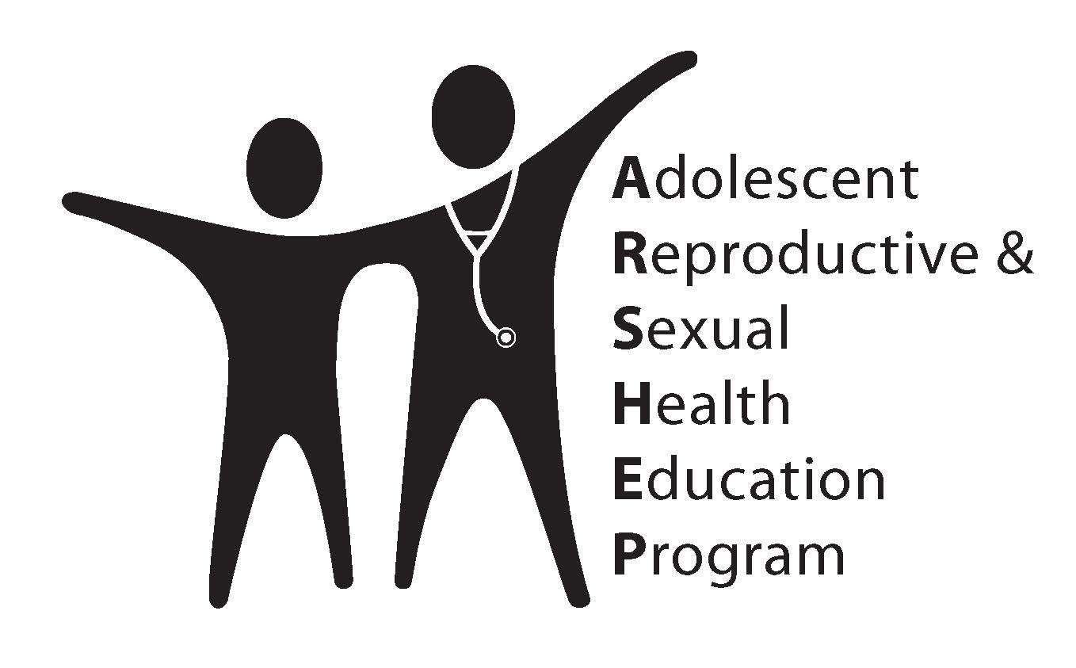
Please Complete Your Evaluations Now

