Slide 1
Essentials of Contraception and Adolescents

Slide 2
Objectives
Review teen pregnancy trends, rates of sexual activity and contraceptive use
Describe a comprehensive list of contraceptive methods and advantages/disadvantages of each option
Discuss tips for initiation and use
Dispel common myths
Explain safety and risk in context

Slide 3
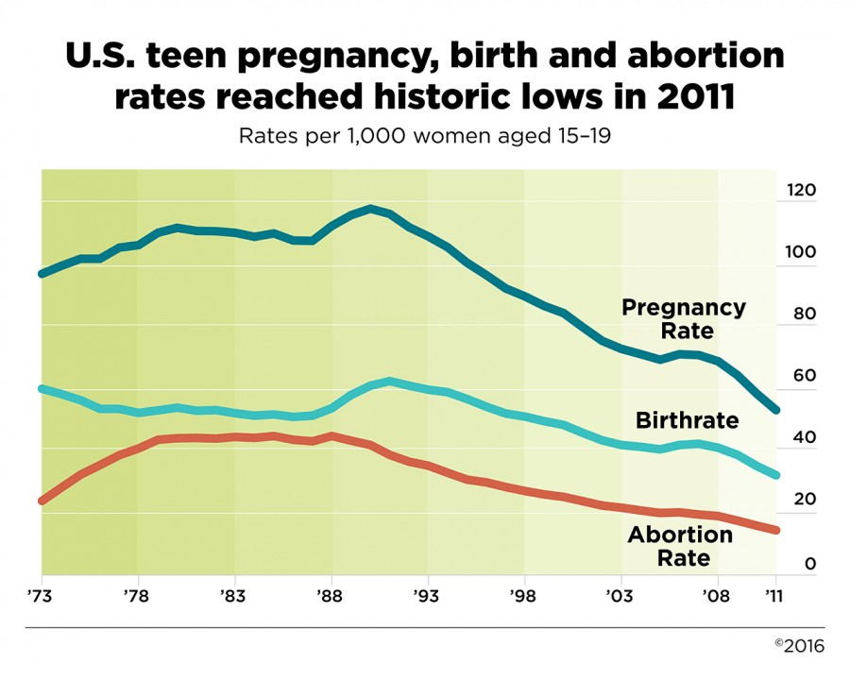
Teen Pregnancy, Birth, and Abortion Rates Are Declining (15- to 19-year-olds)
Kost K and Henshaw S, U.S. Teenage Pregnancies, Births and Abortions, 2010: National and State Trends by Age, Race and Ethnicity. Guttmacher Institute 2014.
Notes:
https://guttmacher.org/media/nr/2014/05/05/index.html
http://www.guttmacher.org/pubs/USTPtrends10.pdf
More recent data are available for teen birthrates than for teen pregnancy rates, and those data show that the decline in teen births has continued: It dropped 10% from 2012 to 2013, to 27 per 1,000—the lowest rate ever reported for the United States. Although data for the same time period are not yet available for abortions (and therefore pregnancies), these numbers suggest that teen pregnancy rates may very well have continued their long-term declines as well.
Source: Hamilton BE et al., Births: preliminary data for 2013, National Vital Statistics Reports, 2014, Vol. 63, No. 2, <http://www.cdc.gov/nchs/data/nvsr/nvsr63/nvsr63_02.pdf>, accessed Aug. 20, 2014.
Overall pregnancy, birth and abortion rates for 15–19 year olds are declining
In 2010, some 614,000 pregnancies occurred among teenage women aged 15–19, for a rate of 57.4 pregnancies per 1,000 women that age. This marks a 51% decline from the 1990 peak, and a 15% decline in just two years, from 67.8 in 2008
While there was a substantial drop in the pregnancy rate for 15–17-year-olds and 18–19-year-olds between 2008 and 2010, pregnancies among 18–19-year-olds constituted the majority (69%) of teen pregnancies. During this same time period, increasing proportions of 18–19-year-olds reported having ever had sex, yet fewer of them became pregnant. The likely reason is improved contraceptive use and use of more effective methods.
The study also found dramatic declines in teen pregnancy rates among all racial and ethnic groups.
However, wide disparities persist, and rates among both black and Hispanic teens remain twice as high as the rate for non-Hispanic white teens.
Teen pregnancy rates declined in all 50 states between 2008 and 2010. Yet even with ongoing declines, substantial disparities remain between states. In 2010, New Mexico had the highest teenage pregnancy rate (80 per 1,000), followed by Mississippi (76), Texas (73), Arkansas (73), Louisiana (69) and Oklahoma (69). The lowest rates were in New Hampshire (28 per 1,000), Vermont (32), Minnesota (36), Massachusetts (37) and Maine (37). The authors suggest that the demographic characteristics of states’ populations, the availability of comprehensive sex education, knowledge about and availability of contraceptive services and cultural attitudes toward sexual behavior and early childbearing likely play a role in these variations.

Slide 4
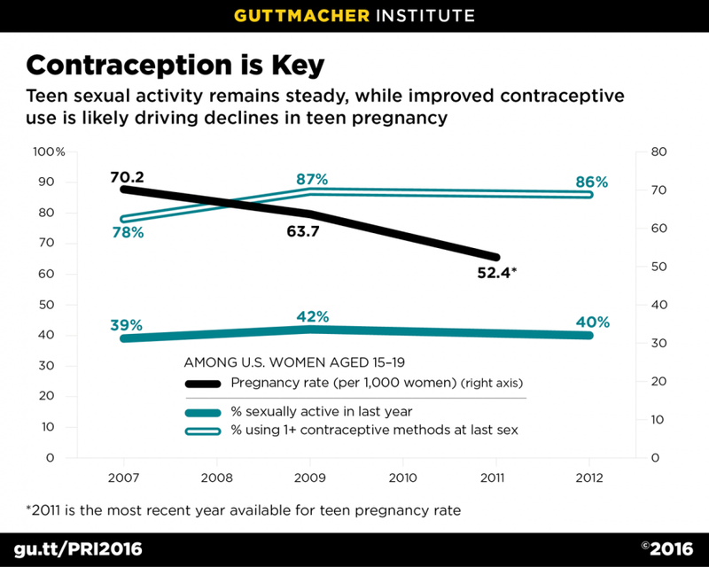
Notes:
A 2016 study that examined data from the National Survey of Family Growth estimated that the decline in adolescent pregnancy rates was almost entirely attributable to improved contraceptive use.
This graph shows a decline in adolescent pregnancy rates from 2007 – 2012, despite the fact that the level of sexual activity did not decrease (and actually increased a small amount). There was a small increase in the percent of teens reporting using at least 1 contraceptive method at the time of last sex.
The study also found significant increases in teens using highly-effective methods like LARC, and in the use of more than one method (like condoms + pills, for example).
This is yet another example of how improved access to effective contraceptive options can make a measurable positive impact on the health outcomes of many people.
Source: Linberg, Laura et al. Understanding the decline in adolescent fertility in the United States, 2007 – 2012. Journal of Adolescent Health, 2016, 1-7.

Slide 5
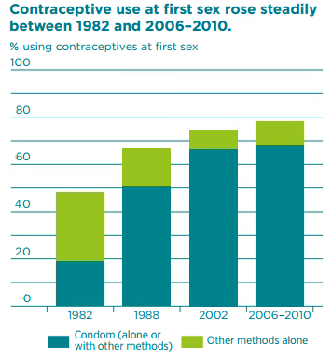
Contraceptive Use Rising at First Sex: 1982-2010
Guttmacher. September 2016.
Notes:
Source: https://www.guttmacher.org/sites/default/files/factsheet/fb-atsrh.pdf (September 2016)
The proportion of U.S. females aged 15–19 who used contraceptives the first time they had sex has increased, from 48% in 1982 to 79% in 2011–2013
Source: Martinez GM and Abma JC, Sexual activity, contraceptive use, and childbearing of teenagers aged 15–19 in the United States, NCHS Data Brief, 2015, No. 209.

Slide 6
What are Teens Using for Contraception?
★ Not so well | ★★★ Okay | ★★★★★ Really, really well
NCHS Data Brief #209, July 2015 (CDC NSFG 2011-2013)
Notes:
IUD use up from undetectable levels (2002 National Survey of Family Growth)
% of teens who’ve had sex 1+ times using these methods
Only 28% of teens using contraception
Of 72 % not using contraception:
9% sexually active, not seeking pregnancy and using nothing
5.4% pregnant
1.3% seeking pregnancy
84% not sexually active in past 3 months/ever

Slide 7
Condom Use at Last Sex
National Youth Risk Behavior Survey, 2015
Notes:
Source: MMWR / June 10, 2016 / Vol. 65 / No. 6
Data for this slide are from the 2015 National Youth Risk Behavior Survey. This slide shows the percentage of high school students who used a condom (during last sexual intercourse among students who were currently sexually active).
The percentage for all students is 56.9. The percentage for Male students is 61.5. The percentage for Female students is 52.0. The percentage for 9th grade students is 60.5. The percentage for 10th grade students is 59.9. The percentage for 11th grade students is 57.7. The percentage for 12th grade students is 52.9. The percentage for Black students is 63.4. The percentage for Hispanic students is 55.6. The percentage for White students is 56.8. All Hispanic students are included in the Hispanic category. All other races are non-Hispanic. Note: This graph contains weighted results.
For this behavior, the prevalence for male students is higher than for female students. The prevalence for 9th grade students is higher than for 12th grade students. The prevalence for 10th grade students is higher than for 12th grade students. The prevalence for Black students is higher than for Hispanic students. (Based on t-test analysis, p < 0.05.)
*During last sexual intercourse among students who were currently sexually active
†M > F; 9th > 12th, 10th > 12th; B > H (Based on t-test analysis, p < 0.05.)
All Hispanic students are included in the Hispanic category. All other races are non-Hispanic.
Note: This graph contains weighted results.

Slide 8
Case 1: Angela
Angela is a 16-year-old young woman who makes an appointment to go on birth control.
Her intake form indicates that she uses condoms “most of the time.”
What additional information do you need from this patient?
®

Slide 9
Medical History
Menstrual history
Age at menarche
Date of LMP
Duration of menses
Regularity/spotting
Cycle length
Cramps and impact on activities
History of PE, DVT, MI, migraine with aura or focal neurologic deficit
Personal or family history of blood clots
If affirmative, work-up for clotting disorder
Prior experiences with contraception
Notes:
Before initiating a patient on contraception, you must take a medical and psychosocial history. The medical history will determine if there are any contraindications to hormonal contraception use or other physiologic conditions that would affect ability to choose a certain method or to maintain compliance.

Slide 10
Case: Angela
Angela is a little unsure of her medical history.
She does not think anyone in her family has a history of blood clots.
What questions do you ask before beginning contraception counseling?
®

Slide 11
Sexual Health History
Sexual orientation and gender identity
History of vaginal, oral, anal sex
Age at coitarche
Number and genders of partners
Condom and contraception use
Pregnancy history
History of STIs
Sexual satisfaction
History of survival, unwanted or coerced sex
Childbearing plans

Slide 12
Case: Angela
Angela has had sex 3 times with her current boyfriend and used condoms during 2 of those three encounters.
What did she do well?
®

Slide 13
Affirmation And Education
Used condoms at least 2 of 3 times!
Came in to discuss birth control methods
Give positive reinforcement whenever possible
IDEAL = DUAL USE
Notes:
STRESS THE POSITIVE
DUAL USE

Slide 14
Dual Use:
Condom + LARC/Pill/Injectable/Patch/Ring Before Last Sex
National Youth Risk Behavior Survey, 2015
Notes:
Source: MMWR / June 10, 2016 / Vol. 65 / No. 6
Data for this slide are from the 2015 National Youth Risk Behavior Survey. This slide shows the percentage of high school students who used both a condom during and birth control pills; an IUD or implant; or a shot, patch, or birth control ring before last sexual intercourse (to prevent STD and pregnancy among students who were currently sexually active).
The percentage for all students is 8.8. The percentage for Male students is 5.9. The percentage for Female students is 11.8. The percentage for 9th grade students is 5.8. The percentage for 10th grade students is 8.3. The percentage for 11th grade students is 12.2. The percentage for 12th grade students is 7.7. The percentage for Black students is 4.7. The percentage for Hispanic students is 4.7. The percentage for White students is 12.0. All Hispanic students are included in the Hispanic category. All other races are non-Hispanic. Note: This graph contains weighted results.
For this behavior, the prevalence for female students is higher than for male students. The prevalence for 11th grade students is higher than for 9th grade students. The prevalence for 11th grade students is higher than for 12th grade students. The prevalence for White students is higher than for Black students. The prevalence for White students is higher than for Hispanic students. (Based on t-test analysis, p < 0.05.)
*To prevent STD and pregnancy among students who were currently sexually active
†F > M; 11th > 9th, 11th > 12th; W > B, W > H (Based on t-test analysis, p < 0.05.)
All Hispanic students are included in the Hispanic category. All other races are non-Hispanic.
Note: This graph contains weighted results.

Slide 15
Unprotected Sex in the Past Five Days?
No
Yes
Urine pregnancy test if unprotected sex occurred more than 14 days prior
Notes:
Today most formulations of emergency contraception come in a single dose product. Advise patients that if they take a 2-dose product, it is preferable to take both doses at once.

Slide 17
Branded EC products in the U.S.
Plan B OneStep®
ella®
Single dose
Single dose - 1.5 mg levonorgestrel
30 mg Ulipristal acetate (UPA)
Prescription Only
OTC for men and women of all ages
Can order online at www.ella-kwikmed.com
Label: Up to 72h after unprotected sex
Label: Up to 120h after unprotected sex
Recommend: Up to 120h
Notes:
Plan B OneStep:
1 tablet, 1.5 mg levonorgestrel
Manufactured by Teva Pharmeceuticals
Currently available in pharmacies and health centers
0–120 hours (Less effective between 72 and 120 hours and may be less effective for women with BMI >30kg/m²)
Mechanism of action: (1) prevents ovulation and fertilization, (2) may inhibit implantation, not effective once implantation has begun.
Costs about $35–$60
Source: Glasier, A., Cameron, S.T., Blithe, D., Scherrer, B., Mathe, H., Levy, D., et al. (2011). Can we identify women at risk of pregnancy despite using emergency contraception? Data from randomized trials of ulipristal acetate and levonorgestrel. Contraception, 84(4), 363-367.
Source: Reproductive Health Technologies Project. (2013). Frequently Asked Questions: The Impact of Weight on Efficacy of Emergency Contraception.
ella:
1 tablet 30 mg ulipristal acetate
Manufactured by Watson Pharmaceuticals
Single product labeled for prescription usage only
One tablet taken orally as soon as possible within 120 hours (5 days) after unprotected intercourse or a known or suspected contraceptive failure.
Mechanism of action: (1) inhibits or delays ovulation, (2) may inhibit implantation
Pharmacy prices tend to be $5–$10 dollars more than Plan B One-Step. Since it is prescription only, it is covered by some private and public insurance.
Rx required for all ages
May be ordered from online prescription service - https://www.ella-kwikmed.com/
Pill mailed the next day
Unlike levonorgestrel, ulipristal effectiveness does not decline with delay in treatment

Slide 18
Starting Contraception After LNG EC
COCs/Progestin-only Pills
Start immediately after LNG EC
Vaginal Ring/Patch
Start immediately after LNG EC
DMPA/Implants/
IUCs
Start immediately after LNG EC
*With ALL methods: abstain/use back-up protection for first 7 days
Notes:
Source: The CDC’s 2013 update for Selected Practice Recommendations for Contraceptive Use, http://www.cdc.gov/mmwr/preview/mmwrhtml/rr6205a1.htm
Note: COCs, patch, and ring are not effective until seven days after initiation (abstain from intercourse or use back-up protection for the first 7 days for ALL methods).
**Note: ella is an antiprogestin. When starting hormonal contraception immediately after using ella, it is not known whether the instructions above for abstaining or using back-up contraception are conservative enough. It is recommended to abstain or use condoms for 2 weeks.
**If starting hormonal methods immediately after EC treatment, a pregnancy test should be administered 3 weeks later to rule out pregnancy that may have resulted from failed EC.
Source:
Hatcher RA, Trussell J, Nelson AL, Cates Jr. W, Kowal D, Policar MS. Contraceptive Technology: Twentieth Revised Edition. “Emergency Contaception.” Trussell J, Schwarz, EB. Chapter 6, p.134.

Slide 19
Starting Contraception After UPA EC – U.S. Selected Practice Recommendations for Contraceptive Use, 2016
Start or resume hormonal contraception NO SOONER than 5 days after use of UPA
Any nonhormonal contraceptive method can be started immediately after the use of UPA.
For methods requiring a visit to a health care provider, such as Depo, implants, and IUDs, starting the method at the time of UPA use may be considered; the risk that the regular contraceptive method might decrease the effectiveness of UPA must be weighed against the risk of not starting a regular hormonal contraceptive method.
Advise a pregnancy test if she does not have a withdrawal bleed within 3 weeks.
*With hormonal methods: abstain/use back-up protection for 7 days after restarting contraception
Notes:
Source: The CDC’s 2013 update for Selected Practice Recommendations for Contraceptive Use, http://www.cdc.gov/mmwr/preview/mmwrhtml/rr6205a1.htm
Note: COCs, patch, and ring are not effective until seven days after initiation (abstain from intercourse or use back-up protection for the first 7 days for ALL methods).
**Note: ella is an antiprogestin. When starting hormonal contraception immediately after using ella, it is not known whether the instructions above for abstaining or using back-up contraception are conservative enough. It is recommended to abstain or use condoms for 2 weeks.
**If starting hormonal methods immediately after EC treatment, a pregnancy test should be administered 3 weeks later to rule out pregnancy that may have resulted from failed EC.
Source:
Hatcher RA, Trussell J, Nelson AL, Cates Jr. W, Kowal D, Policar MS. Contraceptive Technology: Twentieth Revised Edition. “Emergency Contaception.” Trussell J, Schwarz, EB. Chapter 6, p.134.

Slide 20
Case: Angela
Angela informs you that she last had unprotected sex two weeks ago.
You do a urine pregnancy test. The result is negative.
Do you need to perform a pelvic exam?
Notes:
Not necessary if she has no STI symptoms.
A pelvic exam may be a deterrent for many young women considering initiating hormonal contraception; therefore, it may be deferred if the patient is healthy, not pregnant, and has no contraindications to taking the pills.
Because hormonal contraceptives do not accelerate cervical neoplasia or interfere with cervical cytology, young women who have not had a recent Pap smear can begin using hormonal contraceptives before the test is performed.

Slide 21
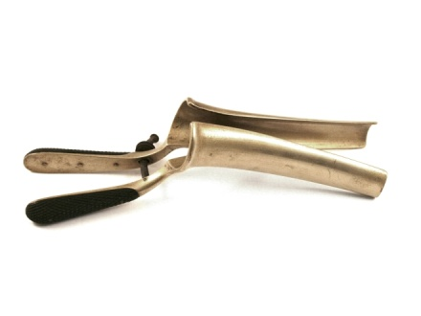
When to Begin Pelvic and Pap smears
Summary Cervical Cytology Guidelines
Organization (Year Updated) | Initial Screening | Screening Interval for Under 30 | HPV vaccination
American Congress of Obstetricians and Gynecologists (2016) | Age 21, regardless of sexual initiation | Every three years | Same as unvaccinated women
United States Preventive Services Task Force (2012) | Age 21 | Every three years | Same as unvaccinated women
American Cancer Society (2012) | Age 21 | Every three years | Same as unvaccinated women
Notes:
Sources:
http://www.acog.org/Resources-And-Publications/Practice-Bulletins/Committee-on-Practice-Bulletins-Gynecology/Screening-for-Cervical-Cancer
http://www.uspreventiveservicestaskforce.org/uspstf/uspscerv.htm
http://www.cancer.org/cancer/news/news/new-screening-guidelines-for-cervical-cancer

Slide 22
Case: Angela
You tell Angela that there are many contraceptive options available to her and you are confident that you can help her find one if she likes.
®
Notes:
Many factors affect the likelihood that an adolescent will use contraception at all:
Knowledge of different contraceptive methods, including awareness of mechanism of action and proper use, may positively affect correct use. Knowledge of benefits relative to risks also helps encourage use.
Non-contraceptive benefits may motivate initiation and continuation of use, and side effects such as perceived weight gain and breakthrough bleeding can be leading factors in the discontinuation of the method.
Ambiguity or positive attitudes toward pregnancy of either or both partners can decrease contraceptive use.
Partner and parental support (or lack of) are also key factors affecting an adolescent’s willingness to use and stay on contraception.
Satisfaction with the health care provider and costs of the method and health care visit can positively or negatively affect an adolescent’s decision.
Finally, an adolescent’s perceptions of whether his/or her care is confidential could impede him/her from seeking family planning services.
Additionally, there are many factors that will affect an adolescent’s choice of contraceptive method. For instance, if a teen is having regular intercourse it would be very beneficial for her to begin hormonal contraception. Birth control pills require daily adherence: does the teen think she will be able to remember to take the pill daily? If not, is there another method that may be more appropriate? If she is having sex with more than one partner at a time, it is essential that she and her partners use condoms during every sexual encounter.
Health care providers and adolescents should discuss all of the contraceptive options and decide based on the patient’s individual situation and preferences which would be the best option.
All factors can potentially affect the adolescent’s compliance with the method.
Source: Moos M, et al. Counseling

Slide 23
Notes:
Effectiveness rates are given with both perfect use (correct and consistent use of the method with every act of intercourse) and typical use (actual use, including occasional inconsistent or incorrect use).
Except where otherwise noted, these rates are based on those reported in the 18th edition of Contraceptive Technology.
---
Original content for this slide submitted by Association of Reproductive Health Professionals in June 2008. Original funding received from the Association of Reproductive Health Professionals general operating funds. This slide is available at www.arhp.org/core.

Slide 24
Long-Acting Reversible Contraception

Slide 25
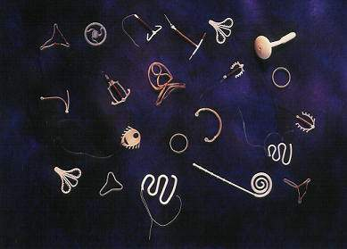
Long-Acting Reversible Contraception (LARC) = IUDs and Implants
Most effective methods: >99%
Safest
No estrogen
Contraindications rare
Highest patient satisfaction
(80% LARC vs 50% short acting)
Highest continuation rates
(86% LARC vs. 55% short acting)
Long-term protection—lasts 3-12 years
Rapid return of fertility
Most cost effective
Least likely to be used by teens
Secura GM. The Contraceptive Choice Project. Am J Obstet Gyn. 2011.
Notes:
[Insert Lecture Name Here]
Slide 25
9,256 women from St Louis—over 4 years
Short acting methods (pill, patch, ring, DMPA)
Continuation rates were at 1 year (88% Mirena®/84% Paragard®/83% Implanon®)
The Contraceptive Choice Project

Slide 26
LARC Use at Last Sex: IUD/Implant
National Youth Risk Behavior Survey, 2015
Notes:
Source: MMWR / June 10, 2016 / Vol. 65 / No. 6
Data for this slide are from the 2015 National Youth Risk Behavior Survey. This slide shows the percentage of high school students who used an IUD (e.g., Mirena or ParaGard) or implant (e.g., Implanon or Nexplanon) (before last sexual intercourse to prevent pregnancy among students who were currently sexually active).
The percentage for all students is 3.3. The percentage for Male students is 2.2. The percentage for Female students is 4.5. The percentage for 9th grade students is 2.1. The percentage for 10th grade students is 2.8. The percentage for 11th grade students is 3.9. The percentage for 12th grade students is 3.8. The percentage for Black students is 2.1. The percentage for Hispanic students is 2.9. The percentage for White students is 3.9. All Hispanic students are included in the Hispanic category. All other races are non-Hispanic. Note: This graph contains weighted results.
For this behavior, the prevalence for female students is higher than for male students. (Based on t-test analysis, p < 0.05.)
*Before last sexual intercourse to prevent pregnancy among students who were currently sexually active
†F > M (Based on t-test analysis, p < 0.05.)
All Hispanic students are included in the Hispanic category. All other races are non-Hispanic.
Note: This graph contains weighted results.

Slide 27
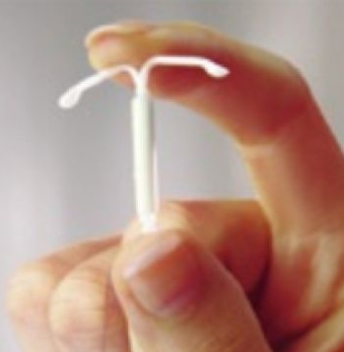
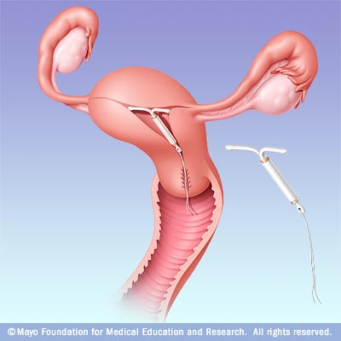
Levonorgestrel IUD (Mirena®)
Extremely Effective
20 mcg levonorgestrel/day
Progestin-only method
5-6 years use
Cost : $50–$700
Bleeding pattern:
Light spotting initially:
25% at 6 months
~10% at 1 year
Amenorrhea in:
44% by 6 months
50% by 12 months
Trussel J. Contraceptive Technology. 2007;
Hidalgo M. Contraception. 2002.
Notes:
The LNG IUS (Mirena) became available in U.S. in 2001. It is a long-acting, progestin-only intrauterine contraceptive method.
Provides highly effective contraceptive protection for five years.
The T-shaped reservoir placed within the uterine cavity releases 20 μg of levonorgestrel per day initially; rate decreases progressively to 10 μg/day after 5 years.
LNG IUS requires an office visit for insertion and an office visit for removal.
Mechanism of Action:
LNG IUS thickens the cervical mucus and inhibits sperm motility and function.
The endometrial atrophy that is a consequence of the high endometrial levels of LNG leads to a substantial decrease in menstrual flow and absence of bleeding in some women who use this form of intrauterine contraception.
It is important to some patients that the LNG IUD mechanisms of action are all before conception. It prevents fertilization rather than disrupts implantation (a common misconception).
The low ectopic pregnancy rate relative to pregnancy rate suggests that an anti-implantation effect is not the primary contraceptive mechanism of action of the device.
Candidates:
All women of reproductive age who are seeking a long-term, highly effective contraceptive.
IUD is especially appropriate for:
Women who are looking for a convenient method.
Women with menstrual symptoms that may improve with LNG IUS. Similar to long-acting, progestin-only DMPA, use of the LNG IUS generally improves menorrhagia, dysmenorrhea, and anemia.
Lactating women.
Advantages:
Use of the LNG IUS may reduce menstrual symptoms in women with uterine fibroids or adenomyosis, thereby reducing the need for hysterectomy.
Data from the United Kingdom also suggest that use of the LNG IUS may reduce the occurrence of benign endometrial polyps in patients who have breast cancer and are taking tamoxifen.
Can be used by lactating women.
Contraindications (WHO MEC):
Puerperal sepsis
Immediate post-septic abortion
Unexplained vaginal bleeding before evaluation
Malignant gestational trophoblastic disease
Cervical cancer awaiting treatment
Current breast cancer
Endometrial cancer
Uterine fibroids with distortion of the uterine cavity
Distorted uterine cavity
Current PID (initiation of IUD)
Current purulent cervicitis or chlaymdial infection or gonorrhea at initiation
Acute PID or recent history of PID
Risk factors for STIs and PID
Post-pregnancy infection (if within the past 3 months)
Distorted uterine cavity
Uterine or cervical cancer or unresolved abnormal Pap smear
Genital bleeding of unknown source
Acute cervicitis, vaginitis, or genital actinomycosis
Increased susceptibility to infection
Disadvantages:
Uterine perforation is a possible, but rare complication of LNG IUS use (1/1000), occurring only at the time of insertion.
Rates of expulsion from 2% to 12% have been reported. Most expulsions occur in the first months following insertion, with decreasing frequency thereafter.
Enlarged ovarian follicles have been diagnosed in about of 12% of subjects using the LNG IUS. Most of these follicles are asymptomatic, although some may be accompanied by pelvic pain or dyspareunia. Usually, the enlarged follicles disappear spontaneously during 2–3 months of observation, and surgical intervention is usually not required.
Obese women have an elevated risk of dysfunctional uterine bleeding and endometrial neoplasia, so the LNG IUS may be an appropriate choice in these women.
Counseling:
Users of the LNG IUS may experience progestin-related side effects such as mood changes, acne, headache, breast tenderness, and follicular ovarian cysts. These side effects are more common during the initial months of use and occur less often over time.
During the first 3–6 months of use, women may experience an increased number of bleeding and spotting days and irregular bleeding patterns. Thereafter, the number of bleeding and spotting days usually decreases, but bleeding may remain irregular. Amenorrhea develops in approximately 20% of LNG IUD users by 1 year.
Breast tenderness and nausea are quite uncommon.
Inform women that LNG IUS do not cause an increased risk of STIs, tubal infertility, and ectopic pregnancies.
Explain non contraceptive benefits and possible menstrual changes.
Describe how to check for the string, follow-up visits, and warning signs.
References
ACOG Committee on Practice Bulletins. No. 73. Use of Hormonal Contraception in Women with Coexisting Medical conditions. Obstet Gynecol. 2006;107:1453–72.
Gardner FJ, Konje JC, Abrams KR, et al. Endometrial protection from tamoxifen-stimulated changes by a levonorgestrel-releasing intrauterine system: a randomised controlled trial. Lancet. 2000;356:1711–7.
Hatcher RA, et al. A Pocket Guide to Managing Contraception. 4th ed. Tiger, GA: The Bridging the Gap Foundation, 2001.
Hidalgo M, Bahamondes L, Perrotti M, Diaz J, Dantas-Monteiro C, Petta C. Bleeding patterns and clinical performance of the levonorgestrel-releasing intrauterine system (Mirena) up to two years. Contraception. 2002;65(2):129–32.
Hubacher D, Grimes DA. Noncontraceptive health benefits of intrauterine devices: a systematic review. Obstet Gynecol Surv. 2002;57:120–8.
Inki P, Hurskainen R, Palo P, Ekholm E, Grenman S, Kivel A, Kujansuu E, Teperi J, Yliskoski M, Paavonen J. Comparison of ovarian cyst formation in women using the levonorgestrel-releasing intrauterine system vs. hysterectomy. Ultrasound Obstet Gynecol. 2002 Oct;20(4):381–5.
Jonsson B, Landgren B-M, Eneroth P. Effects of various IUDs on the composition of cervical mucus. Contraception. 1991;43:447.
Luukkainen T. The levonorgestrel intrauterine system: therapeutic aspects. Steroids. 2000;65:699–7.
Mirena [package labeling]. Montville, NJ: Berlex Laboratories, Inc.; 2000.
Mirena Prescribing Information. Berlex Laboratories, Inc., Montville, NJ; 2000.
Mohllajee AP, Curtis KM, Peterson HB. Does insertion and use of an intrauterine device increase the risk of pelvic inflammatory disease among women with sexually transmitted infection? A systematic review. Contraception. 2006 Feb;73(2):145–53.
Nelson AL. The intrauterine contraceptive device. Obstet Gynecol Clin North Am. 2000;27(4):723–40.
Silverberg SG, Haukkamaa M, Arko H, et al. Endometrial morphology during long-term use of levonorgestrel-releasing intrauterine devices. Int J Gynecol Pathol. 1986;5(3):235–41.
Trussel J. Contraceptive efficacy. In Hatcher RA, Trussel J, Nelson AL, Cates W, Stewart FH, Kowal D. Contraceptive Technology: Nineteen Revised Edition. New York, NY: Ardent Media, 2007.
27

Slide 28
Levonorgestrel IUD: (Liletta®)
FDA approved 2015 for 3 years – anticipate 7 year approval
19 mcg levonorgestrel/day – similar to Mirena
Progestin-only method
Bleeding pattern:
Light spotting initially:
25% at 6 months
~10% at 1 year
Amenorrhea in:
44% by 6 months
50% by 12 months

Slide 29
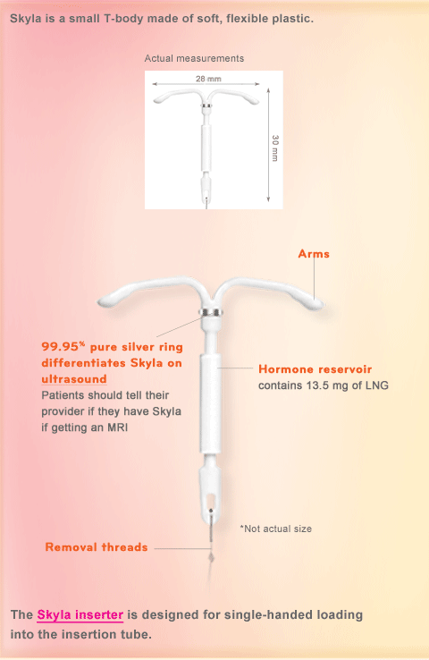
Levonorgestrel IUD (Skyla®)
14 mcg levonorgestrel/day
Progestin-only method
3 years use
Cost : ~$300–$650
Smaller in size than Mirena
1.1 x 1.2 in. (vs. 1.3 x 1.3 in)
Inserter tube 0.15 in. (vs. 0.19 in)
More irregular bleeding than Mirena
Only 6% have amenorrhea at 1 yr
Extremely Effective
Notes:
29

Slide 30
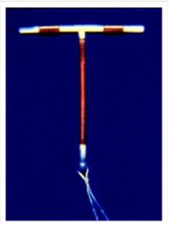
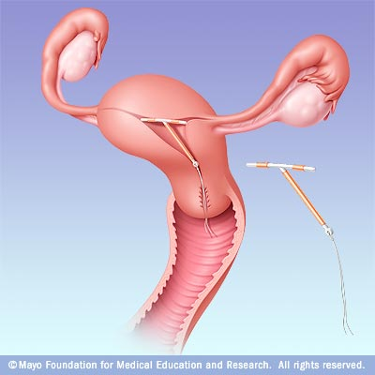
Copper-T IUD: (Paragard®)
Extremely Effective
Copper ions
No hormones
12 years of use
Cost: ~$150-$475
99% effective as EC
Bleeding Pattern:
Menses regular
May be heavier, longer, crampier for first 6 months
Thonneau, PF. Am J Obstet Gynecol. 2008. Trussel J. Contraceptive Technology. 2007.
Notes:
[Insert Lecture Name Here]
Slide 30
The Cooper T 380A IUD is a small T-shaped device made of polyethylene. The device has two flexible arms that fold down for insertion and expand to form a T shape when released inside the uterus. The vertical stem of the device is wound with fine copper wire, and the two horizontal arms also have a sleeve of cooper. At the bottom of the vertical stem, a 3-mm bulb houses a monofilament poyethylene string that enables the device’s easy removal.
The arms of the Copper-T IUD are wrapped with copper wire, which acts as a functional spermicide. There is clear evidence that IUDs are not abortifacients. They prevent pregnancy by preventing fertilization.
The Copper-T IUD is approved for 10 years of use; however, efficacy lasts 12 years or more.
Mechanism of Action:
Cooper-containing IUDs reduce the motility and viability of the sperm and the development of ova.
Research shows that sperm counts found in the cervical mucus and uterine tube are much lower in women using IUDs than those in non-users.
A clinical study found that women using copper-containing IUDs had uncoordinated contractions, which suggests that the device may act by hindering sperm transport.
Candidates:
Women who desire long-term contraception.
Women who do not want the systematic effects of hormones.
Women who desire a quickly reversible method
Advantages
Fertility returns rapidly after removal of the copper IUD.
There is no ongoing cost after insertion.
The Cooper-T IUD may be associated with a decreased risk for endometrial cancer, but the exact mechanism for this association is unclear.
Contraindications (WHO Criteria): same as Mirena
Disadvantages
Menstrual changes
The Copper T IUD can increase the duration and amount of menstrual flow and menstrual cramping.
Expulsion is rare, occurring in only 5% of users, but is the most likely cause of IUC failure. Expulsion is most common within the first three months after insertion.
Uterine perforation is a rare complication of IUC, occurring approximately once every 770 to 1600 insertions. Perforation generally occurs at insertion, when a portion of the device becomes embedded in the uterine wall.
There’s a possible increased risk of PID during early post-insertion period in women with cervical infections.
Studies suggest that women with chlamydial infection or gonorrhea at the time of IUD insertion were at an increased risk of PID relative to women without infection. The absolute risk of PID was low for both groups (0%–5% for those with STIs and 0%–2% for those without).
Counseling:
Inform women that IUDs do not cause an increased risk of STIs, tubal infertility, and ectopic pregnancies.
Describe how to check for the string, follow-up visits, and warning signs.
References
Beining RM, Dennis LK, Smith LK, Smith EM, Dokras A. Meta-Analysis of Intrauterine Device Use and Risk of endometrial cancer. Ann Epidemiol. 2008.
Fortney JA, Feldblum PJ, Raymond EG. Intrauterine Devices. J Reprod Med. 1999. March;44(3):269–274.
Larsson G, Milsom I, Jonasson K, Lindstedt G, Rybo G. The long-term effects of copper surface area on menstrual blood loss and iron status in women fitted with an IUD. Contraception. 1993;48(5):471–80.
Maslow KD, Lyons EA. Effect of oral contraceptives and intrauterine devices on midcycle myometrial contractions. Fertil Steril. 2003;80(5):1224–7.
Milsom I, Rybo G, Lindstedt G. The influence of copper surface area on menstrual blood loss and iron status in women fitted with an IUD. Contraception. 1990;41(3):271–81.20.
Mohllajee AP, Curtis KM, Peterson HB. Does insertion and use of an intrauterine device increase the risk of pelvic inflammatory disease among women with sexually transmitted infection? A systematic review. Contraception. 2006 Feb;73(2):145–53
Nelson AL. The intrauterine contraceptive device. Obstet Gynecol Clin North Am. 2000;27(4):723–40.12.
Thonneau PF, Almont TE. Contraceptive efficacy of intrauterine devices. Am J Obstet Gynecol. 2008. March;198(3): 248–253.
Trussel J. Contraceptive efficacy. In: Hatcher RA, Trussel J, Nelson AL, et al. Contraceptive Technology: 19th revised ed. New York, NY: Ardent Media, 2007.
WHO Medical Eligibility Criteria for Contraceptive Use, 3rd edition 2004.

Slide 31
Which IUD Is the Best Choice?
Copper T IUD
LNG IUD
Want regular periods
Want no hormones
No h/o dysmenorrhea
No h/o menorrhagia
OK w/irregular bleeding
OK w/amenorrhea
H/O dysmenorrhea
H/O menorrhagia
Notes:
[Insert Lecture Name Here]
Slide 31

Slide 32
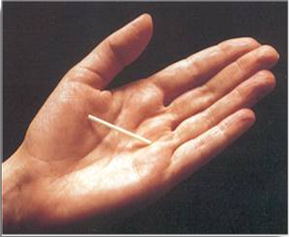
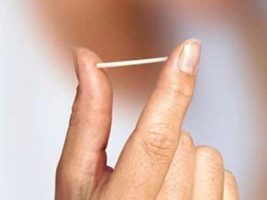
Implant: Nexplanon®
Extremely
Effective
Progesterone only (etonogestrel)
Effective for 3-4 years
Cost: ~$300–$600
Mechanism: Inhibits ovulation
Bleeding pattern:
Amenorrhea (22%)
Infrequent (34%)
11% stop due to frequent bleeding
Implanon insert: Diaz S., Contraception, 2002: Trussel J, Contraceptive Technology, 2007 Croxatto HB, Contraception, 1998; Diaz S, Contraception, 2002; Funk S, Contraception, 2005.
Notes:
Note: The original version of the implant was called Implanon. The current version is referred to as Nexplanon.
Implanon, an etonogestrel implant, is used by more than 2 million women in European and Asian countries and is now available in the United States.
One rod is 40 mm x 2 mm and its core is 40% ethylene vinyl acetate (EVA) and 60% etonogestrel. It has a rate-controlling membrane of 100% EVA
Because contraceptive implants do not contain estrogen, they can be used during lactation as soon as six weeks postpartum. This feature may be especially attractive to women with young infants who want highly effective contraception that does not require daily action.
The effectiveness of Implanon in overweight women has not been determined; women who weighed more than 130% of their ideal body weight were not studied.
Mechanism of Action:
The multiple-rod implant relies on ovulation inhibition for contraceptive action for the first 3 months of use, then on thicker cervical mucus after three months of use. In contrast, the single-rod implant continues to rely on ovulation inhibition over the entire duration of use.
Candidates:
In addition to its high efficacy rate and long-term effectiveness (3 years), it has rapid reversibility. After the etonogestrel implant is removed, most women (94%) ovulate by 3 months, the majority within 3 weeks.
Advantages:
This method is a particularly good choice for women who do not want a daily or weekly action, desire a discreet method (it is nearly invisible), or want to use contraception during lactation. According to studies with lactating women, there are no negative effects on nursing or infant growth or development with etonogestrel implant.
This method also can confer noncontraceptive benefits, such as improved dysmenorrhea and acne.
Contraindications:
Known or suspected pregnancy
Current or past history of thrombosis
Hepatic tumor or active liver disease
Undiagnosed abnormal genital bleeding
Known or suspected carcinoma of the breast or history of breast cancer
Hypersensitivity to the components of the implant
Disadvantages:
The most common side effect of implant is bleeding irregularities, including infrequent bleeding (26.9%), amenorrhea (18.6%), prolonged bleeding (15.1%), and frequent bleeding (7.4%).
But as with other progestin-only methods, it is the variability and unpredictably of the bleeding that is most characteristic of this method; for example, a bleeding pattern may change from one 2 to 3 month period to the next.
More unpredictable bleeding than Depo, less amenorrhea.
Unfortunately, studies on progestin-only methods have not identified a simple approach for managing bleeding.
However, one study found that ethinyl estradiol may help control bleeding during the first few months of implant use.
Other side effects include weight gain (2.3%), emotional lability (2.3%), headache (1.6%), acne (1.3%), and depression (1.0%).
There is no evidence of long-term effects such as decreased bone mineral density (BMD) and deep vein thrombosis, or anemia with the etonogestrel implant. On the contrary, lumbar spine BMD improved in studies.
Both procedures are rapid: insertion takes 1 minute and removal takes 3 minutes.
Counseling:
During patient counseling, address misperceptions about implants, such as visibility of the implant, low libido, excessive hair growth, and they break off in the arm.
To decrease chances of unintended pregnancy, a quick start method can be used. With this method, the implant can be inserted any time after a negative urine pregnancy test. Another test will need to be done in 3 weeks to make sure the woman was not pregnant when the implant was inserted.
Counseling women about bleeding patterns and other side effects helps prevents early discontinuation.
References
Beerthuizen R, van Beek A, Massai R, Mäkäräinen L, Hout J, Bennink HC. Bone mineral density during long-term use of the progestogen contraceptive implant Implanon compared to a non-hormonal method of contraception. Hum Reprod. 2000;15(1):118–122.
Croxatto HB, Mäkäräinen L. The pharmacodynamics and efficacy of Implanon. An overview of the data. Contraception. 1998;58(6):91S–97S.
Croxatto HB, Urbancsek J, Massai R, Coelingh Bennink H, van Beek A. A multicentre efficacy and safety study of the single contraceptive implant Implanon. Implanon Study Group. Hum Reprod. 1999;14(4):976–981.
Diaz S. Contraceptive implants and lactation. Contraception. 2002;65(1):39–46.
Funk S, Miller MM, Mishell DR Jr, et al; The Implanon US Study Group. Safety and efficacy of Implanon, a single-rod implantable contraceptive containing etonogestrel. Contraception. 2005;71(5):319–326.
Implanon [package insert]. Roseland, NJ: Organon USA, Inc; 2005.
Implanon prescribing information.sa.com/authfiles/images/543_174733.pdf
Meirik O, Fraser IS, d’Arcangues C, et al. WHO Consultation on Implantable contraceptives for women. Hum Reproduct Update. 2003;9(1):49–59.
Trussel J. Contraceptive efficacy. In Hatcher RA, Trussel J, Nelson AL, Cates W, Stewart FH, Kowal D. Contraceptive Technology: Nineteen Revised Edition. New York, NY: Ardent Media, 2007.
Urbancsek J. An integrated analysis of nonmenstrual adverse events with Implanon. Contraception. 1998;58(6):109S–115S.
Weisberg E, Hickey M, Palmer D, et al. A pilot study to assess the effect of three short-term treatments on frequent and/or prolonged bleeding compared to placebo in women using Implanon. Hum Reprod. 2006;21(1):295–302.
Zheng SR, Zheng HM, Qian SZ, Sang GW, Kaper RF. A randomized multicenter study comparing the efficacy and bleeding pattern of a single-rod (Implanon) and a six-capsule (Norplant) hormonal contraceptive implant. Contraception. 1999;60(1):1–8.
---
Original content for this slide submitted by Association of Reproductive Health Professionals in June 2008. Original funding received from the Association of Reproductive Health Professionals general operating funds. This slide is available at www.arhp.org/core

Slide 33
Combined Hormonal Contraception
Short-Acting Reversible Contraception

Slide 34
Combined Hormonal Contraception (CHC)
Estrogen
Inhibits FSH and LH
Inhibits ovulation
Progesterone
Thickens cervical mucus to prevent sperm penetration
Inhibits capacitation of sperm
Includes oral contraceptive pills, contraceptive patch, intravaginal ring
Notes:
COCs are effective because they can prevent pregnancy through three means. Primarily, combined oral contraceptives prevent pregnancy by suppressing ovulation. They do this by inhibiting the production of both follicle stimulating hormone (FSH) and luteinizing hormone (LH). The progestins in COCs provide secondary mechanisms that include altering the cervical mucus to prevent sperm penetration.
Source: Goldzieher JW. The hypothalamo-pituitary-ovarian system. Pharmacology of the Contraceptive Steroids. (New York: Raven Press, 1994)185–98.

Slide 35
Birth Control Pill Use at Last Sex
National Youth Risk Behavior Survey, 2015
Notes:
Source: MMWR / June 10, 2016 / Vol. 65 / No. 6
Data for this slide are from the 2015 National Youth Risk Behavior Survey. This slide shows the percentage of high school students who used birth control pills (before last sexual intercourse to prevent pregnancy among students who were currently sexually active).
The percentage for all students is 18.2. The percentage for Male students is 15.2. The percentage for Female students is 21.3. The percentage for 9th grade students is 10.9. The percentage for 10th grade students is 15.9. The percentage for 11th grade students is 21.5. The percentage for 12th grade students is 20.1. The percentage for Black students is 9.0. The percentage for Hispanic students is 11.8. The percentage for White students is 23.5. All Hispanic students are included in the Hispanic category. All other races are non-Hispanic. Note: This graph contains weighted results.
For this behavior, the prevalence for female students is higher than for male students. The prevalence for 10th grade students is higher than for 9th grade students. The prevalence for 11th grade students is higher than for 9th grade students. The prevalence for 11th grade students is higher than for 10th grade students. The prevalence for 12th grade students is higher than for 9th grade students. The prevalence for White students is higher than for Black students. The prevalence for White students is higher than for Hispanic students. (Based on t-test analysis, p < 0.05.)
*Before last sexual intercourse to prevent pregnancy among students who were currently sexually active
†F > M; 10th > 9th, 11th > 9th, 11th > 10th, 12th > 9th; W > B, W > H (Based on t-test analysis, p < 0.05.)
All Hispanic students are included in the Hispanic category. All other races are non-Hispanic.
Note: This graph contains weighted results.

Slide 36
Short-Acting Contraception Use: Injectable/Patch/Ring Before Last Sex
National Youth Risk Behavior Survey, 2015
Notes:
Source: MMWR / June 10, 2016 / Vol. 65 / No. 6
Data for this slide are from the 2015 National Youth Risk Behavior Survey. This slide shows the percentage of high school students who used a shot (e.g., Depo-Provera), patch (e.g., OrthoEvra), or birth control ring (e.g., NuvaRing) (before last sexual intercourse among students who were currently sexually active).
The percentage for all students is 5.3. The percentage for Male students is 2.7. The percentage for Female students is 7.9. The percentage for 9th grade students is 3.3. The percentage for 10th grade students is 5.8. The percentage for 11th grade students is 5.5. The percentage for 12th grade students is 5.7. The percentage for Black students is 4.9. The percentage for Hispanic students is 3.1. The percentage for White students is 6.0. All Hispanic students are included in the Hispanic category. All other races are non-Hispanic. Note: This graph contains weighted results.
For this behavior, the prevalence for female students is higher than for male students. The prevalence for White students is higher than for Hispanic students. (Based on t-test analysis, p < 0.05.)
*Before last sexual intercourse among students who were currently sexually active
†F > M; W > H (Based on t-test analysis, p < 0.05.)
All Hispanic students are included in the Hispanic category. All other races are non-Hispanic.
Note: This graph contains weighted results.

Slide 37
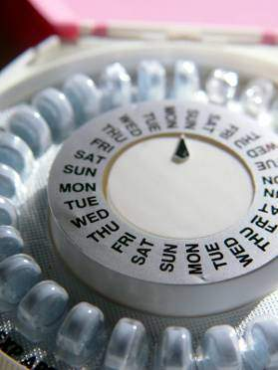
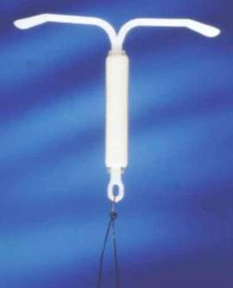
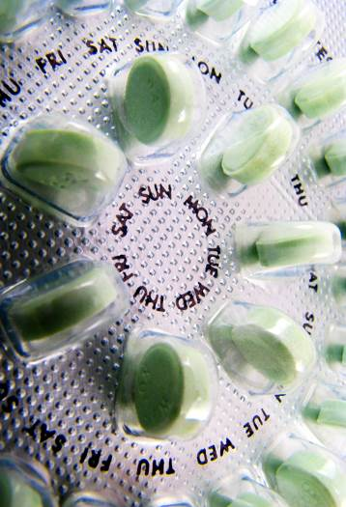
Combined Oral Contraceptive Pills
Very Effective
Contain estrogen & progestin
Most newer formulations contain 20 – 35 mcg of ethinyl estradiol
1 of 8 available progestins
Mechanism: Inhibits ovulation
Notes:
[Insert Lecture Name Here]
Slide 37
Source: Trussel J. Contraceptive Technology. 2007:Rosenberg MJ. Reprod Med. 1995: Potter L. Fam Plann Perspect. 1996; Mosher WD. AdvanceData. 2004. Hardman JG. McGraw-Hill. 1996.: Goldzieher JW. Fertil Steril. 1971.: Moghissi KS. Fertil Steril. 1971.
Missed Pills: A high number of unintended pregnancies are due to misuse or discontinuation of OCs. By the third month of use, the typical user misses three or more pills each cycle. These data are not presented to focus blame on OCs but to suggest that many women using daily methods are at risk for unintended pregnancy.
Counseling:
Breakthrough and /or irregular bleeding is the primary cause of discontinuation among new users. Other side effects include breast tenderness, nausea, and bloating.
Many of these side effects usually disappear after the first few cycles of pill use.
After breakthrough bleeding, breast tenderness and nausea are the leading causes of discontinuation.
There is less likely to be side effects, such as nausea and breast tenderness, with low-dose pills. In fact, the incidence of these side effects is approximately 50 percent lower in users of 20 ug pills compared with a 35 ug pill. But the lower the dose the more likely breakthrough bleeding will occur.
Even though weight gain is a primary concern of women using OCs, research shows that use of OCs does not substantially affect body weight for most women.
Fear of side effects, such as weight gain and nausea, is often the reason women discontinue COC. Emphasize that side effects abate with time.
Weight gain: Pooled data from two, 6-cycle, multi-center, double-blind, placebo-controlled trials showed that 2.2% of 228 OC users and 2.1% of 234 placebo users reported weight gain. Likewise, a Cochrane Review of all English-language randomized controlled trials of at least 3 treatment cycles’ duration noted that 3 placebo-controlled trials found no evidence to support a causal association between combination OCs or a combination skin patch and weight gain. [Note: Redmond data were not included.] Their overall conclusion was that there was insufficient evidence to determine the effect of combination OCs on weight, but that no large effect was evident. In actual practice, however, clinicians appreciate that the effects of hormonal contraception on weight will vary from patient to patient, depending on a variety of physiological and lifestyle issues.
Combined oral contraceptives (COCs) are a combination of estrogen and progestin.
The reduction in estrogen and progestin dosages over the past 30 years has led to a significant reduction in COC-related health risk.
Most COC formulations now contain 20 to 35 mcg of ethinyl estradiol plus one of eight available progestins.
Three new OC formulations were introduced in the United States between 2000 and 2002: two containing reduced doses of estrogen (25 μg) and the widely used progestins desogestrel and norgestimate (Cyclessa, Ortho Tri-Cyclen Lo), and one containing 30 μg of estrogen and the novel progestin drospirenone (Yasmin). The novel progestin drospirenone is not derived from testosterone; rather, it is a spironolactone derivative. Like spironolactone, drospirenone has some antiandrogenic effects. In addition, it has anti-mineralocorticoid activity, which may reduce estrogen-induced sodium and water retention.
These new formulations were developed with the goal of minimizing estrogen-related nonmenstrual side effects, such as breast tenderness, bloating, and nausea, and enhancing rather than diminishing cycle control (i.e., minimal breakthrough bleeding/spotting and amenorrhea). With ultra-low-dose OCs containing 20 μg of estrogen, improved tolerability often was obtained at the expense of good cycle control. The new formulations have tried to achieve the optimum balance between the ultra-low dose OCs containing 20 μg of estrogen and those containing higher estrogen doses of 30–35 μg.
A spearmint-flavored, chewable OC (Ovcon 35) was approved in 2003 and is expected to be launched in late spring 2004. Like other OCs, Ovcon 35 chewable comes in a blister package containing 21 active tablets and 7 inactive tablets. If chewed, it is recommended that the OC be followed by 8 ounces of liquid. It should be taken at the same time each day to ensure efficacy.
More than 20 generic OCs are now available, such as Aviane (same as Alesse), Lessina (same as Levlite), Kariva (same as Mircette), Enpresse and Trivora (same as Triphasil-28), and Portia and Levora (same as Levlen).
Consider the “quick start” method when initiating oral contraceptives.
Mechanism of Action:
The progestin in COCS is the main actor in preventing pregnancy. It suppresses the secretion of gonadotropin (mainly leutinizing hormone) by the pituitary gland. The estrogen primarily inhibits follicle-stimulating hormone secretion.
The estrogen also works synergistically with the progestin to affect the uterine lining and cervical mucus production.
Candidates:
Women with dysmenorrhea and menorrhagia
Women who want to regulate menses
Women who will use a daily method consistently
Advantages:
Most users of COCs have reduced mentrual flow and dysmenorrhea.
COCs reduce the risk of ovarian cancer by 40-80% after ~ one year of use and decrease the risk from 10-12% annually thereafter. (Burkman) Even after discontinuing COC use, protection continues for 15-20 years. COCs also reduce the risk of endometrial cancer by 40-50%, and like ovarian cancer, protection increases with duration of use.
Studies demonstrate 90 percent protection from ectopic pregnancy with current OC use.
A reduced incidence of benign breast disease--including fibrocystic changes and fibro ademomas has been consistently shown.
Three multicenter, randomized, placebo-controlled trial have demonstrated COC’s effectiveness in reducing acne.
OCs can relieve vasomotor symptoms in most women.
Possible Advantages: 1) May preserve bone density, and 2) May protect against iron deficiency anemia, ovarian cysts with higher doses, and pelvic inflammatory disease.
Contraindications:
Multiple risk factors for arterial cardiovascular disease, such as smoking, diabetes, hypertension
Known thrombogenic mutations
Current or history of current ischemic heart disease
History of stroke
History of or current deep venous thrombois or pulmonary embolism
Vascular disease
Complicated valvular heart disease
Hypertension (systolic ≥160 or diastolic ≥ 100)
Smoking (>10 cigarettes/day and age 35 or older)
Migraine headache with aura
Major surgery with prolonged immobilization
Current breast cancer
Active viral hepatitis
Severe cirrhosis
Benign or malignant liver tumors
Breastfeeding <6 weeks postpartum
Disadvantages:
Obesity may impair the effectiveness of COCs.
Women also fear risks, such as breast cancer and venous thromboembolism. Review their risks.
Breast cancer: There is confusion regarding the risk of breast cancer and OC use. Many women think that the findings of the Women’s Health Initiative regarding combination (estrogen/progestin) hormone replacement therapy apply to all hormones. Recent high-quality observational data from the Women’s Contraceptive and Reproductive Experiences (CARE) Study provide reassuring evidence that OC use does not increase breast cancer risk. The relative risk was 1.0 (95% CI = 0.8–1.0) for current OC users and 0.9 (95% CI = 0.8–1.0) for former users. These findings were not changed by duration and dosage of OC use, timing of use, age at use, or risk status based on family history. Likewise, a pooled analysis of data from WHO and New Zealand trials of DMPA found no overall increase in breast cancer risk.
Venous thromboembolism: Use of combination OCs increases the risk of thromboembolism. However, the annual risk is low (1.0–3.0 per 10,000 women) and approximately half that associated with pregnancy (5.9 per 10,000).
Obesity and use of COCs are independent risk factors for venous thromboembolism.
Another common concern is that OCs cause heart attack and stroke. This risk is related to the presence of other risk factors, especially smoking. In fact, OC use does not increase the risk of myocardial infarction or hemorrhagic stroke among healthy nonsmokers under age 35 who do not have other risk factors for these events, and is associated with only a slight increase in the risk of ischemic stroke.
References
ACOG Committee on Practice Bulletins. No. 73. Use of Hormonal Contraception in Women with Coexisting Medical conditions. Obstet Gynecol. 2006;107:1453-72.
Burkman R, Schlesselman JJ, Zieman M. Safety concerns and health benefits associated with oral contraception. Am J Obstet Gynecol. 2004;190(Suppl):S5-S22.
Burkman RT, Fisher AC, LaGuardia KD. Effects of low-dose oral contraceptives on body weight: results of a randomized study of up to 13 cycles of use. J Reprod Med. 2007 Nov;52(11):1030-4.
Burkman RT. Management of the Fibroid Uterus. Adv Obstet Gynecol. 1996;3:103-128.
Davis A. Wysocki S. Clinician/patient interaction: communicating the benefits and risks of oral contraceptives. Contraception. 1999;59(1 Suppl):39S-42S.
Farmer RDT, Preston TD. The risk of venous thromboembolism associated with low oestrogen oral contraceptives. J Obstet Gynecol. 1995;15:195-200.
Gallo MF, Grimes DA, Schulz KF, Helmerhorst FM. Combination contraceptives: effects on weight (Cochrane Review). In: The Cochrane Library, Issue 4, 2003. Chichester, UK: John Wiley & Sons, Ltd.
Goldzieher JW. The hypothalamo-pituitary-ovarian system. Pharmacology of the Contraceptive Steroids. (New York: Raven Press, 1994)185-98.4 Moghissi KS. Effects of microdose progestogens on endogenous gonadotrophic and steroid hormones, cervical mucus properties, vaginal cytology and endometrium. Fertil Steril. 1971;22(7):424-34.
Hardman JG, Limbird LE (eds.) Goodman & Gillman’s The Pharmaceutical Basics of Therapeutics. Ninth edition. Section XIII: Hormones and hormone synthesis. New York: The McGraw-Hill Companies, Inc., 1996.
Kaunitz AM. Use of combination hormone replacement therapy in light of recent data from the Women’s Health Initiative. Medscape Women’s Health eJournal. 2002;7. Available at: http://www.medscape.com/viewarticle/438357. Retrieved July 12, 2002.
Marchbanks PA, McDonald JA, Wilson HG, et al. Oral contraceptives and the risk of breast cancer. N Engl J Med. 2002;346:2025-32.
Martin SL, Curtis KM, Glasier AF. Combined hormonal contraception and bone health: a systematic review. Contraception. 2006;73(5):445-469.
Moghissi KS. Effects of microdose progestogens on endogenous gonadotrophic and steroid hormones, cervical mucus properties, vaginal cytology and endometrium. Fertil Steril. 1971;22(7):424-34.
Mosher WD, Martinez GM, Chandra A, et al. Use of contraception and use of family planning services in the United States: 1982-2002. Advance Data 2004 Dec 10;(350):17-52.
National Association of Nurse Practitioners in Women’s Health (NPWH). National survey on weight gain and oral contraceptives. Washington, DC:NPWH, 1999.
Peterson HB, Lee NC. The health effects of oral contraceptives: misperceptions, controversies, and continuing good news. Clin Obstet Gynecol. 1989;32:339-55.
Potter L, Oakley D, deLeon-Wong E, Canamar R. Measuring compliance among oral contraceptive users. Fam Plann Perspect. 1996:28:154-158.
Redmond G, Godwin AJ, Olson W, Lippman JS. Use of placebo controls in an oral contraceptive trial: methodological issues and adverse event incidence. Contraception. 1999;60:81-85.
Redmond GP, Olson WH, Lippman JS, Kafrissen ME, Jones TM, Jorizzo JL. Norgestimate and ethinyl estradiol in the treatment of acne vulgaris: a randomized, placebo-controlled trial. Obstet Gynecol. 1997;89:615-622.
Rosenberg MJ, Meyers A, Roy V. Efficacy, cycle control, and side effects of low- and lower-dose oral contraceptives: a randomized trial of 20 ug and 35 ug estrogen preparations. Contraception. 2000;60:320-329.
Rosenberg MJ, Waugh MS, Long S. Unintended pregnancies and use, misuse and discontinuation of oral contraceptives. J Reprod Med. 1995;40:355-360.
Rosenberg MJ, Waugh MS. Oral contraceptive discontinuation: a prospective evaluation of frequency and reasons. Am J Obstet Gynecol. 1998;179:577-582.
Rosenberg MJ, Waugh MS. Oral contraceptive discontinuation: a prospective evaluation of frequency and reasons. Am J Obstet Gynecol. 1998;179:577-582.
Skegg DC, Noonan EA, Paul C, et al. Depot medroxyprogesterone acetate and breast cancer. A pooled analysis of the World Health Organization and New Zealand studies. JAMA. 1995;273:799-804.
Spector TD, Hochberg MC. The protective effect of the oral contraceptive pill on rheumatoid arthritis: an overview of the analytic epidemiological studies using meta-analysis. J Clin Epidemiol. 1990;43(11):1221-1230.
Trussel J. Contraceptive efficacy. In: Hatcher RA, Trussel J, Nelson AL, et al. Contraceptive Technology: Nineteen Revised Edition. New York, NY: Ardent Media, 2007.
WHO Medical Eligibility Criteria for Contraceptive Use, 3rd edition 2004.
---
Original content for this slide submitted by Association of Reproductive Health Professionals in June 2008. Original funding received from the Association of Reproductive Health Professionals general operating funds. This slide is available at www.arhp.org/core

Slide 38
Effectiveness
Perfect use: 0.3%
Typical adult use: 8%
Typical adolescent use: 5%-25%—mainly due to poor adherence
Notes:
When used correctly and consistently, the failure rate for combined oral contraceptive pills is <1%, but, because the pill requires daily maintenance, efficacy rates for typical use are approximately 3% in adults.[i] Failure rates in adolescents range from 5%–25%, mainly due to noncompliance.[ii] Research indicates that 33% of adolescents are adherent after one year of use (i.e. 2/3 are not).[ii]
Sources:
[i] Nelson A. Combined Oral Contraceptives. In: Hatcher RA, Trussell J, Nelson A, Cates W, Stewart F, Kowal D. (editors) Contraceptive Technology, 19th revised edition. New York: Ardent Media, 2007.
[ii]Berenson AB, Wiemann CM. Use of levonorgestrel implants versus oral contraceptives in adolescents: a case-control study. Am J Obstet Gynecol 1995;172:1128–1137
Additional studies on poor adherance/continuity rates for adolescents on COCs:
Blumenthal PD, Wilson LE,Remsburg R, et al.: Contraceptive outcomes among postpartum and postabortal adolescents. Contraception 50:451, 1994
Polaneczky M, Slap G, Forke C, et al: The use of levonorgestrel implants (Norplant) for contraception in adolescent mothers. N Engl J Med 331:1201, 1994

Slide 39
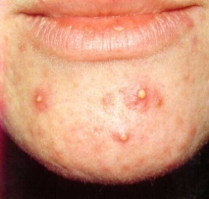
Non-Contraceptive Health Benefits
Improves acne and hirsutism
Menstrual-related health benefits:
Decreased dysmenorrhea
Decreased menstrual blood loss - decreased anemia
May reduce menstrual-related PMS symptoms
Reduces
Endometrial and ovarian cancer risk
Benign breast conditions
PID
Notes:
Combined oral contraceptive pills have many non-contraceptive benefits. Primarily, they alleviate menstrual disturbances. Studies have shown COCs to substantially decrease dysmenorrhea, menstrual blood loss, premenstrual syndrome, and anovulatory bleeding.
Additionally, COCs are associated with a reduction in risk for ovarian and endometrial cancer and benign breast conditions. Particularly important for adolescents, COCs can reduce the incidence of acne. Though only three formulations (Yaz®, Ortho Tri-Cyclen® and Estrostep®) are specifically FDA approved for this purpose, many other formulations have also been shown to improve acne.
Source:
Palastati R, Hirvensal E, et al. Serum total and unbound testosterone and sex hormone binding globulin in female acne patients treated with two different types of oral contraceptives. Acta Derm Venereol 1984;64:517–23
Sources:
Larsson G, Milsom I, Lindstedt G, Rybo G. The influence of a low-dose combined oral contraceptive on menstrual blood loss and iron status. Contraception 1992;46(4):327–34
Parsey KS, Pong A. An open-label, multi-center study to evaluate Yasmin, a low-dose combination oral contraceptive containing drospirenone, a new progestogen. Contraception 2000;61:105–11
Freeman EW, Borisute H, Deal L, Smith L, et al. A continuous-use regimen of levonorgestrel/ethinyl estradiol significantly alleviates cycle-related symptoms: Results of a Phase 3 stud. Fertil Steril 2005;84:S25.
Davis A, Godwin A, Lippman J, et al. Triphasic norgestimate ethinyl estradiol for treating dysfunctional dysphoric disorder. Obstet Gynecol 2005;106:492–501

Slide 40
Estrogen-Related Side Effects
Rare but serious health risks, including blood clots, heart attack, and stroke
Patients should contact their medical provider immediately if they experience ACHES:
Abdominal pain
Chest pain
Headaches
Eye or visual changes
Severe leg pain or swelling
®
Notes:
Source: Hatcher R, Nelson A. Combined Hormonal Contraceptive Methods. In: Hatcher R, Trussell J, Stewart F, Nelson A, Cates W, Guest F, Kowal D. Contraceptive Technology. 18th Edition. New York, NY: Ardent Media Inc; 2005: 226; 462.

Slide 41
Progestin-Related Side Effects
Edema
Abdominal bloating
Anxiety
Irritability
Depression
Myalgia
Menstrual irregularities
Notes:
Source: Hatcher R, Nelson A. Combined Hormonal Contraceptive Methods. In: Hatcher R, Trussell J, Stewart F, Nelson A, Cates W, Guest F, Kowal D. Contraceptive Technology. 18th Edition. New York, NY: Ardent Media Inc; 2005: 226; 462.

Slide 42
Extended Cycling
Decrease hormonal shifts and number of menses
Convenience, treat dysmenorrhea, other cyclic symptoms
Seasonale®—levonorgestrel, 30 mcg EE for 84 days, 7 placebos
Seasonique®—added 10 mcg EE to placebos
LoSeasonique®—20 mcg EE for 84 days
Lybrel™—28 days 20 mcg EE, no placebos
Do NOT need branded extended-cycling product!
Notes:
Any monophasic pill can be used
Can take active pills until breakthrough bleeding occurs, then stop pills for 7 days
Can extend duration of active pills from 6 weeks up to 12 weeks and beyond
Be specific in prescribing:
Disp: 3 packs for a 9 week supply of active pills
Sig: Take 1 active pill daily, skip inactive pills

Slide 43
Improving Contraceptive Continuation
Providing more than one cycle of birth control at initial visit increases contraceptive continuation
Women initiating OCP use at an urban family-planning clinic who received 7 pill packs had a higher 6-month continuation rate than those getting 3 cycles (51% v. 35%)
Greatest effect: teens younger than 18 years old
White KO, Westhoff C. Obstet Gynecol 2011;118:615–22
Notes:
Source: White KO, Westhoff C. The effect of pack supply on oral contraceptive pill continuation: a randomized controlled trial. Obstet Gynecol 2011;118:615–22
CONCLUSION: A greater OCP supply at the time of initiation can improve continuation rates, especially among women younger than 18 years of age.
Access to multiple pill packs at one time results in higher rates of continuation. In a 2011 randomized trial, investigators compared 6-month contraceptive continuation rates among women who were dispensed three pill packs or seven pill packs. Participants who received seven pill packs had a higher 6-month rate continuation than participants who received three pill packs (51% compared with 35%, P<.001), and the effect was greater among participants younger than 18 years (49% compared with 12%, P<.001). Although not statistically significant, participants who received a prescription were less likely to continue OC use than those who received pill packs over-the-counter

Slide 44
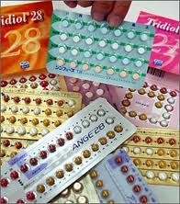
Prescribe or Dispense Multiple Cycles of Contraception
Making contraceptives more accessible may reduce unintended pregnancy and abortion
California women who received a 1-year supply were less likely to have a pregnancy compared with women who got 3 cycles or 1 month of pills
Dispensing a 1-year supply:
30% reduction in odds of unplanned pregnancy
46% reduction in odds of an abortion
Foster, Diana G. et al. Obstet Gynecol 2011;117:566–72)
Notes:
http://www.ansirh.org/_documents/library/foster-green_obstet-gyn2-2011.pdf
Methods: We linked 84,401 women who received oral contraceptives through the California family planning program in January 2006 to Medi-Cal pregnancy events and births conceived in 2006.
Results: Making oral contraceptives more accessible may reduce the incidence of unintended pregnancy and abortion. Health insurance programs and public health programs may avert costly unintended pregnancies by increasing dispensing limits on oral contraceptives to a 1-year supply. Dispensing a 1-year supply is associated with a 30% reduction in the odds of conceiving an unplanned pregnancy compared with dispensing just one or three packs (confidence interval [CI] 0.57–0.87) and a 46% reduction in the odds of an abortion (95% CI 0.32–0.93),controlling for age, race or ethnicity, and previous pill use.
But what other factors can affect a providers’ ability to prescribe multiple cycles of contraceptives?
The ability to dispense or prescribe multiple packs will differ, depending on what insurance a patient has and/or whether or not onsite supplies are available and in what quantity.
Providers should become familiar with the number of cycles that can be prescribed at once via Medicaid and the common private insurance plans that their patients have.
Pharmacies also have different prescribing practices that limit amounts given out. Mail order pharmacy programs are often better about dispensing larger supplies.

Slide 45
Are COCs the best choice?
Advantages:
Effective
Safe
Quick return to fertility
Health benefits
Disadvantages:
Requires daily adherence
Semi-private
Estrogen-related risks & side-effects

Slide 46
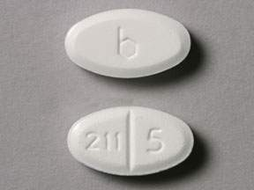
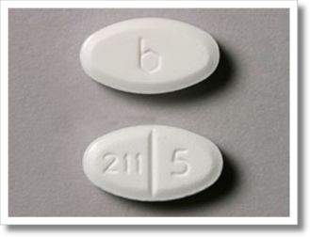
Progestin-Only Oral Contraceptives
Called the “mini-pill”
Two formulations: norethindrone and norgestrel
No placebo week
Mechanism of action: thickens cervical mucous
Timing crucial – ideally SAME TIME EVERY DAY
If >3h late – backup contraception for 48h
Apgar BS. AFP. 2000; WHO MEC. 2004. Contraception Report. 1999. Apgar BS. AFP. 2000. et al.
Notes:
Often called “mini-pills,” progestin-only pills are a good contraceptive choice for women who can’t use estrogen.
There are currently two formulations—norethindrone (Micronor®, each pill contains 0.35 mg of norethindrone) and norgestrel (Ovrette, each pill contains 0.075 mg of norgestrel).
Efficacy of progestin-only pills requires consistent use. So women should take the pill at the same time every day.
Mechanism of Action:
Progestin-only pills prevent contraception through multiple mechanisms including suppressing ovulation and mid-cycle gonadotropin peaks and altering the cervical mucus, the endometrium, and fallopian tubes.
Candidates:
Progestin-only pills are useful for women who want immediately reversible hormonal contraception but for whom estrogen is contraindicated because of breastfeeding, cardiovascular disease, and migraine, for example.
Advantages:
Progestin-only pills (COCs also are used) can be used to correct dysfunctional uterine bleeding. This bleeding usually results from anovulation and occurs at the extremes of life.
Progestin-only pills do not have the estrogen-related side effects that COCs have, such as nausea, headache, and bloating, but they do cause irregular vaginal bleeding.
These pills protect against cancer of the uterus and ovaries, benign breast disease, and pelvic inflammatory disease.
Contraindication:
The only contraindication to taking progestin-only pills is current breast cancer.
Disadvantages:
Efficacy of progestin-only pills requires consistent use. So women should take the pill at the same time every day.
Progestin-only users should be prepared to use a back-up method in case they don’t take the pill as required.
The primary side effect is irregular menstrual bleeding, including spotting or breakthrough bleeding, amenorrhea, or shorted cycles. Irregular bleeding decreases in many users by cycle 12. But menstrual side effects are the most frequently cited reasons for discontinuing progestin-only pills. Less common side effects are headache, breast tenderness, and dizziness.
Counseling:
The pill must be taken at the same time each day.
If a pill is more than 3 hours late, a backup method of contraception should be used for at least the next 48 hours. Inform women about emergency contraception.
Explain that the range of bleeding disturbances that may occur, including frequent bleeding, prolonged bleeding, irregular bleeding, or, in some cases, amenorrhea. In many women, this irregular bleeding improves within a few months. If bleeding is heavy or particularly bothersome, women should contact their health care provider.
References
Progestin-only oral contraceptives: An update. Contraception Report. 1999. Vol. 10, Issue 4.
Apgar BS, Greenberg G. Using Progestins in Clinical Practice. AFP. 2000;62:1849–1850.
American College of Obstetricians and Gynecologists. Birth Control Pills. 2006. http://www.acog.org/publications/patient_education/bp021.cfm
WHO Medical Eligibility Criteria for Contraceptive Use, 3rd edition 2004.
Trussel J. Contraceptive efficacy. In Hatcher RA, Trussel J, Nelson AL, Cates W, Stewart FH, Kowal D. Contraceptive Technology: Nineteen Revised Edition. New York, NY: Ardent Media, 2007.
---
Original content for this slide submitted by Association of Reproductive Health Professionals in June 2008. Original funding received from the Association of Reproductive Health Professionals general operating funds. This slide is available at www.arhp.org/core

Slide 47
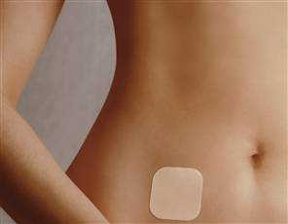
Transdermal Patch: Ortho Evra®
Very Effective
Estrogen and progestin
Beige-colored patch changed once per week
3 weeks on/1 week off
9 days of medication in each patch
Mechanism: Inhibits ovulation
Notes:
[Insert Lecture Name Here]
Slide 47
Source: Abrams LS. Fertil Steril. 2002: Ortho Evra Prescribing Information. Archer DF, et al. Fertil Steril. 2002.; Zacur HA, et al. Fertil Steril. 2002.; Zieman M, et al. Fertil Steril. 2002.; Archer DF, et al. Contraception. 2004.; Audet MC, et al. JAMA. 2001.
First available in US in 2002.
The weekly transdermal contraceptive patch (Ortho Evra) , which is beige-colored, is applied once a week to the abdomen, buttock, upper outer arm, or upper torso.
The patch delivers 150 μg of norelgestromin/20 μg of ethinyl estradiol daily to systemic circulation. Serum concentrations of norelgestromin and ethinyl estradiol within the range generally seen with oral norgestimate 250 μg/ethinyl estradiol 35 μg are maintained for up to 10 days, suggesting that clinical efficacy would be maintained even if a scheduled change is missed for as long as 2 full days.
Three consecutive 7-day patches (21 days) are applied, followed by 1 patch-free week per cycle.
Use of the patch should be initiated during the first 24 hours of menses; no back-up is recommended. However, if use is initiated after day 1 of the menstrual cycle, a nonhormonal back-up method is recommended.
The contraceptive efficacy of the transdermal patch is comparable to that of combination OCs. In clinical trials, fewer than 3% of patches were replaced due to partial (2.9%) or complete (1.8%) detachment. Adhesion is not affected by heat, humidity, or exercise.
Mechanism of Action:
Comparative studies suggest that young women in particular may be able to use the patch more consistently than OCs.
The patch is an appropriate method for women who desire the convenience of a once-weekly regimen, as well as those who have difficulty using a method that requires daily attention.
Noncontraceptive benefits are similar to those of OCs.
Candidates:
Women who want an easy, nondaily method.
Women with dysmenorrhea and menorrhagia
Women who are concerned about interference with nausea or vomiting.
Advantages:
Weekly form of birth control
Rapid reversibility
Contraindications :
Same as those for combination OCs.
Disadvantages:
Side effects are similar to COC’s side effects. Because the patch contains estrogen and progestin, side effects associated with its use are probably similar to OCs, although more study is needed. A 2008 publication of a Cochrane Database sytematic review determined that compared to COC users, patch users were more likely to report breast discomfort, dysmenorrhea, nausea, and vomiting, but that patch users had better compliance than OC users. These side effects usually dissipate within the first 2 months of use.
Increased exposure to estrogen, which may increase the risk of side effects
Application site reactions.
Breast tenderness. Breast tenderness is greater in the first few cycles of use and dissipates over time.
Contraceptive failures may be increased among women weighing 90 kg (198 lbs) or more.
Counseling:
Educate patient on application and removal of patch
Avoid placing patch in areas that receive a lot of friction, such as bra straps
Place on buttocks, abdomen, upper torso (excluding breasts), or upper arm
Apply to clean, dry skin
Once removed, fold patch closed to reduce release of hormones
Do not flush in the waste system. Dispose of it in the garbage
References
Archer DF, Bigrigg A, Smallwood GH, et al. Assessment of compliance with a weekly contraceptive patch (Ortho Evra/Evra) among North American women. Fertil Steril. 2002;77(Suppl 2):S27-31.
Archer DF, Cullins V, Creasy GW, Fisher AC. The impact of improved compliance with a weekly contraceptive transdermal system (Ortho Evra®) on contraceptive efficacy. Contraception. 2004;69:189-195.
Audet M-C, Moreau M, Koltun WD, et al. Evaluation of contraceptive efficacy and cycle control of a transdermal contraceptive patch vs an oral contraceptive. A randomized controlled trial. JAMA 2001;285:2347-54.
Ortho Evra™ Prescribing Information, Ortho-McNeil Pharmaceutical, Raritan, NJ; November 2001.
Sibai BM, Odlind V, Meador ML, Shangold GA, Fisher AC, Creasy GW. A comparative and pooled analysis of the safety and tolerability of the contraceptive patch (Ortho Evra™/ Evra™). Fertil Steril. 2002;77(2 Suppl 2):S19-26.
ACOG Committee on Practice Bulletins. No. 73. Use of Hormonal Contraception in Women with Coexisting Medical conditions. Obstet Gynecol 2006;107:1453-72..
Lopez LM, Grimes DA, Gallo MF, Schulz KF. Skin patch and vaginal ring versus combined oral contraceptives for contraception. Cochrane Database Syst Rev 2008;(1).
WHO Medical Eligibility Criteria for Contraceptive Use, 3rd edition 2004.
Abrams LS, Skee D, Natarajan J, Wong FA. Pharmacokinetic overview of Ortho Evra™/Evra™. Fertil Steril. 2002;77( Suppl 2):S3-12.
Ortho Evra Prescribing Information. Ortho-McNeil Pharmaceutical, Raritan, NJ; November 2001.
Trussel J. Contraceptive efficacy. In Hatcher RA, Trussel J, Nelson AL, Cates W, Stewart FH, Kowal D. Contraceptive Technology: Nineteen Revised Edition. New York, NY: Ardent Media, 2007.
---
Original content for this slide submitted by Association of Reproductive Health Professionals in June 2008. Original funding received from the Association of Reproductive Health Professionals general operating funds. This slide is available at www.arhp.org/core

Slide 48
Counseling Issues and Facilitating Use
Application
Reapplication
Missed or Late Patch
Place on clean, dry skin on arm, torso, buttocks, or stomach, NOT the breast
Must stick directly to skin
No patch during the fourth week
Apply a new patch after day 7 even if still bleeding
Use back-up method when:
On for >9 days
Off for >7 days
Falls off >24 hrs
Notes:
Extended cycling is also a safe and effective option with the patch.
Sources:
Edelman A, Gallo MF, Jensen JT, Nichols MD, Grimes DA. Continuous or extended cycle vs. cyclic use of combined hormonal contraceptives for contraception. Cochrane Database of Systematic Reviews 2005, Issue 3. Art. No.: CD004695. DOI: 10.1002/14651858.CD004695.pub2.
Nanda K. Contraceptive Patch and Vaginal Contraceptive Ring. In: Hatcher RA, Trussell J, Nelson A, Cates W, Stewart F, Kowal D. (editors) Contraceptive Technology, 19th revised edition. New York: Ardent Media, 2007
48

Slide 49
Is the Patch the Right Choice?
Advantages
Effective
Safe
Disadvantages
60% more estrogen than COCs
Semi-private
Weekly (not daily) adherence
Possible same health benefits as COCs
Estrogen-related risks and side effects
Hyperpigmentation, irritation, and adhesive residue
Cost
Notes:
Nanda K. Contraceptive Patch and Vaginal Contraceptive Ring. In: Hatcher RA, Trussell J, Nelson A, Cates W, Stewart F, Kowal D. (editors) Contraceptive Technology, 19th revised edition. New York: Ardent Media, 2007

Slide 50
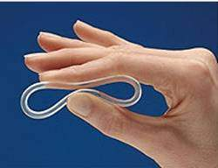
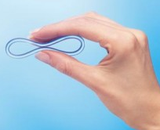
Vaginal Ring
Very Effective
Estrogen and progestin
Flexible, unfitted ring placed in vagina
In 3 weeks; out 1 week
4 weeks of medication in ring
Continuous use: change first of each month
Mechanism: inhibits ovulation
Notes:
[Insert Lecture Name Here]
Slide 50
Source: NuvaRing Prescribing Information. Organon. 2001: Timmer CJ. Clin Pharmacokinet. 2000. Herndon EJ. Am Fam Physician. 2004: Dieben TO. Obstet Gynecol. 2002: Linn ES. Int J Fertil. 2003. et al.
The vaginal contraceptive ring (NuvaRing) was approved by the FDA in 2001; became available in US in 2002.
Ring is flexible, transparent, and colorless to nearly colorless.
Ring comes in one size that fits most women; no fitting is required. One ring is inserted into the vagina per cycle and is to remain in place continuously for 3 weeks, followed by a ring-free week.
When inserted, the ring delivers ~ 120 μg of etonorgestrel and 15 μg of ethinyl estradiol/day to the systemic circulation over a 3-week period. After insertion, maximum serum concentrations of etonorgestrel and ethinyl estradiol are achieved in approximately 1 week and show a gradual linear decline thereafter.
Women not previously using hormonal contraception should insert the ring on or before day 5 of the cycle, counting the first day of menstruation as day 1. Back-up contraception is recommended for the first 7 days of ring use.
Women switching from a combination OC may insert the ring any time within 7 days after the last combined estrogen/progestin OC and no later than the day that a new cycle of pills would have been started. No back-up method is needed.
Consider “Quick Start” method with the ring.
Mechanism of Action:
Similar to COC’s mechanism of action.
The ring inhibits ovulation and sperm motility, fertilization, and implantation.
Candidates:
The vaginal ring is an appropriate method for women who desire the convenience of a 3-week regimen, as well as those who have difficulty using a method that requires daily attention.
Women who want to regulate their periods.
The hormonal benefits of the vaginal ring are similar to those of the contraceptive skin patch and pill.
Clinical trials with the vaginal ring were not designed to assess specifically the impact of heavier body weight on contraceptive efficacy. Therefore, no data are available regarding the efficacy of the vaginal contraceptive ring in women of heavier body weight.
Ring improves vaginal flora, leading to reduced frequency of bacterial vaginosis.
A multicenter trial showed a low incidence of gastrointestinal problems, such as nausea and vomiting.
Advantages:
Convenient, once a month use
Privacy
Cycle control, few women experience untimely spotting or bleeding
Contraindications:
Same as those for combination Ocs (except those related to intestinal absorption problems0
Significant pelvic relaxation
Vaginal obstruction
Unable to touch genitalia
Disadvantages:
Possibility of leukorrhea and vaginitis
Hormone-related side effects associated with use of the vaginal ring, such as headache and nausea, are similar to those seen with OCs, although more study is needed. Local adverse effects associated with use of the vaginal ring include leukorrhea, vaginitis, and a slight risk (1%) of device expulsion. The ring is rarely felt during intercourse.
Because the vaginal ring contains estrogen and progestin, contraindications for its use are similar to those for OCs.
Counseling:
The ring is easy to insert; there is no wrong way to insert it.
The ring can be placed anywhere in the vagina, but the deeper it’s placed, the less likely it will be felt.
After 3 weeks, remove the ring for one week and then insert a new ring.
Patients need to be cautioned that the ring can be inadvertently expelled from the vagina while removing a tampon or during bowel and bladder emptying, especially with straining or constipation. Often women are not aware that the device has been expelled.
If the ring falls out, it should be rinsed with warm water and reinserted within 3 hours.
References
Herndon EJ, Zieman M. New contraceptive options. Am Fam Physician. 2004;69:853-860.
Dieben TO, Roumen FJ, Apter D. Efficacy, cycle control, and user acceptability of a novel combined contraceptive vaginal ring. Obstet Gynecol. 2002;100:585-93.
Linn ES. Progress in contraception: new technology. Int J Fertil. 2003;48:182-91.
Brunei V, Pontello V, Luisi S, Petraglia F. An open-label, multicentre trial to evaluate the vaginal bleeding pattern of the combine contraceptive vaginal ring NuvaRing. Eur J Obstet Gynecol Reprod Biol. 2008.
Roumen FJME, Apter D, Mulders TMT, Dieben TOM. Efficacy, tolerability and acceptability of a novel contraceptive vaginal ring releasing etonogestrel and ethinyl oestradiol. Hum Reprod. 2001;16:469-75.
Lete I, Doval JL, Perez-Campos E, et al. Factors affecting women’s selection of a combined hormonal contraceptive method: the TEAM-06 Spanish cross-sectional study. Contraception. 2007;76:77-83.
NuvaRing Prescribing Information. Organon Inc., West Orange, NJ; 2001.
Vaginal ring. Mayo Clinic. January 2008. http://www.mayoclinic.com/health/birth-control/BI99999/PAGE=BI00017
NuvaRing Prescribing Information. Organon Inc., West Orange, NJ; 2001.
Timmer CJ, Mulders TMT. Pharmacokinetics of etonogestrel and ethinylestradiol released from a combined contraceptive vaginal ring. Clin Pharmacokinet. 2000;39:233-42.
Trussel J. Contraceptive efficacy. In Hatcher RA, Trussel J, Nelson AL, Cates W, Stewart FH, Kowal D. Contraceptive Technology: Nineteen Revised Edition. New York, NY: Ardent Media, 2007.

Slide 51
Counseling Issues and Facilitating Use
Insertion
Reinsertion
If Ring Falls Out
Provider can place the ring in patient’s vagina in the office/clinic and have patient remove it and practice inserting it again herself
Advise patients to reinsert ring on the same day every month to increase compliance
During week 1 and 2, reinsert ring
During week 3, insert NEW ring OR have withdrawal bleed and insert NEW ring after 7 days
In all cases, use back-up method for 7 days
Ring can be removed safely for up to 3 hrs/day
Notes:
The ring can safely be removed for up to three hours at a time. If it is out of the body for more than three hours, guidelines differ depending on timing within the cycle. During the first “ring in” weeks, she can reinsert an expelled ring. During week three, she can either insert a new ring right away or start the withdrawal bleed and insert a new ring seven days after the last one was removed/expelled. With any of these options, she should use another backup method of birth control for seven days.
Extended cycling is also a safe and effective option with the ring.
Sources:
Nanda K. Contraceptive Patch and Vaginal Contraceptive Ring. In: Hatcher RA, Trussell J, Nelson A, Cates W, Stewart F, Kowal D. (editors) Contraceptive Technology, 19th revised edition. New York: Ardent Media, 2007
Edelman A, Gallo MF, Jensen JT, Nichols MD, Grimes DA. Continuous or extended cycle vs. cyclic use of combined
hormonal contraceptives for contraception. Cochrane Database of Systematic Reviews 2005, Issue 3. Art. No.: CD004695. DOI:
10.1002/14651858.CD004695.pub2.

Slide 52
Is the Ring the Best Choice?
Advantages
Safe and effective
Low dose
Disadvantages
Estrogen-related risks and side effects
Discomfort with self insertion and removal
Monthly adherence
Same health benefits as COCs?
Increased vaginal wetness and discharge
Patients and partners may feel it during sex
May decrease BV risk
Notes:
Source:
Nanda K. Contraceptive Patch and Vaginal Contraceptive Ring. In: Hatcher RA, Trussell J, Nelson A, Cates W, Stewart F, Kowal D. (editors) Contraceptive Technology, 19th revised edition. New York: Ardent Media, 2007

Slide 53
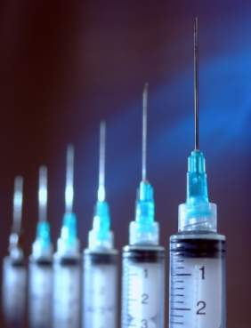
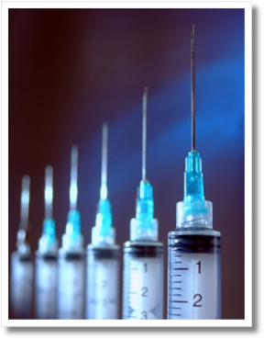
Injectable: Depo-Provera® (DMPA)
Very Effective
Progestin only
IM or SQ injection every 3 months (14 weeks)
Mechanism: Inhibits ovulation
Trussel J. Contraceptive Technology. 2007. Cromer BA. Am J Obstet Gynecol. 2005. Trussel J. Contraception. 2004.; Westhoff C. Contraception. 2003. et al.
Notes:
3-month injectable (Depo-Provera): A 1-mL crystalline suspension of 150 mg of DMPA is injected intramuscularly into the deltoid or gluteus maximus muscle every 11–13 weeks.
Mechanism of Action:
As with other progestins it not only prevents ovulation; it also reduces ovarian production of estradiol.
Candidates:
DMPA is a good choice for women who want reversible, nondaily contraception
DMPA does not require daily use. The convenience and high efficacy rate of DMPA has made this contraceptive method an increasingly popular with teens--the percentage of teens who had used DMPA increased from 10% in 1995 to 21% in 2002.
Clinical situations in which estrogen is contraindicated include complicated migraine headaches, diabetes, smokers aged >age 35, and postpartum women. DMPA can be initiated immediately postpartum because it does not contain estrogen--it does not affect breastfeeding.
The amenorrhea the majority of DMPA users experience may improve conditions such as menorrhagia, dysmenorrhia, and iron deficiency anemia. At least one-half of users develop amenorrhea within 12 months. Amenorrhea may be a desired lifestyle change. DMPA also can decrease the risk of dysfunctional menstrual bleeding in women who are overweight.
But it is only appropriate for women who do not wish to conceive immediately after discontinuing it. The median time to conception for those who do conceive is 10 months following the last injection.
Advantages:
Reduces the risk of endometrial cancer by up to 80%, with continuing protection after discontinuation.
Reduces risk of PID and uterine leiomyomata
Can decrease the number and severity of crises in patients with sickle cell anemia.
Contraindication:
Known or suspected malignancy of the breast (WHO Medical Eligibility Criteria for Contraceptive Use, 3rd edition 2004).
Disadvantages:
Weight gain: The data suggests that weight gain with DMPA is varies from person to person. Some gain weight while others lose or maintain body weight.
Menstrual irregularities: Most women have an altered menstrual cycle with DMPA, including irregular bleeding and spotting, and rarely heavy bleeding, for at least the first 3 months of use. Then, these menstrual changes decrease over time. By one year, up to 70% of women have amenorrhea.
Bone mineral density: In 2004, the FDA issued a black box warning that DMPA use may lead to significant BMD loss, increasing the risk of future osteoporotic fractures. But evidence is mounting that BMD generally rebounds 2 to 3 years after DMPA discontinuation. This evidence of complete BMD recovery was observed regardless of ethnicity (black vs. mixed race), duration of injectable use, age during use, or injectable formulation used (DMPA vs. NET-EN). Health care providers and women should weigh concerns about temporary bone loss with DMPA’s convenience and well-established efficacy.
Return to fertility: The median time to conception for those who do conceive is 10 months following the last injection.
References
Cromer BA, Lazebnik R, Rome E, et al. Double-blinded randomized controlled trial of estrogen supplementation in adolescent girls who receive depot medroxyprogesterone acetate for contraception. Am J Obstet Gynecol. 2005;192(1):42-47.
Trussel J. Contraceptive failure in the United States. Contraception. 2004;70(2):89-96.
Westhoff C. Depot-medroxyprogesterone acetate injection (Depo-Provera®): a highly effective contraceptive option with proven long-term safety. Contraception. 2003;68(2):75-87.
Thomas DB, Ray RM. Depot-medroxyprogesterone acetate (DMPA) and risk of invasive adenocarcinomas and adenosquamous carcinomas of the uterine cervix. WHO Collaborative Study of Neoplasia and Steroid Contraceptives. Contraception. 1995;52(5):307-312.
Kaunitz AM. Current concepts regarding use of DMPA. J Reprod Med. 2002;47(9 Suppl):785-789.
Cullins VE. Noncontraceptive benefits and therapeutic uses of depot medroxyprogesterone acetate. J Reprod Med. 1996;41(5 Suppl):428-433. Review.
Rosenberg L et al. Bone status after cessation of use of injectable progestin contraceptives. Contraception 2007 Dec; 76:425.
Kaunitz A, Shields W. Depo-Provera’s black box: time to reconsider? Contraception. 2005;72(3): 165-167.
FDA Talk Paper. Black box warning added concerning long-term use of Depo-Provera contraceptive injection. US Food and Drug Administration web site. Available at: http://www.fda.gov/bbs/topics/ANSWERS/2004/ANS01325.html.
WHO Medical Eligibility Criteria for Contraceptive Use, 3rd edition 2004.
Leeman L. Medical barriers to effective contraception. Obstet Gynecol Clin N Amer. 34 (2007) 19-29.
Kaunitz AM, Arias R, McClung M. Bone density recovery after depot medroxyprogesterone acetate injectable contraception use. Contraception 77 (2008) 67-76.
World Health Organization. WHO statement on hormonal contraception and bone health. Available at: http://www.who.int/reproductive-health/family_planning/bone_health. html.
ACOG practice bulletin. No. 73: Use of hormonal contraception in women with coexisting medical conditions. Obstet Gynecol 2006;107:1453–72.
Trussel J. Contraceptive efficacy. In Hatcher RA, Trussel J, Nelson AL, Cates W, Stewart FH, Kowal D. Contraceptive Technology: Nineteen Revised Edition. New York, NY: Ardent Media, 2007.
US Approved Prescribing Information for DMPA Contraceptive Injection, Pharmacia & Upjohn Co. www.pharmacia.com 1999.
---
Original content for this slide submitted by Association of Reproductive Health Professionals in June 2008. Original funding received from the Association of Reproductive Health Professionals general operating funds. This slide is available at www.arhp.org/core

Slide 54
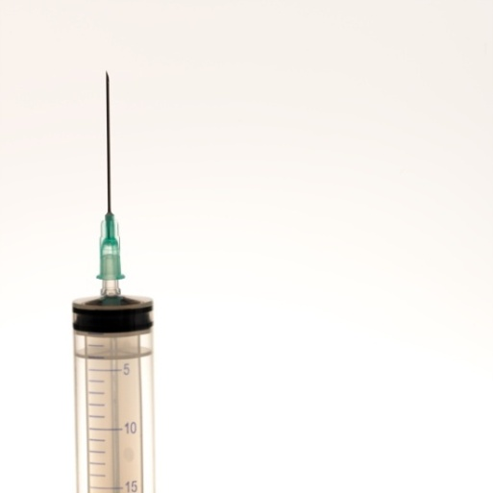
Injectable Contraception
Perfect Use: 0.3%
Typical Use: 3%
Highly Effective
Low- Maintenance & Long- Acting
No Estrogen
Private
Health Benefits
Injected in deltoid or gluteus muscle every 3 months
Notes:
Depo-Provera is a progestin-only injectable contraceptive containing depot medroxyprogesterone and administered in a deep intramuscular injection of 150 mg every 11 to 12 weeks. This method prevents pregnancy by acting at the level of the pituitary and the hypothalamus. Primarily, DMPA inhibits ovulation by suppressing the level of follicle stimulating hormone (FSH) and luteinizing hormone (LH), ultimately preventing the LH surge. DMPA also decreases the quality of the cervical mucus, thereby preventing sperm penetration.
DMPA is a safe, highly efficacious method with rates ranging from 0.3% with correct and consistent use to 3% with actual use. Because DMPA does not require daily maintenance, efficacy rates for typical use are much higher than for oral contraceptives. DMPA is reversible (though return to fertility may take as long as 10 months and affords young users a certain level of privacy as the method is not visible to partners or parents. Additionally, because effective plasma concentration is sustained for at least 14 weeks, and ovulation is suppressed, on average for 18 weeks, the method is forgiving of delayed injections. For these reasons, teen use has increased over the last several years. According to the National Survey of Family Growth, 10% of young women 15–19 reported using DMPA in 1995. By 2002, this percentage had grown to 21%.
Ismail AA, el-Faras A, Rocca M, el-Sibai FA, Toppozada M. Pituitary response to LHRH in long-term users of injectable contraceptives. Contraception 1987;35:287–95
Petta CA, Faunndes A, Dunson TR, et al. Timing of onset of contraceptive effectiveness in Depo-Provera users: Part II. Effects on ovarian function. Fertil Steril 1998:70:817–20
Trussell J. Contraceptive failure in the United States. Contraception 2004;70:89–96
Mishell DR. Pharmacokinetics of depot medroxyprogesterone acetate contraception. J Reprod Med 1997;41(5 Suppl):381–90
Kaunitz AM. Long-acting injectable contraception with depot medroxyprogesterone acetate for contraception. Am J Obstet Gynecol 2005;192:42–7
Centers for Disease Control and Prevention. Teenagers in the United States: Sexual Activity, Contraceptive Use, and Childbearing, 2002—A Fact Sheet for Series 23, Number 24

Slide 55
Non-Contraceptive Benefits
Decreases ovulation pain, mood changes, headaches, breast tenderness, and nausea
Decreases risk of PID
Decrease frequency of grand mal seizures
Reduces frequency of sickle-cell crises
Notes:
Importantly, DMPA has several non-contraceptive benefits. Because DMPA do not contain estrogen, this method does not appear to carry the rare but serious risks of complications attributable to exogenous estrogen. DMPA has also been shown to decrease menstrual disturbances including ovulation pain, dysmenorrhea, mood changes, headaches, breast tenderness, and nausea. The thickened cervical mucous caused by DMPA may prevent pathogens from entering the upper genital tract therefore decreasing the risk of pelvic inflammatory disease in DMPA users. DMPA use may also help young women with some chronic illnesses. For instance, possibly due to the sedative properties of progestins, research indicates that DMPA can decrease the frequency of grand mal seizures. DMPA use is associated with greater reduction in the frequency of sickle cell crises when compared with combined oral contraception or no intervention. There are also minimal drug interactions between DMPA and antibiotics or enzyme-inducing drugs such as many anticonvulsants, mood stabilizers, and medications for migraine prophylaxis. The only drug that decreases the effectiveness of DMPA is aminoglutethimide, which is indicated for suppression of adrenal function in selected cases of Cushing’s disease.
McCann MF, Poter LS. Progestin-only oral contraception: a comprehensive review. Contraception 1994; (6 Suppl 1):S1–195
Kaunitz AM. Injectable depot medroxyprogesterone acetate contraception: an update for U.S. clinicians. Int J Fertil Womens Med 1998;43:73–83
Baeten J, Nyange P, Richardson B, et al. Hormonal contraception and risk of sexually transmitted disease acquisition: results from a prospective study. Am J Obstet Gynecol 2001;185:380–385
Mattson RH, Cramer JA, Darney PD, Naftolin F. Use of oral contraceptives by women with epilepsy. JAMA 1986;256:238–240
Mattson RH, Rebar RW. Contraceptive methods for women with neurologic disorders. Am J Obstet Gynecol 1993;168:2027–2032
de Abood M, de Castilo Z, Guerrero F, Austin KL. Effect of Depo-Provera or Microgynon on the painful crises of sickle cell anemia patients. Contraception 1997;56:313–16
Hatcher RA, Schare S. Ask the experts: progestin-only contraceptives. Contraceptive Technol Update 1993;14:114–115

Slide 56
Side Effects
First several months: unpredictable or prolonged spotting
After one year: 40%-50% have amenorrhea
20%–25% of women discontinue use because of menstrual issues
Notes:
Primarily, women taking DMPA will experience menstrual irregularities.
In the first several months many women experience unpredictable and prolonged spotting. After one year of DMPA use, 40% to 50% of women experience amenorrhea and, after five years, up to 80% no longer menstruate. Research indicates that menstrual disturbances are the most frequent cause of dissatisfaction with this method, causing 20% to 25% of patients to discontinue use.
For teens, it is especially important to discuss potential issues with parents (i.e., no menses).
Providers must candidly discuss a patient’s comfort with initial spotting or irregular bleeding and the eventual lack of periods to ascertain whether DMPA is an acceptable contraceptive choice to her. If, after the first three months, a young woman has concerns about these menstrual irregularities, providers may offer her a short course of exogenous estrogen or a prostaglandin synthetase inhibitor (NSAID), if not contraindicated. These regimens have been shown to decrease bleeding in the short term but menstrual irregularities will most likely return upon discontinuation.
Sources:
Belsey EM. Vaginal bleeding patterns among women using one natural and eight hormonal methods of contraception. Contracetpion 1988;38:181–206.
Polaneczky M, Liblanc M. Long-term depot medroxyprogesterone acetate (Depo-Provider) use in inner-city adolescents. J Adolesc Health 1998;23:81–88.
Potter LS, Dalberth BT, Canamer R, Betz M. Depot medroxyprogesterone acetate. Patterns of use and reasons for discontinuation. Contraception 1997;56:209–214.
Said S, Sadek W, Rocca M, et al. Clinical evaluation of the therapeutic effectiveness of ethinyl oestradiol and oestrone sulphate on prolonged bleeding in women using depot medroxprogesterone acetate for contraception.
World Health Organization, Special Programme of Research, Development and Research Training in HIman Reproduction, Task Force on Long-acting Systemic Agents for Fertility Regulation. Human Reprod 1996;11 Suppl 2:2–13
Tantiwattanakul P, Tneepanichskul S. Effect of mefenamic acid on controlling irregular uterine bleeding in DMPA users. Contraception 2004;70:277–79

Slide 57
Is DMPA the Best Choice?
Advantages
Highly effective
Safe and private
Disadvantages
Menstrual irregularities
Possible effects on weight and bones
Injection every 12 weeks
Health benefits
Irreversible for three months
Office visit every three months
Delayed return to fertility

Slide 58
Dispel Common Myths

Slide 59
Dispelling Myths
When providers or patients hold misperceptions about the risks associated with contraception…
Teens’ choices are unnecessarily limited
Notes:
ARSHEP would like to acknowledge Dr. Rachael Phelps for creation of this slide.
Myth about birth control are common and pose significant barriers to use
Myths are held by both patients and providers

Slide 60
DMPA and Bone: Much Ado about Nothing!
Significant bone loss during pregnancy (3-5%) & breastfeeding (4-5%)
Bone loss from DMPA similar.
Most pronounced in first 1-2 years (3-5%) and then stabilizes (5% at 4.5 years).
Bone loss is temporary and reversible.
Duration of use does not impact recovery.
Bone loss associated with DMPA has never been shown to increase risk of fracture or any other clinical outcome.
Notes:
ARSHEP would like to acknowledge Dr. Rachael Phelps for creation of this slide.
Source: Guilbert, E.R et al. Contraception 2009;79: 167-177
Scholes D, et al. Arch Pediatr Adolesc Med 2005;159:139–144
Berenson AB, et al. Am J Obstet Gynecol 2001;98:576-82
Demonstrates that after DMPA initiation, women lose from 1%-3% of their bone mineral density per year of DMPA use., This results from DMPA’s suppression of gonadotropin secretions, which in turn suppresses ovarian estradiol production and creates a hypoestrogenenic state. Bone resorption in women in this state exceeds bone formation, resulting in declines in BMD.
This is of potential concern with adolescent women who are accruing bone mineral density during this period. Four studies that evaluated the specific effect of DMPA on the bone density in adolescent women found that bone mineral density at the lumbar spine decreased a grand average of -3.1% compared to +7.2% in adolescents not taking the method. In response to these data, in November 2004, the FDA added a black box warning to the label for Depo Provera raising concerns about DMPA’s effect on peak BMD and questioning the risk for osteoporotic fracture in later life.
Recent research suggests that DMPA’s effect on bone mineral density is temporary and reversible. A 2005 study followed 80 DMPA users and 90 controls ages 14 to 18 years with BMD testing every 6 months for 23 months to 36 months. Though the authors found a -5.0% loss at the spine among new DMPA users after 24 months, adjusted bone mineral density values for discontinuers were at least as high as those of nonusers after 12 months discontinuation.
Berenson AB, Radecki CM, Grady JJ, et al. A prospective, controlled study of the effects of hormonal contraception on bone mineral density. Am J Obstet Gynecol 2001;98:576-82
Clark MK, Sowers M, Levy BT, Tenhundfeld P. Magnitude and variability of sequential estradiol and progesterone concentrations in women using depot medroxyprogesterone acetate for contraception. Fertil Steril 2001; 75:871–877
Gbolade BA. Depo-Provera and bone density. J Fam Plann Reprod Healthcare 2002; 28:7–11
Cromer BA, Blair JM, Mahan JD, et al. A prospective comparison of bone density in adolescent girls on depot medroxyprogesterone acetate, Levonorgestrel, or oral contraceptives. J Pediatr 1996;129:671-6
Busen NH, Britt RB, Rianon N. Bone mineral density in a cohort of adolescent women using depot medroxyprogesterone acetate for one to two years. J Adolesc Health 2003;32:257-9
Depo-Provera label. Pharmacia & Upjohn. October 2004. Available at www.fda.gove/edwatch/SAFETY/2004/nov_PI/Depo-Provera_PI.pdf
Scholes D, Lacroix AZ, Ichikawa LE, et al. Change in bone mineral density among adolescent women using and discontinuing depot medroxyprogesterone acetate contraception. Arch Pediatr Adolesc Med 2005; 159:139–144
60

Slide 61
DMPA and Bone: Take Home Messages
Women should be informed that the use of DMPA is associated with a slight decrease in BMD, which is reversible
There should be no limit to the length of time that DMPA is used regardless of a woman’s age
Measuring BMD among DMPA users is not recommended
Guilbert, E.R et al. Contraception 2009;79: 167-177
Notes:
ARSHEP would like to acknowledge Dr. Rachael Phelps for creation of this slide.
Findings from a scientific meeting in 2008 of ob/gyn, rheumatologists, ortho surgeons and endocrinologists who reviewed all existing data on subject.

Slide 62
Contraception and Weight Gain
Not all DMPA users gain weight
25% of users gain excessive weight
Other users gain minimal weight
Early weight gain at 6 months predicts excessive weight gain (avg. 15 lbs more over 3 years)
No association between caloric intake and weight gain
Le Y.C. et al. Obstet Gynecol. 2009 Aug;114:279-84
Bahamondes L, et al. Contraception 2001;64:223-225
Notes:
DMPA is associated with weight gain.
IUDs, IMPLANT, PILLS, PATCH, RING: => DO NOT CAUSE WEIGHT GAIN!!!
ARSHEP would like to acknowledge Dr. Rachael Phelps for creation of this slide.
Polaneczky M, et al. J Adolesc Health 1998;23:81-88
Bahamondes L, et al. Contraception 2001;64:223-225
Mangan SA, et al. J Pediatr Adolesc Gynecol 2002;15:79-82
SFP: Contraceptive Considerations in Obese Women, Contraception 2009

Slide 63
Contraception Efficacy and Weight: Evidence is Limited and Inconsistent
Does obesity decrease efficacy?
IUCs: No
Implant: No effect
Patch: data weak, no effect or weak effect
COC: data weak, no effect or weak effect
Ring: No effect
Xu et al. Obstetrics and Gynecology 2012
SFP: Contraceptive Considerations in Obese Women, Contraception 2009
Notes:
ARSHEP would like to acknowledge Dr. Rachael Phelps for creation of this slide.
EURAS-OC- 59,000 COC users2000-2005 no diferrence in efficacy
ｧ Levonorgestrel Regimens
o obese women (BMI ≥30 kg/m2) were at four-fold higher risk of pregnancy (OR 4.41; 95% CI 2.05–9.44)
o overweight women (BMI 25-29.9 kg/m2) were at two-fold higher risk of pregnancy (OR 2.09; 95% CI 0.86–4.87)
o for overweight and obese women, levonorgestrel use was not associated with a significant reduction in pregnancy rate compared with that expected with no medication.
ｧ Ulipristal acetate
o obese women were at two-fold higher risk of pregnancy (OR 2.62, 95% CI 0.89–7.00).
o Overweight women appeared to have no increase in risk (OR 0.97; 95% CI 0.27–2.83) compared to normal or underweight women using ulipristal acetate

Slide 64
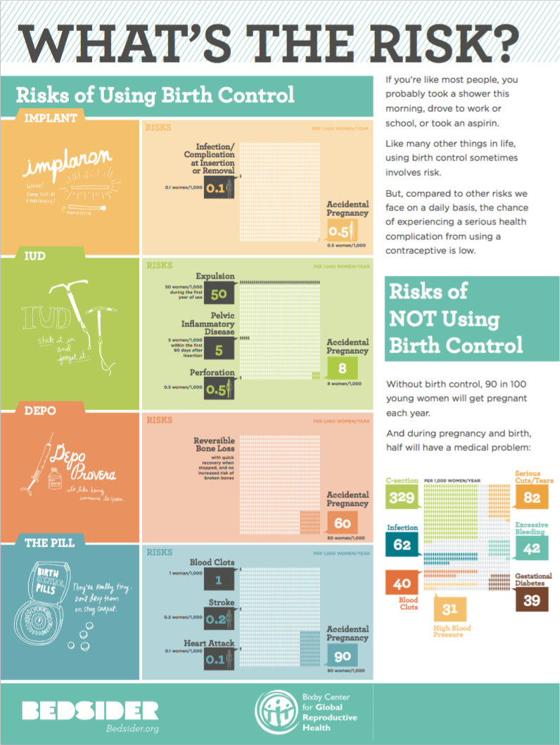
Safety and Risk in Context

Slide 65
Determining Safety of Contraception Methods
The CDC developed the U.S. Medical Eligibility Criteria (MEC) for Contraceptive Use based on the World Health Organization Guidelines for Contraceptive Use
There are 4 categories:
1 - No restriction (method can be used)
2 - Advantages generally outweigh risks
3 - Theoretical or proven risks usually outweigh the advantages
4 - Unacceptable health risk (method not to be used)
CDC MMWR. 2016.
Notes:
Most healthy women are potential candidates for COCs.
But how do we determine whether it is safe for a young woman to use a particular method of contraception? Similar to STI guidelines we look to the CDC and use their US Medical Eligibility Criteria (MEC) for contraceptive use.
There are four categories that the MED addresses:
No restriction (method can be used)
Advantages generally outweigh theoretical or proven risks
Theoretical or proven risks usually outweigh the advantages
Unacceptable health risk (method not to be used)
There is a new user friendly MEC app for the iPhone which was created by the CDC. You can find it by searching Apple’s mobile app store for CDC Contraception.
Source:
Centers for Disease Control and Prevention. U.S. Medical Eligibility Criteria for Contraceptive Use, 2012. Morbidity and Mortality Weekly Report (MMWR). 2012, June; 61(24);449–452. http://www.cdc.gov/reproductivehealth/unintendedpregnancy/Docs/USMEC-Color-62012.docx.

Slide 66
U.S. Medical Eligibility Criteria (MEC) for CHC Use
Category 4 = Absolute Contraindications
Current breast cancer
Severe cirrhosis, Hepatocellular adenoma, Malignant liver tumor, Acute/flare viral hepatitis
Acute DVT/PE, History of DVT/PE with high risk for recurrence, Major surgery with prolonged immobilization
Documented thrombogenic mutations
Migraine headaches with auras
Diabetes >20 yrs or with vascular end-organ damage
Hypertension: Sys >160, Dias >100 or with vascular disease
Current or history of ischemic heart disease, complicated valvular heart disease, peripartum cardiomyopathy
Postpartum <21days
Age >35 and >15 cigarettes/day
Complicated solid organ transplant
History of stroke
Lupus with positive or unknown antiphospholipid antibody
Notes:
Now if we take a look at the Category 4 Absolute Contraindications we get what looks like a fairly long list, but if I ask you to pick out which of these is most likely to occur in an otherwise healthy young woman you will find that few of these issues are common.
Young women do frequently come in with headaches that they often call migraines but it is important to clarify whether those headaches are actually migraines and more importantly migraines with aura as it is only a migraine with aura that is an absolute contraindication.
Unfortunately with our epidemic of obesity we are seeing more hypertension in our younger patients but please note that the upper numbers for elevated systolic and diastolic pressures are fairly high in this category.
Of course we do have teen pregnancies and a combined method is contraindicated in the first 21 days postpartu.m
Cigarette smoking is only a category 4 contraindication if a patient is older than 35 and smokes more than 15 cigarettes per day.
People worry a lot about young people having a thrombogenic mutation that might predispose them to thromboses, but it is not recommended to routinely screen all young people for these mutations as they are very rare and screening is very expensive. If your patient has a personal or family history suspicious for a thrombogenic mutation in particular then a workup is probably indicated before starting them on a combined hormonal method; but you can probably start them on a progestin only method or a copper IUD until your investigation is complete.
Thrombogenic mutations: factor V leiden, prothrombin mutation; protein s, protein c and antithrombin deficiencies (CU iud -1, Prog – 2)

Slide 67
U.S. Medical Eligibility Criteria (MEC) for CHC Use
Category 3 = Relative Contraindications
Past Breast Cancer (>5 years)
Breastfeeding <1m postpartum
Postpartum 21–42d with VTE risk
History of DVT/PE with low risk for recurrence
Symptomatic gallbladder disease
Malabsorptive bariatric surgery (COCs)
Superficial venous thrombosis
Past OCP related cholestasis
IBD with increased risk for VTE
HTN: systolic <140–159, diastolic <90–99, controlled
Age >35 and <15 cigarettes/day
Drugs: Rifampin, Rifabutin, Certain Anticonvulsants, Lamotrigine, Protease inhibitors
Multiple sclerosis with prolonged immobility
Peripartum cardiomyopathy >6 months
Notes:
In terms of Category 3 relative contraindications once again we see fewer issues that are more common in adolescents:
Breastfeeding teens should wait one month before considering combined methods
Patients with less severe HTN or controlled HTN are better off on a non-combined method
And patients who are on Rifampin, Rifabutin, and certain anticonvulsants are better off on the injection, IUD or implant, as other methods including combined pills, the patch, the ring and the progestin only pill are less effective when taken with these medications. Please note that all other broad spectrum antibiotics, antifungals and antiparasitics are Category 1 and combined hormonal methods can be used without restriction when these medications are being taken.
Please refer to the basic MEC chart and its more detailed CLARIFICATIONS when you are uncertain about any contraindications to combined methods.

Slide 68
IUDs have Very Few Contraindications
Current PID
Current untreated mucopurulent cervicitis, gonorrhea, or chlamydia
Post abortion/partum infection in past 3 mo.
Current or suspected pregnancy
Anatomically distorted uterine cavity
Wilson’s disease (Paragard)
Other: Uncommon issues for TEENS
Known cervical or uterine cancer
Known Breast Cancer (Mirena only)
Genital bleeding of unknown etiology
CDC US Medical Eligibility Criteria 2016

Slide 69
Implant: Only ONE Contraindication
Current Breast Cancer
Important to know about Class labeling of implant with CHC by FDA.
CDC US Medical Eligibility Criteria 2016

Slide 70
CDC US Medical Eligibility Criteria (USMEC)
Nulliparity
Adolescence
CIN
Obesity
Postpartum
Breastfeeding
Diabetes
HIV
Depression
Stroke/DVT
PID (continuation)
STI (continuation)
IUDs & Implants are a USMEC 1/2
for ALL of the following conditions
CDC US Medical Eligibility Criteria MMWR 2016

Slide 71
VTE Risk in Context
Risk in General Population
Risk in COC Users
Pregnancy and Postpartum Period
0.8 per 10,000 women per year
3-4 per 10,000 women per year
6-12 per 10,000 women per year
Notes:
VTE is very rare in the general population—0.8 women per 10,000 will experience an event each year. Women using hormonal contraception face higher risk but an occurrence of VTE in this population is also very rare. VTE risk in the pregnancy and postpartum period carries the most risk, yet the majority of women have normal healthy pregnancies. Even if one was concerned about the findings of patch users having double the risk of VTE compared to COC users, this would still be an extremely low number of VTE cases, less than 10 in 10,000 per year, which is the rate of VTE in pregnant and postpartum women.
Sources:
Kujovich JL. Hormones and pregnancy: thromboembolic risks for women. Br J Haematol. 2004 Aug; 126(4):443–54.
Vandenbroucke JP, Rosing J, Bloemenkamp KW, Middeldorp S, Helmerhorst FM, Bouma BN, Rosendaal FR. Oral contraceptives and the risk of venous thrombosis. N Engl J Med. 2001 May 17;344(20):1527–35.
Greer IA. Thrombosis in pregnancy: maternal and fetal issues. Lancet 1999;353:1258–1265.

Slide 72
The Patch Is Safe
Failure rates similar to COCs
Forgiving of delayed reapplication
Higher detachment rate with teens (up to 35%)
Higher failure rate among women who weigh 198 lbs
Similar estrogen-related side effects and risks as COCs
Increased amount of estrogen may increase clot risk, but risk still very low
Notes:
In clinical trials, the failure rates for the patch were similar to COCs: 0.3% with perfect use and 8% with typical use. Because the patch is administered weekly, not daily, adherence rates with younger women are higher. One study of 50 adolescents found that 87% of participants reported perfect compliance. Additionally, the method is forgiving of delayed patch reapplication. Hormone levels remain active for at least nine days after application of a second patch suggesting that ovulation would be inhibited with a delay of at least two days.
Sources:
Nanda K. Contraceptive Patch and Vaginal Contraceptive Ring. In: Hatcher RA, Trussell J, Nelson A, Cates W, Stewart F, Kowal D. (editors) Contraceptive Technology, 19th revised edition. New York: Ardent Media, 2007
Rubinstein ML, Halpern-Felsher BL, Irwin CE. An evaluation of the use of the transdermal contraceptive patch in adolescents. J Adolesc Health 2004;24:295-401
Abrams LS, Skee D, Natarajan J, Wong FA. Pharmacokinetic overview of Ortho Evra/Evra. Fertil Steril 2002;77:S3-12

Slide 73
Few Contraindications for DMPA Use
CDC/WHO Category 4: current breast cancer
CDC/WHO Category 3: cirrhosis, diabetes-related complications, history of breast cancer, current cardiovascular disease, liver tumors, unexplained vaginal bleeding, poorly controlled hypertension or with vascular disease, multiple risk factors for cardiovascular disease, history of stroke, lupus with positive or unknown antiphospholipid antibodies
Notes:
Almost all adolescents are potential candidates for DMPA as there are few contraindications for use. In fact, according to the WHO the only absolute contraindication category 4 condition to DMPA use is current breast cancer. There are several category 3 conditions, including current cardiovascular disease, abnormal liver function or liver tumors, nephropathy/retinopathy/neuropathy related to diabetes, women with a history of breast cancer or unexplained vaginal bleeding. It is also category 3 to initiate DMPA in women with migraines with aura, although current users can continue DMPA even if they develop migraines.
DMPA is also an alternative for patients who have contraindications to estrogen use (including deep vein thrombosis or recent pulmonary embolism) and for women who are breastfeeding.
Sources:
Centers for Disease Control and Prevention. U.S. Medical Eligibility Criteria for Contraceptive Use, 2010. Adapted from the World Health Organization Medical Eligibility Criteria for Contraceptive Use, 4th edition. MMWR Early Release 2010;59 May 28, 2010. Available at http://www.cdc.gov/mmwr/pdf/rr/rr59e0528.pdf.
World Health Organization. Improving Access to Quality Care in Family Planning: Medical Eligibility Criteria for Contraceptive Use, 2nd edition. Geneva, Switzerland: World Health Organization, 2000
Halderman LD, Nelson AL. Impact of early postpartum administration of progestin-only hormonal contraceptives compared with nonhormonal contraceptives on short-term breast-feeding patterns. Am J Obstet Gynecol 2002; 186:1250–56

Slide 74
Quick Start

Slide 75
Improving Contraception Initiation with Quick Start for Hormonal Methods
Patients are more likely to start method
Improves continuation rates
Offers earlier protection from pregnancy
No significant difference in the bleeding patterns compared with menses start

Slide 76
Improving Contraception Initiation with Quick Start for Hormonal Methods
Start the method THE DAY they fill the prescription for OCP, Ring, Patch, DMPA, Implant
Ensure that:
Negative pregnancy test that day
Use condoms for first week
Understands risks and benefits of method and when protected
Discussion of EC
Westoff C, Kerns J, Morroni C, et al. Contraception. 2002;66:141–5.
Notes:
Conventional hormonal contraception initiation instructions require waiting until after menses to begin the method. Though no clinical evidence has shown that any hormonal contraception adversely affects a developing fetus, this measure is intended to rule out existing pregnancy. However, stipulating that initiation can only occur within this small window requires a young woman to return for another appointment and to abstain from sexual intercourse or to utilize barrier methods of contraception in the interim. For a substantial number of women, this increases the risk of unintended pregnancy. In recent years, providers have been increasingly starting young women on contraception on the day of their visit. Commonly referred to as “Quick Start,” this method has been shown to improve compliance while maintaining a good safety and side effect profile. In a recent randomized study of young women aged 14–26, receiving the first injection of Depo-Provera (DMPA) at the conclusion of their first visit (known as Depo Now) was associated with improved adherence to DMPA continuation and fewer pregnancies.
If a young woman’s menses occurred more than five days before the day of the visit, providers should assess the last time that unprotected sex occurred and administer a pregnancy test. If unprotected sex occurred within five days, patients should be given emergency contraception. In previous studies, about 3% of patients were found to be pregnant after their DMPA injection was started as a Quick Start. These data support the need for a 21-day follow-up after Quick Start initiation with any contraceptive method. Providers must therefore discuss the risk of pregnancy and the necessity of the return visit with all patients. To increase the likelihood that young women will return for this visit, providers can develop internal office protocols to facilitate a 21-day return visit such as follow-up phone calls or text message reminders.
Sources:
Bracken MB. Oral contraception and congenital malformations in offspring: a review and meta-analysis of prospective studies. Obstet Gynecol 1990;76:552–7
Ohlemeyer CL. Adolescents’ compliance with return visits for depot medroxyprogesterone initiation. J Pediatr Adolesc Gynecol 2003;16:297–9
Lara-Torre E, Schroeder B. Adolescent compliance and side effects with Quick Start initiation of oral contraceptive pills. Contraception 2002;66:81.
Westhoff C, Kerns J, Morroni C, et al. Quick Start: a novel oral contraceptive initiation method. Contraception 2002;66:141.
Rickert VI, Tiezzi L, Lipshutz J, León J, Vaughan RD, Westhoff C. Depo Now: preventing unintended pregnancies among adolescents and young adults. J Adolesc Health. 2007 Jan;40(1):22–8
Polaneczky M, Slap G, Forke C, et al. The use of levonorgestrel implants for contraception in adolescent mothers. N Engl J Med 1994;331:1201–6
Westhoff C, Kerns J, Morroni C, et al. Quick start: a novel oral contraceptive initiation method. Contraception 2002;79:322–9
Morroni C, Grams M, Tiezzi L, Westhoff C. Immediate monthly combination contraception to facilitate initiation of the depot medroxyprogesterone acetate contraceptive injection. Contraception 2004;70:19–23
Sneed R, Westhoff C, Morrni C, Tiezzi L. A prospective study of immediate initiation of depo medroxyprogesterone acetate contraceptive injection. Contraception 2005;71:99–103.

Slide 77
How to be Reasonably Certain that Your Patient is Not Pregnant (CDC SPR 2016)
If they have no symptoms or signs of pregnancy and meet any one of the following criteria:
is ≤7 days after the start of normal menses
has not had sexual intercourse since the start of last normal menses
has been correctly and consistently using a reliable method of contraception
is ≤7 days after spontaneous or induced abortion
is within 4 weeks postpartum
is fully or nearly fully breastfeeding (exclusively breastfeeding or the vast majority [≥85%] of feeds are breastfeeds), amenorrheic, and <6 months postpartum

Slide 78
Making Contraception Affordable
www.contraceptionjournal.org/article/S0010-7824(14)00687-8/pdf
Notes:
Source: Sonfield A et al., "The Impact of the Federal Contraceptive Coverage Guarantee on Out-of-Pocket Payments for Contraceptives: 2014 Update," Contraception, 2014, <www.contraceptionjournal.org/article/S0010-7824(14)00687-8>
Between fall 2012 and spring 2014, the proportion of privately insured women paying zero dollars out of pocket for oral contraceptives increased substantially, from 15% to 67%. Similar changes occurred among privately insured women using injectable contraception, the vaginal ring, and the intrauterine device.
Data for this study come from a subset of the 1842 women aged 18–39 years who responded to all four waves of a national longitudinal survey. This analysis focuses on the 892 women who had private health insurance and who used a prescription contraceptive method during any of the four study periods. Women were asked about the amount they paid out of pocket in an average month for their method of choice

Slide 79
Wrap Up
Take a full medical and sexual history
Explore personal circumstances affecting method choice and compliance
Discuss side effects candidly and validate concerns
Encourage dual condom/contraception use
Write an advanced prescription of EC or instruct on OTC access

Slide 80
Provider Resources: Contraception
www.cdc.gov/reproductivehealth/unintendedpregnancy/usmec.htm United States Medical Eligibility Criteria (US MEC) for Contraceptive Use, 2016
www.managingcontraception.com –Managing Contraception
store.managingcontraception.com/contraceptive-technology-20th-edition -Contraceptive Technology 20th Edition
www.choiceproject.wustl.edu -Contraceptive Choice Project
bedsider.org -Bedsider
thenationalcampaign.org -The National Campaign to Prevent Teen and Unplanned Pregnancy
www.reproductiveaccess.org/key-areas/contraception -Reproductive Health Access Project

