Slide 1
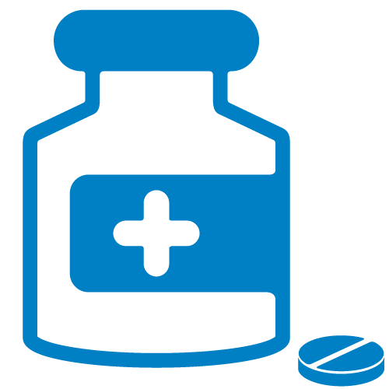
HIV Pre-Exposure Prophylaxis (PrEP) and Adolescents
Notes:
This module was developed in part with funding provided by the NYS Department of Health, Bureau of Maternal & Child Health, Division of Family Health, C-027009 to Columbia University HDPFH. Its contents are solely the responsibility of Columbia University HDPFH and do not necessarily represent the official views of the New York State Department of Health.
The three main contributors on the development of this module are ARSHEP faculty:
Renata Arrington-Sanders, MD, MPH
Assistant Professor
Division of General Pediatrics and Adolescent Medicine
Bloomberg School of Public Health
Johns Hopkins School of Medicine
Baltimore, MD
Veenod Chulani, MD, MSED, FSAHM,
CEDS
Medical Director
Homeless Youth Outreach Program
Section Chief, Adolescent Medicine
Division of General Pediatrics and
Adolescent Medicine
Phoenix Children’s Hospital
Phoenix, AZ
Allison Eliscu, MD, FAAP
Clinical Assistant Professor of Pediatrics
Division Chief of Adolescent Medicine
Stony Brook School of Medicine,
Stony Brook Children’s Hospital
Stony Brook, NY

Slide 2
Learning Objectives
Describe the Epidemic of HIV in the United States
Discuss role of PrEP in National HIV/AIDS Strategy
Identify populations eligible for PrEP
Discuss PreP initiation and monitoring
Discuss systems-based challenges and consideration in delivering PrEP services, including minors’ consent, and cost considerations

Slide 3
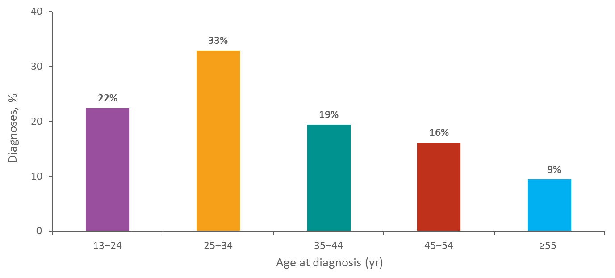
Diagnoses of HIV Infection among US Adults and Adolescents by Age at Diagnosis, 2015
Note. Data include persons with a diagnosis of HIV infection regardless of stage of disease at diagnosis. Data for the year 2015 are preliminary and based on 6 months reporting delay.; N = 39,393
Notes:
This slide presents percentages of diagnoses of HIV infection by age group for 2015 in the United States. Of the 39,393 diagnoses of HIV infection among adults and adolescents, 33% were among persons aged 25–34 years, 22% among persons aged 13–24 years, 19% among persons aged 35–44 years, 16% among persons aged 45–54 years, and 9% among persons aged ≥55 years.
Data include persons with a diagnosis of HIV infection regardless of stage of disease at diagnosis. Data for the year 2015 are preliminary and based on 6 months reporting delay.

Slide 4
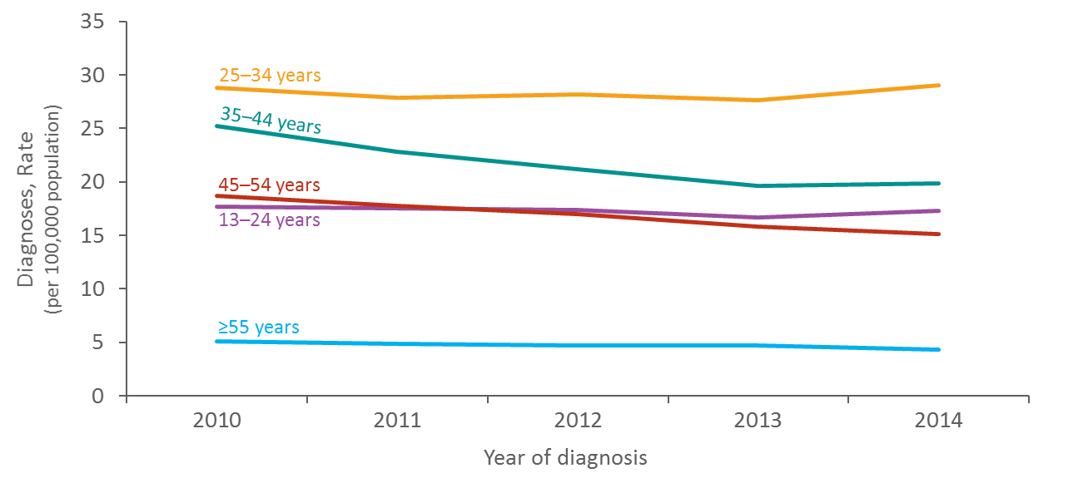
Rates of Diagnoses of HIV Infection among US Adults and Adolescents by Age at Diagnosis, 2010–2014
Note. Data include persons with a diagnosis of HIV infection regardless of stage of disease at diagnosis.
Notes:
This slide presents the rates of diagnoses of HIV infection by age group among adults and adolescents in the United States from 2010 though 2014.
Persons aged 25–34 years accounted for the highest rates of diagnoses of HIV infection each year; whereas, persons aged ≥55 years accounted for the lowest rates of diagnoses of HIV infection each year.
From 2010 though 2014, rates of diagnoses of HIV infection remained stable among persons aged 13–24 years and 25–34 years. Decreases were seen in rates among persons aged 35–44 years (-21.0%), 45–54 years (-19.3%), and ≥55 years (-15.7).
Data include persons with a diagnosis of HIV infection regardless of stage of disease at diagnosis.

Slide 5
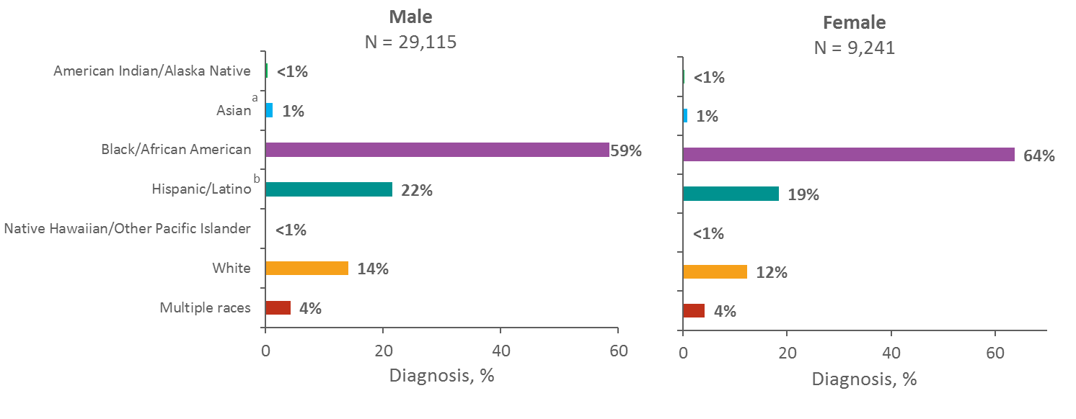
US Adolescents and Young Adults Aged 13–24 Years Living with Diagnosed HIV Infection, by Sex and Race/Ethnicity, Year-end 2014
Note. Data include persons with a diagnosis of HIV infection regardless of stage of disease at diagnosis.
ª Includes Asian/Pacific Islander legacy cases.
^{b} Hispanics/Latinos can be of any race.
Notes:
At the end of 2014, 38,356 adolescents and young adults 13–24 years of age were living with diagnosed HIV infection in the United States and 6 dependent areas.
Of the 29,115 male adolescents and young adults living with diagnosed HIV infection, 59% were black/African American, 22% were Hispanic/Latino, 14% were white, 4% were of multiple races, and 1% were Asian. Less than 1% each were American Indian/Alaska Native and Native Hawaiian/other Pacific Islander.
Among female adolescents and young adults living with diagnosed HIV infection, 64% were black/African American, 19% were Hispanic/Latino, 12% were white, 4% were of multiple races, and 1% were Asian. Less than 1% each were American Indian/Alaska Native and Native Hawaiian/other Pacific Islander.
Data include persons with a diagnosis of HIV infection regardless of stage of disease at diagnosis.
The Asian category includes Asian/Pacific Islander legacy cases (cases that were diagnosed and reported under the pre-1997 Office of Management and Budget race/ethnicity classification system).
Hispanics/Latinos can be of any race.
Persons living with diagnosed HIV infection are classified as adult or adolescent based on age at year-end 2014.

Slide 6
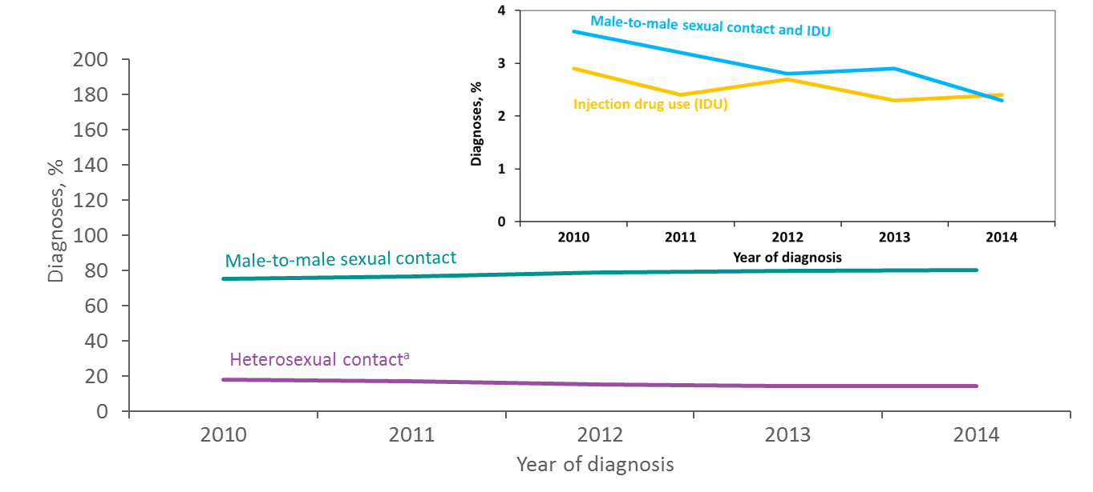
Diagnoses of HIV Infection among Adolescents and Young Adults Aged 13–24 Years, by Transmission Category, 2010–2014—United States and 6 Dependent Areas
Note. Data include persons with a diagnosis of HIV infection regardless of stage of disease at diagnosis. Data have been statistically adjusted to account for missing transmission category. “Other” transmission category not displayed as it comprises less than 1% of cases.
ª Heterosexual contact with a person known to have, or to be at high risk for, HIV infection.
Notes:
This slide presents the distribution of diagnoses of HIV infection by transmission category for adolescents and young adults aged 13–24 years with HIV diagnosed from 2010 through 2014 in the United States and 6 dependent areas.
Among adolescents and young adults, the percentage of diagnosed HIV infections attributed to male-to-male sexual contact increased from 75% in 2010 to 80% in 2014. The percentage of diagnosed HIV infections attributed to heterosexual contact decreased from 18% to 14% during this time. The percentage of diagnosed HIV infections attributed to injection drug use, and male-to-male sexual contact and injection drug use also decreased from 2010 through 2014. The “Other” transmission category is not displayed as it comprises less than 1% of cases. The category includes hemophilia, perinatal exposure, and risk factor not reported or not identified.
Data include persons with a diagnosis of HIV infection regardless of stage of disease at diagnosis. Data have been statistical adjustment to account for missing transmission category.
Heterosexual contact is with a person known to have, or to be at high risk for, HIV infection.

Slide 7
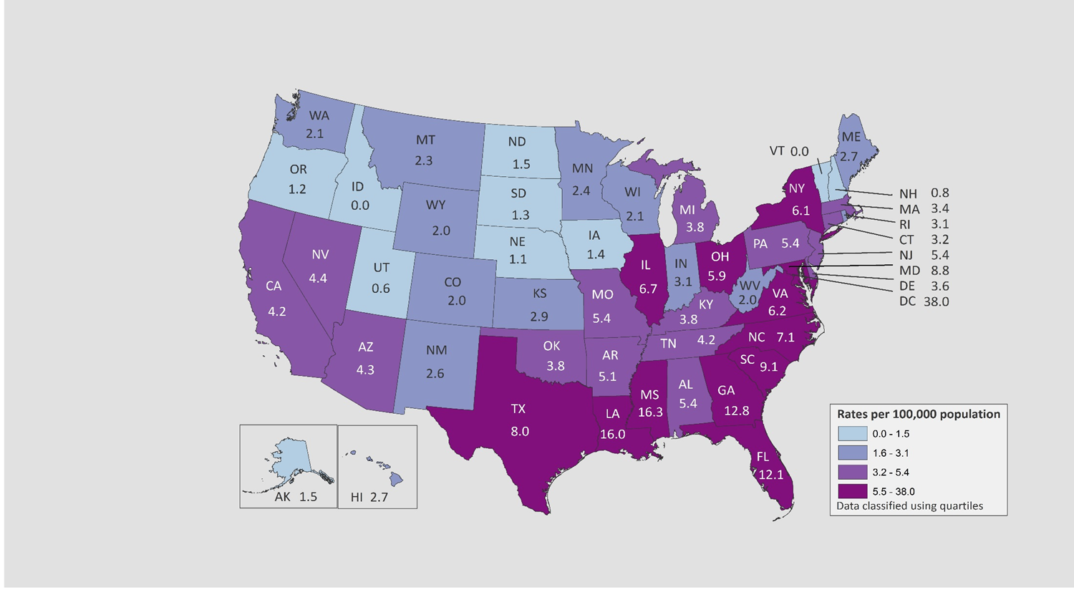
Rates of Diagnoses of HIV Infection among US, 2015
Adolescents 13-19 years
Adolescents 20-24 years
0.0
0.0
0.0
1.8
0.0
0.0
American Samoa
Guam
Northern Mariana Islands
Puerto Rico
Republic of Palau
U.S. Virgin Islands
American Samoa
Guam
Northern Mariana Islands
Puerto Rico
Republic of Palau
U.S. Virgin Islands
Note. Data include persons with a diagnosis of HIV infection regardless of stage of disease at diagnosis. Data for the year 2015 are preliminary and based on 6 months reporting delay.
Notes:
In 2015, there were 1,729 adolescents aged 13–19 years with HIV infection diagnosed in the United States and 6 dependent areas. The rate of diagnoses of HIV infection in adolescents was 5.8 per 100,000 population. The rates of diagnoses of HIV infection among adolescents in 2015 were highest in the District of Columbia (38.0), Mississippi (16.3), Louisiana (16.0), Georgia (12.8), and Florida (12.1).
The District of Columbia (i.e., Washington, DC) is a city; use caution when comparing the HIV diagnosis rate in DC with the rates in states.
Data include persons with a diagnosis of HIV infection regardless of stage of disease at diagnosis. Data for the year 2015 are preliminary and based on 6 months reporting delay.
In 2015, there were 7,151 young adults aged 20–24 years with HIV infection diagnosed in the United States and 6 dependent areas. The rate of diagnoses of HIV infection in young adults was 31.1 per 100,000 population. The rates of diagnoses of HIV infection among young adults in 2015 were highest in the South; specifically, the District of Columbia (93.3), Louisiana (64.0 ), Georgia (63.3 ), Mississippi (61.1 ), Florida (56.2), and Maryland (52.1).
The District of Columbia (i.e., Washington, DC) is a city; use caution when comparing the HIV diagnosis rate in DC with the rates in states.
Data include persons with a diagnosis of HIV infection regardless of stage of disease at diagnosis. Data for the year 2015 are preliminary and based on 6 months reporting delay.

Slide 8
HIV Prevention Challenges
Inadequate sex education
Low rates of testing
Low rates of condom use
Substance use
High rates of STIs
Stigma around HIV
Feelings of isolation
Homophobia/transphobia
Minority Stress
Notes:
Inadequate Sex Education. The status of sexual health education varies substantially throughout the United States and is insufficient in many areas according to CDC’s 2014 School Health Profiles.(https://www.cdc.gov/healthyyouth/data/profiles) In most states, fewer than half of high schools teach all 16 critical topics that CDC recommends for inclusion in curriculums. Specifically, many curricula do not include prevention information that relates to the needs of young gay and bisexual men. In addition, sex education is not starting early enough: in no state did more than half of middle schools meet goals put forth by CDC. Finally, sex education has been declining over time across the country.
The percentage of US schools in which students are required to receive instruction on HIV prevention decreased from 64% in 2000 to 41% in 2014.
2015 data from the Youth Risk Behavior Surveillance System (YRBS)(https://www.cdc.gov/healthyyouth/data/yrbs/index.htm), which monitors health risk behaviors that contribute to the leading causes of death and disability among youth reveal:
Low rates of testing. Low rates of condom use. Of the 30.1% of high school students reporting sexual intercourse during the previous 3 months, 43.1% did not use a condom the last time they had sexual intercourse.
Substance use.. Of the 30% of high school students reporting sexual intercourse during the previous 3 months, 20.6% drank alcohol or used drugs before last sexual intercourse
High rates of sexually transmitted diseases (STDs). Some of the highest STD rates are among youth aged 20 to 24, especially youth of color. The presence of another STD greatly increases a person’s likelihood of getting or transmitting HIV.
Stigma around HIV. In a 2012 Kaiser Family Foundation survey, 84% of youth aged 15 to 24 said there is stigma around HIV in the United States, which means they may not be comfortable discussing their status with others and agreeing on measures to protect themselves and their partners. For gay and bisexual youth who are just beginning to explore their sexuality, homophobia can pose obstacles to HIV testing and treatment.
Feelings of isolation. Gay and bisexual high school students may engage in risky sexual behaviors and substance abuse because they feel isolated and lack support. They are more likely to experience bullying and other forms of violence, which can lead to mental distress and engagement in risk behaviors that are associated with getting HIV
Homophobia/Transphobia. Homophobia refers to irrational fear and resulting hatred of homosexuality and homosexual persons. It engenders assault on personhood. Transphobia is a reaction of fear, loathing, and discriminatory treatment of people whose identity or gender presentation (or perceived gender or gender identity) does not “match,” in the societally accepted way, the sex they were assigned at birth. (Glick and Golden, 2010)
Minority Stress. Unfortunately, there is stigma attached to sexual orientation and gender nonconformity in many societies around the world. Such stigma can lead to prejudice and discrimination, resulting in “minority stress” (I. H. Meyer, 2003). Minority stress is unique (additive to general stressors experienced by all people), socially based, and chronic, and may make transsexual, transgender, and gender nonconforming individuals more vulnerable to acquiring HIV/STIs and developing mental health concerns such as anxiety and depression (Institute of Medicine, 2011).

Slide 9
HIV Preventative Measures
Abstinence
Decrease number of sexual partners
Regular condom use
Avoid sex with partners symptomatic for STIs
Regular STI screening
Partners screened regularly for STIs
Avoid alcohol or drug use
Syringe exchange and other harm reduction
PrEP (Pre-Exposure Prophylaxis)

Slide 10
National HIV/AIDS Strategy Vision
The United States will become a place where new HIV infections are rare and when they do occur, every person regardless of age, gender, race/ethnicity, sexual orientation, gender identity or socio-economic circumstance, will have unfettered access to high quality, life-extending care, free from stigma and discrimination
Notes:
The National HIV/AIDS Strategy (NHAS) is a comprehensive coordinated HIV/AIDS roadmap for policymakers and the general public with clear and measurable targets. First released on July 13, 2010, the Strategy identified a set of priorities and strategic action steps tied to measurable outcomes for moving the Nation forward in addressing the domestic HIV epidemic. In July 2015, the National HIV/AIDS Strategy for the United States: Updated to 2020 was released. The updated Strategy reflects the work accomplished and the new scientific developments since 2010 and charts a course for collective action across the Federal government and all sectors of society to move us close to the Strategy’s vision..

Slide 11
National HIV/AIDS Strategy Goals
Reducing new HIV infections
Increasing access to care and improving health outcomes for people living with HIV
Reducing HIV-related disparities and health inequities
Achieving a more coordinated national response to the HIV epidemic
Notes:
The primary goals of the NHAS include reducing HIV incidence, increasing access to care and optimizing health outcomes, reducing HIV-related health disparities, and achieving a more coordinated national response to the HIV epidemic.

Slide 12
National HIV/AIDS Strategy Prevention Related Outcomes by 2020
Reduce the number of new diagnoses by at least 25%
Reduce the percentage of young gay and bisexual men who have engaged in HIV-risk behaviors by at least 10%
Reduce disparities in the rate of new diagnoses by at least 15% among:
Gay and bisexual men
Young Black gay and bisexual men
Black females
Transgender women, especially Black transgender women
Persons living in the Southern United States
Latinos/Latinas
Notes:
https://obamawhitehouse.archives.gov/the-press-office/2015/07/30/fact-sheet-national-hivaids-strategy-updated-2020

Slide 13
National HIV/AIDS Strategy Key Areas of Focus
Widespread testing and linkage to care with early access to treatment
Broad support for people living with HIV to remain engaged in comprehensive care
Universal viral suppression
Full access to comprehensive PrEP services
Increase provider training
Reduce barriers to PrEP
Increase uptake of PrEP
Notes:
Widespread testing and linkage to care, enabling people living with HIV to access treatment early.
Broad support for people living with HIV to remain engaged in comprehensive care, including support for treatment adherence.
Universal viral suppression among people living with HIV.
Full access to comprehensive PrEP services for those whom it is appropriate and desired, with support for medication adherence for those using PrEP
.

Slide 14
What is HIV Pre-Exposure Prophylaxis (PrEP)?
An HIV-negative person
who engages in risk behavior for HIV
takes one pill TDF/FTC (Truvada) once a day
to prevent from becoming infected with HIV

Slide 15
Meet Jackson…
Jackson is an 18 year old bisexual male
Recently treated for syphilis.
Jackson and his partner are in an open relationship and do not use condoms consistently.
His partner was recently diagnosed with HIV and is currently undetectable, though is not always adherent with his medication.
Jackson is interested in learning more about PrEP…

Slide 16
What is the PrEP Pill?
TDF+FTC
Tenofovir disoproxil fumarate (300mg)
Emtricitabine (200mg)
1 pill taken once daily
FDA Approved to treat HIV in adolescents living with HIV if weight ≥ 35 kg and SMR 4 or 5 in 2004
FDA Approved for HIV PrEP >18yo in 2012
Notes:
FDA approved to treat HIV adolescents living with HIV if weight ≥ 35 kg and SMR 4 or 5

Slide 17
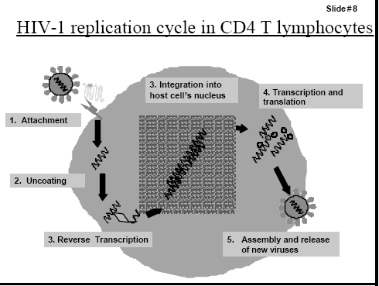
How Does PrEP Work?
TDF+FTC interferes with reverse transcriptase and prevents viral replication

Slide 18
Case: Jackson…
Is Jackson an appropriate candidate for PrEP?

Slide 19
Potential PrEP Target Populations:
Men who have sex with men (MSM) | Heterosexual women and men | Injection Drug Users (IDU)
HIV+ sex partner | HIV+ sex partner | HIV+ injecting partners
Recent bacterial STI (6 months) | Recent bacterial STI (6 months) | Sharing injection equipment or needles
Multiple sex partners | Multiple sex partners | Recent drug treatment but currently injecting
Inconsistent condom use | Inconsistent condom use (with MSM, IDU, high risk partners) | Risk of sexual acquisition (see columns on left)
Commercial sex worker | Commercial sex worker
Additional high risk individuals:
Individuals receiving PEP (especially if >1 course)
Transgender individuals
Individuals using stimulant drugs
CDC HIV PrEP Clinical Practice Guidelines, 2014
www.cdc.gov/hiv/pdf/prepguidelines2014.pdf
Notes:
These are potential PrEP populations that should be targeted. Please consider your catchment or service area to determine need for PrEP.
There is one study showing efficacy for PrEP for IVDUs from Thailand. Limited experience with PrEP for IDUs in the US.

Slide 20
Who Should NOT Receive PrEP?
HIV positive individuals
Renal insufficiency

Slide 21
Case: Jackson…
Jackson asks, “How Effective is PrEP?”

Slide 22
What’s the Evidence for PrEP? The iPrEX Trial
2500 MSM and transgender women in Peru, Ecuador, Thailand, Brazil, South Africa and United States
Age ≥18 years old
Randomized to daily TDF-FTC or placebo
Evaluated every 4 weeks
HIV test
Risk reduction and adherence counseling
Given new Rx and condoms

Slide 23
Results of the iPrEX Trial
Overall 44% reduced risk of acquiring HIV
Efficacy depends on compliance
50% reduction if >50% compliance
73% reduction if >90% compliance
92-99% reduction in acquiring HIV if drug level detectable in blood
Behavior changes in BOTH groups
Fewer # receptive anal intercourse partners
Increased condom use
Differences seen in transgender women and adolescents/young adults ≤ 25 years
Participants received HIV testing, risk reduction counseling and condoms every 3 months
Notes:
Taken 7 days a week in males 99% effective. The 99% came from the STRAND study where subjects were actually observed taking the medication.
There were differences noted in transgender women and adolescents/young adults ≤ 25 years. Higher numbers of receptive anal intercourse partners in both groups and lower blood levels. Lower blood levels were sub therapeutic in transgender women that may be the result of interaction with hormones.
Ref: Anderson PL, et al. Emtricitabine-Tenofovir Concentrations and Pre-Exposure Prophylaxis Efficacy in Men Who Have Sex with Men. Science Translational Medicine 2012; Vol. 4, Issue 151, pp. 151ra125. DOI: 10.1126/scitranslmed.3004006
Lancet HIV. 2015 Dec;2(12):e512-9. doi: 10.1016/S2352-3018(15)00206-4. Epub 2015 Nov 6.
HIV pre-exposure prophylaxis in transgender women: a subgroup analysis of the iPrEx trial.
Deutsch MB¹, Glidden DV², Sevelius J², Keatley J², McMahan V³, Guanira J⁴, Kallas EG⁵, Chariyalertsak S⁶, Grant RM⁷; iPrEx investigators.

Slide 24
Study | Population | Efficacy | HIV+ Conversion
Partners PrEP Trial | 4758 heterosexual males and females in sexual HIV discordant relationship in Kenya and Uganda TDF+FTC vs. Tenofovir vs. Placebo | Overall 67% reduction with Tenofovir 75% reduction with TDF+FTC Men: 84% Women: 66% Placebo stopped early b/c not as effective | 27 infected after baseline in both tx groups No resistant organisms detected
TDF2 | 1219 heterosexual males and females in Botswana TDF+FTC vs. placebo | Overall 62% reduction Men: 80% Women: 49% Study Limitations: Decreased adherence Poor study completion rates | 9/601 in study group No resistant organisms detected
Bangkok Tenofovir Study | 2413 injection drug users in Bangkok Tenofovier vs. Placebo | 49% reduction in acquiring HIV 70% reduction in individuals with detectable drug levels *Decreased IDU, needle sharing and high risk sexual behaviors in both groups | 17/1204 in study group No resistant organisms detected

Slide 25
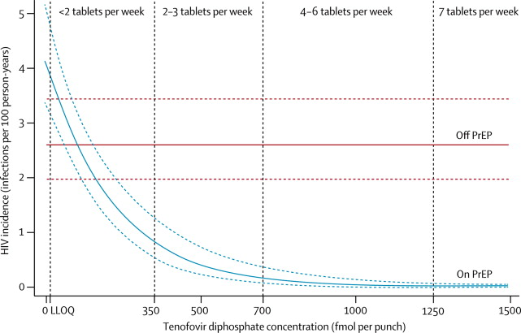
Estimated HIV Incidence IN MSM (>18 yo)
Efficacy improves as adherence improves
2-4 tabs/week may be acceptable for males
Females, IVDU and insertive anal intercourse require 6 tabs/week for similar efficacy
Efficacy:
90%
100%
Grant, Lancet Infect Disease 2014
Grant, Lancet Infect Disease 2014
Notes:
men and transgender women who have sex with men previously enrolled in PrEP trials (ATN 082, iPrEx, and US Safety Study) were enrolled in a 72 week open-label extension.
Women, IVDU and insertive anal intercourse requires higher serum levels to detect effective drug levels in vagina, cervix, urethra and blood

Slide 26
Clinical Studies of PrEP for HIV Prevention Among Youth in the U.S.
HIV Pre-Exposure Prophylaxis Demonstration Project and Safety Study for Young MSM
ATN 110: ages 18-22
ATN 113: ages 15-17
Key Objectives:
TDF/FTC safety data
Examine acceptability, adherence, and measured levels of drug exposure when YMSM are provided open-label TDF/FTC
Examine patterns of sexual behavior
Hosek SG, et al. J Acquir Immune Defic Syndr. 2017;74:21-9;
Hosek SG, et al. AIDS. Durban, South Africa. July 22-26, 2016. Abstract TUAX0104LB;
Hosek SG, et al. IAS. Vancouver, Canada. July 19-22, 2015. Abstract TUAC0204LB.

Slide 27
ATN 100/113: Baseline Demographics
 | ATN 110 | ATN 113
Ages | 18-22 | 15-17
Enrolled | 200 enrolled, 58 prematurely discontinued | 79 enrolled, 32 prematurely discontinued
Racial demographics | 53% Black 21% White 17% Latino 7% Other/Mixed 2% Asian | 33% Other/Mixed 29% Black 21% Latino
STI Incidence | 66.4 per 100 person-years | 28.5 per 100 person-years
HIV Incidence | 3.29 per 100 person-years (95% CI 0.07-6.52) | 6.41 per 100 person-years (95% CI: 4.9-25.8)
At baseline, high rates of condomless anal sex, history of STIs, exchange sex, and being kicked out of home
Lower TFV-DP levels across all time points in African-American MSM
Hosek SG, et al. J Acquir Immune Defic Syndr. 2017;74:21-9;
Hosek SG, et al. AIDS. Durban, South Africa. July 22-26, 2016. Abstract TUAX0104LB;
Hosek SG, et al. IAS. Vancouver, Canada. July 19-22, 2015. Abstract TUAC0204LB.
Notes:
At baseline,
high rates of condomless receptive anal intercourse (ATN 110: 58%; ATN 113 60%)
history of STIs (ATN 110: 22%; ATN 113: 15%)
exchange sex (ATN 110: 29%; ATN 113: 17%)
being kicked out of home (ATN 110: 17%; ATN 113: 15%)
TFV-DP levels dropped below protected levels (>4 doses per week=700 fmole/punch) at week 12, but there were notable differences by race/ethnicity with African-American MSM having lower blood levels across all time points and never reaching an adequate level of protection
http://programme.aids2016.org/Abstract/Abstract/10118

Slide 28
CHAMPS PlusPills
CHAMPS - Choices for Adolescent Prevention Methods for South Africa
148 healthy sexually active HIV-uninfected South African 15-19 year olds
99 females and 49 males
Open label study of TDF/FTC
1 HIV diagnosis (discontinued use 3 months prior)
Followed for up to 1 year
Detectable blood levels in 38% of participants
Reasons for discontinuing use was nausea, headache
https://www.nih.gov/news-events/
news-releases/adolescents-oral-truvada-vaginal-ring-hiv-prevention-are-safe-acceptable
Notes:
CHAMPS PlusPills involved 148 healthy, sexually active, HIV-uninfected South African 15- to 19-year-olds in Cape Town and Johannesburg. The group included 99 girls and 49 boys. Participants were asked to take daily oral Truvada for at least three months and up to one year if they chose to do so.
The researchers found that most participants chose to take daily oral Truvada, which was safe and tolerable for the adolescents. Although the number of participants who actually took Truvada as prescribed was lower than the number who opted in and decreased over time, nearly 40 percent were adherent by the end of the study. Only one participant became infected with HIV during the trial, a 19-year-old who had stopped taking Truvada three months before her HIV diagnosis.
During the first three months of the trial, participants had monthly study visits, and subsequent visits occurred quarterly. Participants could choose to opt out of, continue or resume taking Truvada for PrEP at every quarterly visit. All participants were followed for the entire study year. At each visit, researchers monitored participants’ health and collected blood samples to test for evidence of adherence to Truvada, which contains the drugs tenofovir and emtricitabine.
At three months, tenofovir was detectable in the blood samples of 57 percent of participants, and 82 percent of participants opted to continue taking Truvada for PrEP. At six months, tenofovir was detectable in the blood samples of 38 percent of participants, and 64 percent opted to continue or resume taking Truvada. Sixty-four percent of participants also opted to continue or resume taking Truvada at nine months. At the end of the year, 38 percent of participants tested positive for tenofovir. Participants frequently cited low-grade side effects, such as nausea or headache, as the reason they stopped taking Truvada as oral PrEP.

Slide 29
Do PrEP Users Engage in Riskier Behavior?
Jackson starts on PrEP and within the first year, he is diagnosed with gonorrhea twice and syphilis once. Is that typical?

Slide 30
Do PrEP Users Engage in Riskier Behavior?
Kaiser Permanente study of PrEP Users
657 PrEP users (majority MSM)
84% had multiple partners
Behaviors changes after 6 months of PrEP:
74% unchanged number of partners
56% unchanged condom use
41% decreased condoms use
Volk, et al. Clin Infect Dis 2015
Notes:
1 meta-analysis compared MSM on PrEP vs not on PrEP
PrEP users:
-25x more likely to contract GC
-11x more likely to contract CT
-45x more likely to contract syphilis
-some may be related to inc screening freq and detecting asymptomatic infections
-But significant dec in HIV infections

Slide 31
Kaiser Permanente Study STI and HIV Findings
STI Diagnoses:
30% diagnosed with an STI at 6 months
50% diagnosed with an STI at 12 months¹
Would have expected as many as 34 new HIV infections²
BUT NO NEW HIV INFECTIONS!
Many individuals on PrEP engage in high risk activities
Undergo more frequent screening
Asymptomatic infections are diagnosed and treated quickly
¹Volk, et al. Clin Infect Dis 2015
²Based on data from placebo arm of PrEP trial with similar high rates of anal STIs
McCormack, et al. Lancet Jan 2016
Notes:
Based on data from the placebo arm of a recent PrEP trial with a similarly high rate of rectal STIs [7], we would have expected an HIV incidence as high as 8.9 per 100 person-years in our study population in the absence of effective PrEP use.
This study evaluated 657 PrEP users, mean time of 7.2 months, total of 388 person-years of PrEP use
Another metaanalysis compared MSM on PrEP vs not on PrEP
PrEP users:
-25x more likely to contract GC
-11x more likely to contract CT
-45x more likely to contract syphilis
-some may be related to inc screening freq and detecting asymptomatic infections
-But significant dec in HIV infections

Slide 32
HIV PrEP: More Than a Daily Medication
Once daily pill
Periodic HIV tests
Periodic STI screens
Multidisciplinary team provide risk reduction (Psychiatrist, SW, Navigators)
Counseling about condom use
Education about harm reduction
Counseling to promote adherence to PrEP
Assessing other needs
BUT…PrEP Involves More Than Just A Pill…
Approach to keep at-risk HIV negative individuals healthy
Great Opportunity to Provide Screening and Counseling
to Healthy High Risk Individuals Every 3 Months!
Notes:
a six-pronged
intervention for people who are HIV-negative and at high risk for infection

Slide 33
Psychosocial Assessment
Comprehensive assessment used to assess and understand a patient’s immediate and secondary needs
Housing
Insurance
Mental health
Substance use
Assess readiness to start PrEP
Identify barriers, risk perception and other conflicting needs
Notes:
Comprehensive assessment that includes demographic, biological, psychological, social, sexual health, gender identity, PrEP, and referrals needed

Slide 34
Mental Health Assessment
Anxiety
Depression
Substance Use
Post-Traumatic Stress Disorder
Nightmares, flashbacks, difficulty functioning, avoiding specific situations
Intimate partner violence
Refer to Social Work or Psychiatrist if Appropriate

Slide 35
Now meet Layne…
18 year old transgender female referred to your clinic to initiate PrEP after having been recently diagnosed with rectal chlamydia.
She is struggling with anxiety, depression, and substance use.
She is reports male partners with inconsistent condom use.

Slide 36
What should Layne expect at her initial PrEP appointment?
Determine baseline knowledge of PrEP
Discuss PrEP, answer questions
Assess readiness for taking daily pill
Labs:
HIV test (4th generation Ab/Ag test)
Creatinine
Hepatitis A, B, C serology
Gonorrhea/Chlamydia (oral, rectal, urine)
Syphilis RPR
Urine HCG (for biologic females)
May need more frequent (monthly) visits because of age
If HIV negative, Rx given for 30 days only
Notes:
The CDC recommends using a 4th generation Ab/Ag test within 1 week of starting PrEP. If that is not available, some providers consider using a 3rd generation with viral load RNA PCR and stopping the PrEP if the person is diagnosed with HIV and starting antiretrovirals. A creatinine may also not be available on the same day as screening. One may consider starting PrEP and discontinuing PrEP if creatinine is abnormal.
Ref:
https://www.cdc.gov/hiv/pdf/guidelines/PrEPguidelines2014.pdf

Slide 37
Minimum Recommended PrEP Follow Up
Follow-up appointments 1 month and 3 months after PrEP start, then at least every 3 months
Only 90 day supply of medication prescribed
At each appointment
Screen for difficulties with daily adherence
Screen for adverse effects
Screen for STI symptoms
Discuss risk reduction and provide condoms
Recommended testing every 3 months
HIV test
Pregnancy test
Recommended testing every 6 months
Serum creatinine and Creatinine (starting 3 months after PrEP start)
STI tests (Triple Screen)
Hepatitis C serology – annually
Adolescents on PrEP frequently benefit from more frequent appointments
NY State Dept of Health AIDS Institute
Notes:
http://www.hivguidelines.org/clinical-guidelines/pre-exposure-prophylaxis/guidance-for-the-use-of-pre-exposure-prophylaxis-prep-to-prevent-hiv-transmission/

Slide 38
Adverse Effects of PrEP
Mild GI affects (Nausea, Diarrhea, Gas) in ~9% of individuals
Occasional Headache or dizziness
Renal toxicity (<4%) *
Reversible if medication stopped
Slight decreased bone mineral density*
Most self-resolved
Pregnancy Category B
*Noted in HIV+ individuals on TDF-FTC
Symptoms usually improve within 1st month

Slide 39
Layne – Fast Forward
1 year later, Layne says that she stopped taking PrEP
She presents with ano-rectal pain after anal sex without a condom
HIV test negative
Met partner on an anonymous online sex partner meeting site, his status is unknown
What else should you think about?

Slide 40
Post-exposure prophylaxis (PEP)
Taking medications after possible exposure to HIV
Must be started within 72 hours of exposure
Eligibility for PEP:
Sexual assault
Unprotected anal or vaginal sex
Needle sharing (drug use, hormones)
28-day regimens
Preferred: Tenofovir disoproxil fumarate (tenofovir DF or TDF) (300 mg) with emtricitabine (200 mg) once daily plus raltegravir (RAL) 400 mg twice daily or dolutegravir (DTG) 50 mg daily.
Alternative: Tenofovir DF (300 mg) with emtricitabine (FTC) (200 mg) once daily plus darunavir (DRV) (800 mg) and ritonavira (RTV) (100 mg) once daily. [VII-C]
https://www.cdc.gov/hiv/pdf/programresources/cdc-hiv-npep-guidelines.pdf
https://www.health.ny.gov/diseases/aids/general/prep/
Notes:
The preferred regimen for otherwise healthy adults and adolescents ▪ tenofovir disoproxil fumarate (tenofovir DF or TDF) (300 mg) with emtricitabine (200
mg) once daily plus raltegravir (RAL) 400 mg twice daily or dolutegravir (DTG) 50 mg daily. [VI-A2ci]
[VII-C]
o Alternative regimen for otherwise healthy adults and adolescents is ▪ tenofovir DF (300 mg) with emtricitabine (FTC) (200 mg) once daily plus
darunavir (DRV) (800 mg) and ritonavira (RTV) (100 mg) once daily. [VII-C]

Slide 41
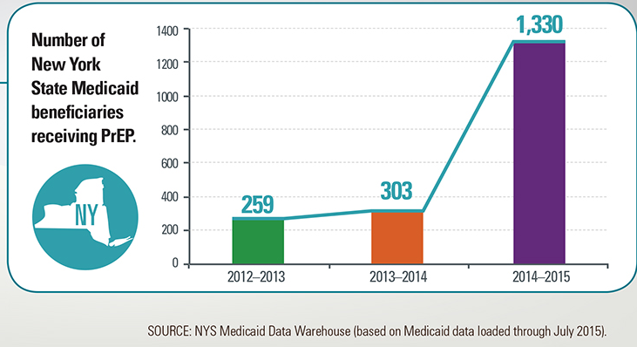
PrEP Use
CDC estimates 1.2 million possible PrEP users in U.S. in 2014 (Based on NHANES data)
25% of sexually active MSM
19% of IVDU
0.5% of heterosexual adults
BUT there are only 40,000
PrEP users currently
Notes:
MMWR Nov 27, 2015
Considered possible prep user:
-MSM: >=2 partners and condomless sex and/or STI in past year
-IVDU: injects drugs and has shared needles
-Hetero: >=2 partners and at least 1 of: sex with HIV+ indiv; condomless sex in past 4 wks; sex with IVDU or bisexual male
PMDs have more access to appropriate patients, should be screening all patients regularly
BUT, PMDs freq have time crunches, discomfort screening pts to determine if appropriate candidates for PrEP, don’t know where to send them or how to Rx or don’t know about PrEP to begin with and discomfort with Rx’ing truvada
Specialists (Adolescent docs, ID docs) freq don’t have access to general population, won’t be abe to get the numbers like PMDs can to screen

Slide 42
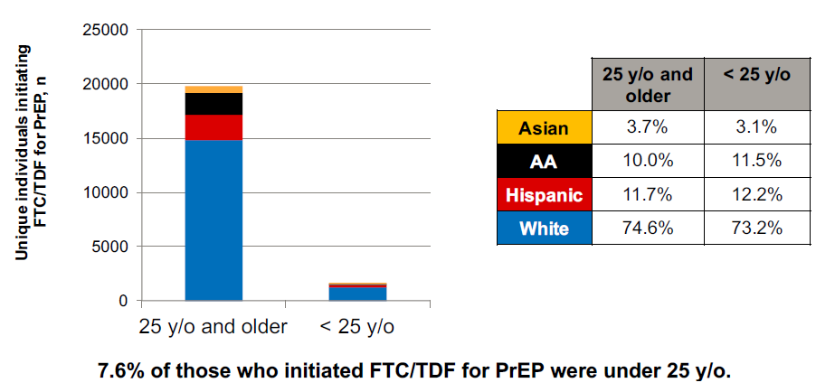
FTC/TDF for PrEP by Age* and Race
*These data represent 44% (n = 21,463) of unique individuals who have started FTC/TDF for PrEP from 2012-3Q2015.
Bush S, et al. Racial characteristics of FTC/TDF for pre-exposure prophylaxis (PrEP) users in the US. ASM Microbe. Boston, MA. June 16-20. Abstract #2651.

Slide 43
Why isn’t PrEP Use More Widespread? Patient Issues
Patients unaware that PrEP exists
8% of sample of YBMSM age 15-24 heard about PrEP¹
Awareness associated with having disclosed sexual orientation
Only 31% of high risk transgender women had heard of PrEP²
After explanation, 69% were interested in taking PrEP²
Lack of perceived risk³
Concern about need for consistent adherence³
Concern about long term side-effects³
Concern about social disinhibition³
Race-based medical mistrust⁴
¹ Sanders R et al. Journal of Adolesc Health 2016; 59: 725-28
² Kuhns L et al. AIDS Behav July 2016
³Perez-Figueroa, et al AIDS Educ Prev Apr 2015
⁴Eaton LA, et al. Sex Health. 2014;11:244-51.

Slide 44
Why isn’t PrEP Use More Widespread? Patient Issues
Personal reasons to stop use:
Personal choice
Life change (not sexually active)
Fear of disclosure
Stigma associated with PrEP
Too busy
Unable to take pills daily
Unable to maintain every 3 month appointments for laboratory tests
Cost
Truvada costs $1,540 per month.
Hosek SG, et al. AIDS. Durban, South Africa. July 22-26, 2016. Abstract TUAX0104LB.

Slide 45
Payment Options for PrEP
INSURED PATIENTS | Medicaid | Covers all PrEP costs Prior approval may be required with renewal every 3 months
 | Private Insurance | Many cover PrEP costs Copays and deductibles apply
 | Gilead: Co-Pay Coupon Card | Patient must have insurance (NOT Medicaid or Medicare) Covers up to $300/month for prescription copays
 | Gilead: Medication Assistance Program | Patient must be uninsured or have NO prescription coverage, under 500% FPL Covers prescription cost
Many PrEP Programs have PrEP Specialists to help navigate these programs
Notes:
Speaker Notes:
Use NYS Prep as an example and advice audience to refer to options which may be available in their state

Slide 46
Why isn’t PrEP Use More Widespread? Barriers for Adolescents
Data on the efficacy and safety of PrEP for adolescents are insufficient
Risks and benefits of PrEP for adolescents should be weighed carefully in the context of local laws and regulations about autonomy in health care decision-making by minors
http://www.cdc.gov/hiv/pdf/guidelines/PrEPguidelines2014.pdf
Notes:
To date, no efficacy or safety studies have been published on the use of PrEP in individuals younger than 18 years of age, but studies in this population are underway. Since the time of licensing for treatment of HIV in adolescents, TDF/FTC has been used without any indication of unique toxicity in this population. Off-label use of TDF/FTC as part of a PEP regimen is recommended for adolescents 13-18 years of age to prevent HIV infection after a high-risk exposure. On April 29, 2015, Governor Andrew Cuomo unveiled the Blueprint to End AIDS Epidemic by 2020, which contained the statewide task force’s recommended strategies to end the AIDS epidemic in New York State. The recommendations include an exhortation that PrEP should be offered to adolescents at high risk for HIV infection.
To date, no efficacy or safety studies have been published on the use of PrEP in individuals younger than 18 years of age, but studies in this population are underway. Since the time of licensing for treatment of HIV in adolescents, TDF/FTC has been used without any indication of unique toxicity in this population. Off-label use of TDF/FTC as part of a PEP regimen is recommended for adolescents 13-18 years of age to prevent HIV infection after a high-risk exposure. The CDC and the International Antiviral Society-USA have now extended the use of TDF/FTC to include PrEP for adolescents in sexual or other behavioral situations that put them at high risk for HIV infection.
Providers should carefully weigh the potential benefits and risks, including acquiring HIV infection, before prescribing PrEP to a younger adolescent and should make clear that the efficacy of PrEP is highly dependent on strict adherence. Clinicians should refer to their institution’s policy or consult with the institution’s legal department about consent to care for adolescents under 18 years of age

Slide 47
Why isn’t PrEP Use More Widespread? Barriers for Adolescents Why isn’t PrEP Use More Widespread?
PrEP and Minor Consent Laws
No state expressly prohibits minors’ access to PrEP or other HIV prevention methods
50 states + DC expressly allow some minors to consent to diagnosis or treatment of STI
State minor consent laws vary
Prevention vs Testing vs Treatment
HIV explicitly stated as STI
Statutory Conditions
Age
STI Exposure
Notes:
State law in a number of states allow minors to consent to preventive care for STDs, in addition to consenting for STD treatment. This absolutely includes consent to PrEP in some states. So, it is important to look at state law where you practice and consult your legal counsel on whether minors can consent to PrEP in your state, and if they can, what parameters, if any, your state law puts on that (e.g. age limits).
Separate from consent rules, its also important to know what confidentiality law applies and whether a minor patient has the right to keep information about PrEP services private in your state. It is possible to have a right to consent but not an absolute right to keep the related health information private from parents.
On the insurance question: If a minor patient is covered by parent's insurance and wants to use that insurance to cover PrEP, there is a risk of confidential health information getting out to parents via an EOB or other communication, even where the minor normally has a right to confidentiality in the information. There are some options though:

Slide 48
Why isn’t PrEP Use More Widespread?
Meet Kim…
19 year old female in a monogamous relationship with an HIV infected male who is not compliant with his medication. She almost always uses condoms. She heard about PrEP on a TV commercial and went to speak to her primary care doctor about it.
Kim’s doctor told her there is no medication to prevent HIV, only condoms.

Slide 49
Providers unaware that PrEP exists
34% primary care docs and nurses haven’t heard of HIV PrEP¹
Discomfort performing sexual history
Discomfort caring for sexual and gender minority groups
Discomfort prescribing HIV medication
Concern that patients on PrEP may engage in riskier behaviors
Why Isn’t PrEP Use More Widespread?
Provider Issues
Who Should Prescribe PrEP?
Primary Care Docs
Subspecialists
¹www.cdc.gov/vitalsigns/hivprep/
Notes:
MMWR Nov 27, 2015
PMDs have more access to appropriate patients, should be screening all patients regularly
BUT, PMDs freq have time crunches, discomfort screening pts to determine if appropriate candidates for PrEP, don’t know where to send them or how to Rx or don’t know about PrEP to begin with and discomfort with Rx’ing truvada
Specialists (Adolescent docs, ID docs) freq don’t have access to general population, won’t be abe to get the numbers like PMDs can to screen

Slide 50
Primary Care Docs Already Prescribe Preventative Medications
Prescribe malaria prophylaxis for individuals before traveling overseas
Still recommend mosquito nets and insect repellant
Don’t withhold prophylaxis if an individual refuses to use insect repellant
Prescribing statins for individuals at risk for having a heart attack
Even if patients continue to eat poorly and not exercise

Slide 51
And Primary Care Docs Partner with Specialists to Prescribe Medications
Adolescent with mental health issues
Psychiatrist evaluates patient and starts medication
Once stable, PMD may continue medication

Slide 52
Follow-Up on Kim…
6 months after asking her PMD, Kim finally found a PrEP provider.
At her initial PrEP screen, her HIV test was POSITIVE
Kim was linked to care with an Adolescent HIV Specialized Care Center
Screening, testing and prescribing PrEP by her PMD
(or referral to PrEP Provider)
6 months ago may have prevented this diagnosis

Slide 53
Primary Care Providers and Sexual History Taking
Provider discomfort in asking “sensitive questions” and taking sexual histories
Studies indicate that only about 10-33% of providers obtain routine sexual histories
And, when they do…
Infrequently ask about key parameters such as sexual practices
Wimberly et al Journal National Medical Association 2006

Slide 54
Comprehensive Sex History (Modified for PrEP)
CDC recommends use of the 5 P’s
Partners (men, women or both; HIV+, IDU partner)
Practices (insertive, receptive intercourse (vaginal or anal; IDU; exchange sex)
Protection from STDs/HIV (without a condom)
Past history of STDs/HIV (last 6 months)
Prevention of pregnancy (without a condom)
CDC. A Guide to Taking a Sexual History. www.cdc.gov.
Notes:
https://www.cdc.gov/std/treatment/sexualhistory.pdf

Slide 55
Myths About HIV PrEP
Individuals on HIV PrEP do not also need to use condoms
HIV PrEP is effective to treat HIV infection
Condoms should be used along with PrEP
Protect against other STIs (which PrEP does not)
Provide pregnancy prevention
Provide back-up prevention for HIV
NOT
^
TDF-FTC alone is insufficient treatment for HIV infection
Individuals infected with HIV should be linked to an
HIV specialist for treatment

Slide 56
More Myths About HIV PrEP
NOT
Episodic PrEP use taken only 1 day before an expected sexual encounter is effective
As long as PrEP is taken at least a few times each week it will be effective
Maximum protection against HIV
Receptive anal sex ~7 days
Insertive anal sex
Vaginal sex
IV drug use
~20 days
Efficacy of PrEP improves with better adherence
In males:
~99% decreased risk with 7 doses/week
~96% decreased risk with 4 doses/week
~76% decreased risk with 2 doses/week
Notes:
Twenty days is an estimate from cervical specimens. It may not accurately reflect tissue concentrations on penile surface.
Tissue levels are not equivalent in insertive anal sex and vaginal sex. And, there continues to be a debate about this. https://na01.safelinks.protection.outlook.com/?url=http%3A%2F%2Fmv.ecuo.org%2Fen%2Fhiv-vaginal-sex-and-prep-initiation-what-should-you-tell-your-patients-or-clients%2F&data=02%7C01%7CAllison.Eliscu%40stonybrookmedicine.edu%7Cca1b204b05d942908f5908d4eb45f608%7Ceafa1b31b194425db36656c215b7760c%7C0%7C0%7C636392133846248557&sdata=o8lzIOmr5KVX22P7tFhNliO9FS%2FLzgh%2FX5fVftbgBsc%3D&reserved=0. The penile tissue offers more protection than vaginal mucosa and cervical areas. We may want to provide 20 days for vaginal tissue on the notes only and not the slide. No specific research has evaluated PrEP levels in vaginal or rectal tissue of transgender women or transgender men.

Slide 57
PrEP Support
WE > AIDS
https://www.greaterthan.org/get-prep/
UCSF Clinician Consultation Center
National Rapid Response for HIV Management and Bloodborne Pathogen Exposures
855-HIV-PREP
(855-448-7737)
Clinician available M-F 11a-6pm EST for consultation
http://nccc.ucsf.edu/
PrEP/PEP Provider Voluntary Directory (by county):
https://preplocator.org/

Slide 58
PrEP Resources
Other access for uninsured patients:
GoodRx: www.goodrx.com/truvada
Gilead Science Medication Assistance:
855-330-5479
Truvada co-pay assistance: www.truvada.com/truvada-patient-assistance

Slide 59
PrEP Summary Points
PrEP should be part of a comprehensive prevention plan
Efficacy of PrEP depends on adherence
Lack of condom use is not a contraindication to PrEP

Slide 60
PrEP Summary Points
Patients on PrEP require visits at least every 3 months
Monitor HIV status, adherence, and side effects
Follow-up also includes prevention services:
Risk-reduction counseling with access to condoms
STI screening
Mental health and substance use screening
Individuals who become HIV+ should stop using PrEP
Linkage to care to specialist to begin HAART

Slide 61
Primary Care Development Corporation (PCDC) Provides High Impact Prevention (HIP)
PCDC believes that quality primary care is transformational and a cornerstone of healthy, thriving communities. PCDC catalyzes excellence in primary care through strategic community investment, capacity building, and policy initiatives to achieve health equity.
PCDC’s HIP in Health Care program is part of the Capacity Building Provider Network (CPN), a network of 21 organizations that are funded by CDC to build the capacity of the nation’s HIV prevention workforce.
HIP in Healthcare provides HIV prevention training and technical assistance to healthcare organizations across the country, focused on HIV Testing, Prevention with Positives, and Prevention with High Risk Negatives.
To request free training and technical assistance from PCDC or for more info:
Email: hip@pcdc.org Website: www.pcdc.og/hip

Slide 62
Https://www1.nyc.gov/assets/doh/downloads/pdf/ah/prep-pep-pocket-guide.pdf
Notes:
https://www1.nyc.gov/assets/doh/downloads/pdf/ah/prep-pep-pocket-guide.pdf

Slide 63
Culp L, Caucci L. State adolescent consent laws and implications for HIV pre-exposure prophylaxis. Am J Prev Med. 2013 Jan;44(1 Suppl 2):S119-24.
Centers for Disease Control and Prevention and Association of Public Health Laboratories. Laboratory Testing for the Diagnosis of HIV Infection: Updated Recommendations. Available at http://stacks.cdc.gov/view/cdc/23447. Published June 27, 2014. Accessed January 30, 2016.
Centers for Disease Control and Prevention. Preexposure Prophylaxis for the Prevention of HIV Infection in the United States – 2014 Clinical Practice Guideline U.S. Department of Health and Human Services; 2015
Resources
Notes:
Add the references at the end and have a different resource list: pocket guide for PrEP from the NY state project;

Slide 64
Questions?

Slide 66
Thank You!

